Slide 1


Slide 2
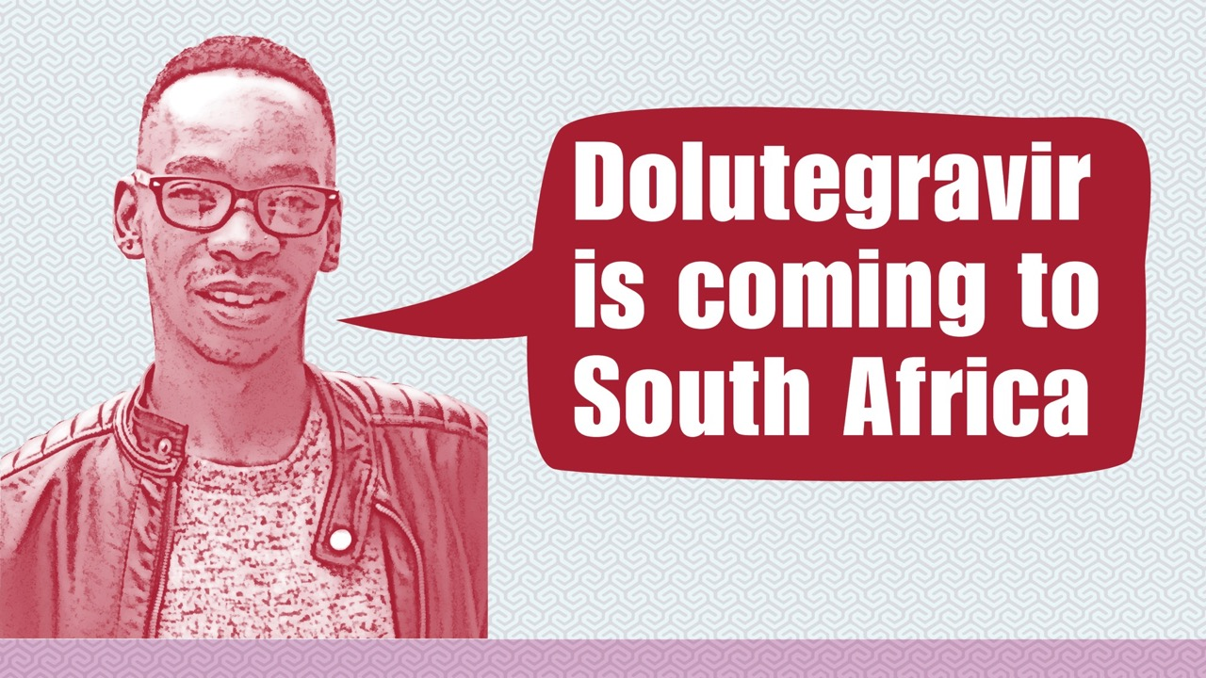

Slide 3

New regimen for $75 a year
New pricing agreement will speed up access to generic, dolutegravir (DTG)-based fixed dose combinations (FDCs)
HIV positive people in low- and middle-income countries including South Africa can be treated for around R900 (US $75 a year)
First time a newer and better FDC available at lower price than the previously recommended first-line ART

Slide 4

How is the new FDC different from the one we use now?
The World Health Organisation (WHO) + South African current preferred (and most widely used) first-line regimen is tenofovir disoproxil fumarate (TDF), lamivudine (3TC) or emtricitabine (FTC) and efavirenz (EFV)
New FDC replaces EFV with DTG
Combines three ARVs: TDF, 3TC and DTG. Its name is shortened to TLD. It will be a smaller tablet than the EFV-based FDC
WHO currently recommends a DTG-based combination as an alternative first-line regimen

Slide 5

Countries starting to use dolutegravir
Almost 60 low- and middle-income countries have already included or plan to include DTG in their national guidelines.
Botswana and Brazil have started providing DTG nationwide
Kenya has started a pilot programme (similar programmes are planned in Uganda and Nigeria)
South Africa will change its first-line to DTG-based in 2018
Up until now, the “early adopter” countries have used DTG from the originator company (Brazil and Botswana). Or more recently, as a single generic formulation plus two NRTIs (Kenya was the first country to introduce generic DTG)
TLD will encourage more countries to change their first-line regimen to a DTG-based one

Slide 6
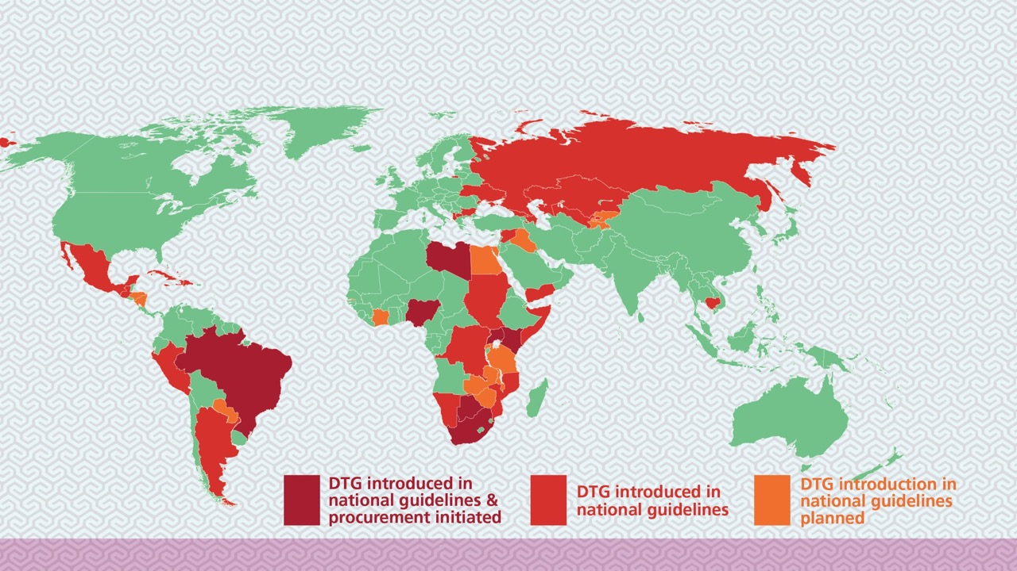
Countries starting to use dolutegravir

Slide 7
What is dolutegravir?
dol-you-TEG-rah-veer
DTG is an integrase inhibitor. When HIV infects a cell, it combines its genetic code into the cell’s own code – this is called integration
DTG blocks integration, so HIV can’t make more copies of itself

Slide 8
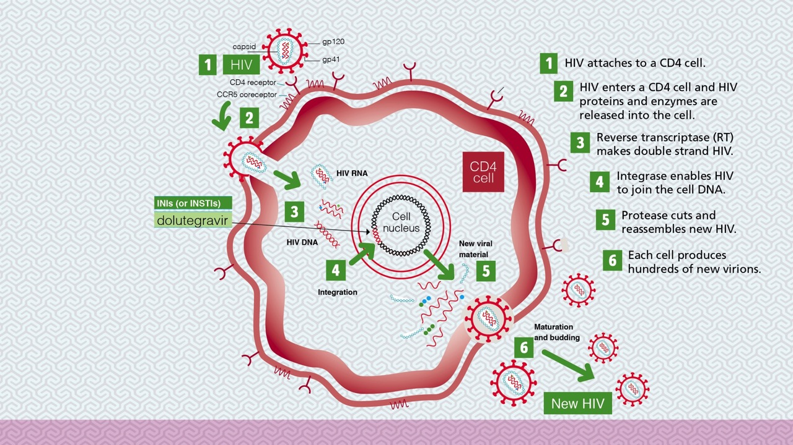
Dolutegravir blocks integration

Slide 9

About dolutegravir
DTG is more effective and seems to have fewer side effects than EFV
It is less easy to get resistance to DTG than EFV
The standard dose of DTG is 50 mg once-daily for people who are taking first-line ART
For most people, DTG can be taken with or without food

Slide 10

Side effects of dolutegravir
Central nervous system (CNS) side effects
(similar to EFV but far less frequent)
These include mood changes and difficulty sleeping
Not common, but occasionally people might
need to change to another ARV
Some people find it better to take DTG in the morning than the evening
More severe CNS side effects, including depression and feelings
of wanting to commit suicide, very rare with DTG
Immune Reconstitution Inflammatory Syndrome (IRIS) happens
mostly in people with low CD4 cell count starting ART
As integrase inhibitors drive down viral load faster than other
ARV classes, IRIS might be more likely in people taking them
with low CD4. There have been some reports of an increased risk

Slide 11

Dolutegravir in pregnancy
WHO and other guidelines do not yet recommend
DTG universally first-line. One reason: not much was known about its safety in pregnancy
Reassuring recent reports from women who
have taken DTG in pregnancy
Including 845 women in Botswana
Several studies looking at DTG-based ART in pregnancy
As DTG is used in more countries (low-, middle- and high-income) more information will be available
Countries are starting to be more comfortable about recommending and providing DTG in pregnancy
Guidelines will be updated as there is more information

Slide 12

Dolutegravir and TB medicine
Another reason that DTG was not part of the preferred WHO regimen was lack of information on giving it with first-line TB treatment
Rifampicin, one of the medicines used in first-line TB treatment,
can reduce the levels of other medicines, including DTG
As with pregnancy we will learn more about
using DTG and TB treatment together
This “interaction” between DTG and rifampicin can be
overcome by adding an extra DTG pill. So DTG is given
twice-daily (once within TLD and once as a single dose)
Another option could be to use the EFV fixed dose-combination during TB treatment. And switch back to TLD when this is completed
As we learn more about using TLD with TB
treatment the guidelines will be updated

Slide 13

Dolutegravir and other medicines and supplements
Interactions between DTG with some supplements, heartburn treatment, laxatives and multivitamins, including calcium supplements
To overcome this DTG should be taken two hours before or six hours after these medicines
DTG also doubles levels of metformin – to treat type 2 diabetes – and requires careful monitoring

Slide 14

Dolutegravir and traditional medicines
Less well understood are interactions with traditional herbal medicines or imbiza
Traditional medicines are not tested or approved. We do not know what imbiza can do
Might weaken the effect of ARVs
Using them together might make the ARVs or imbiza more toxic

Slide 15

Dolutegravir and children
Adolescents aged 12–18 can take the adult formulation of TLD
Children 6 years old and weighing at least 15 kilos can take DTG
Not yet suitable generic FDCs
Manufacturers are working on DTG containing formulations for children aged 6–12
Research is ongoing in children and babies less than 6 years old
Eventually DTG might be available to treat even the youngest babies with HIV

Slide 16

What will TLD look like?
As with all ARVs and FDCs there will be different versions made be different generic manufacturers. So, the pill one person takes might not look exactly the same as the pill a different person takes in another country, district or clinic
Someone’s TLD might change the way it looks a bit and have a different packet
Here are pictures of the first generic versions of TLD

