Slide 1

Readability: importance of information that is easy to read for most people
Simon Collins, HIV i-Base
www.i-Base.info

Slide 2
Outline
This talk is based on an oral presentation to the UK BHIVA conference in 2015.
Designed to show whether literacy in patient information meets guideline targets.
Also, that to show that patient information can be made easier to understand.
Difficult text is a barrier to inclusion. It requires education to access to healthcare.
This is not a new issue and it is not specific to HIV ☺
Notes:
Hi
Thanks for being able to talk today about one aspect of involvement in research.
This is based on a talk to BHIVA a few years ago.

Slide 3
Patient information leaflets (PILs) currently require graduate level literacy levels: equivalent to The Guardian or The Telegraph newspapers
Simon Collins [1], Matt Williams [2], Liam Martin [1],
Robin Jakob [1] Marta Boffito [3]
1. HIV i-Base; 2. UK-CAB; 3. Chelsea & Westminster Hospital

Slide 4
Informed consent
• Informed consent (IC) as an ethical concept is a cornerstone of medical research.
• Patient Information and consent forms are part of the IC process.
- What the study is for.
- What is involved and expected.
- Possible risks and benefits.
- That taking part is voluntary.
• i-Base talks with individuals about joining studies and works with research groups.
Notes:
• Informed consent (IC) is a cornerstone of medical research.
• Patient Information and consent forms are part of the IC process. They aim to ensure that participants understand:
- What the study is for.
- What is involved and expected of them.
- Possible risks and benefits.
- That taking part is voluntary.
• i-Base is often asked to discuss potential enrolment into research studies and we have recently seen patient information sheets that seem quite difficult.π
.

Slide 5
Readability scores
• Recommended in NHS guidelines. [1]
• How difficult is text to read?
• What percentage of people will easily understand - or be excluded.
• Usually include average word, sentence and paragraph length.
• Readability increased with shorter words, sentences (10-12 words), using the active tense, and common words.
NHS. Information Sheets & Consent Forms. Guidance for Researchers and Reviewers. March 2011, Annex 9. http://www.hra.nhs.uk
Notes:
• Recommended in NHS guidelines. [1]
• How difficult is text to read?
• What percentage of people will easily understand - or be excluded.
• Usually includes average word length (syllables) and sentence length (words).
• Sometimes grammar and use of commonly known words.
• Readability is increased by using shorter words, sentences and paragraphs and using the active tense.

Slide 6
Methods
• Evaluate the body text of patient information leaflets from 9 ongoing studies: phase I-IV.
• Text was copied from PDF files into MS Word. Minor edits to help scores. Punctuation added after headings and in bullet lists. Tables were excluded.
• Primary outcome was Reading Ease. Scores calculated online. ^{[1]} Results compiled in Excel.
• Two community-written patient leaflets were used as comparisons.
www.readabilityscore.com and www.read-able.com
Notes:
• The main body text from PILs from 9 current UK studies were evaluated using a free online readability score calculator (www.readabilityscore.com).
• Text was copied from PDF files with minor edits to help improve the scores (adding a full stop after headings and in bullet lists).
• Tables were excluded.
• This was to help increase readability.\
• Two community-written PILs were used as comparisons.

Slide 7
Choice of scores
• Flesch reading ease (Plain English) ^{[1]}
Target: >70 for general public; higher score is better
Practical range 0 – 100 (but can be <0 and >100)
• Flesch-Kincaid reading grade ^{[1]}
Adapted for US school grade: lower is better,
Target: grade <8 = reading age 13-14; grade >12 = graduate
Microsoft Word caps highest grade at 12.
• SMOG grade score ^{[2]}
May have advantages for health information. Stricter criteria for higher comprehension. Used for cancer patients in US. ^{[3]}
1. Wikipediia: Flesch–Kincaid readability tests; 2. Wikipediia: SMOG index 3. Friedma DB, Health Educ Behav. (2006).
Notes:
We used three scales to rate readability
• The Flesch reading ease – widely used for over 50 years – and closely linked to the campaign and development of Plain English
• The Flesch-Kincaid (FK) reading grade – adapted to match to school years and reading age
• SMOG index - May have advantages for health information. Stricter criteria for higher comprehension. Used for cancer patients in US.
• Two community-written PILs were used as comparisons.

Slide 8



Reading scores
Equations are objective estimates.
Flesch reading ease score ^{[1]}
Flesch-Kincaid reading grade ^{[1]}
SMOG index ^{[2]}
1. Wikipediia: Flesch–Kincaid readability tests; 2. Wikipediia: SMOG index.
Notes:
These are the calculations – fairly easy to test manually.
Not as complicated as they look once average sentence length and average syllable count are known.

Slide 9
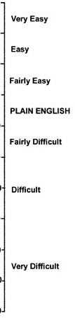



Flesch reading ease
The intersection of the line joining average words per sentence to average syllables per word show the readability score. The minimum score for Plain English is 60.
35 30 25 20 15 10 5
2.0 1.9 1.8 1.7 1.6 1.5 1.4 1.3 1.2
Notes:
This graphic is another ways to show the relative importance of sentence length and average number od syllables.

Slide 10
Target literacy
Reading ease score >70: similar to tabloids. ^{[1]}
Score* % of pop
Easy tabloids >70 70-80%
Standard magazine 60-70 50-60%
Broadsheet 40-60 30-50%
Academic 30-40 <30%
UK literacy ^{[2]}
Level 2 - 57% or higher - GSCE grade A-C
Level 1 - 27% - GSCE grade D-E
Below Level 1 - 16% - reading age 11
* modified, based on recent sampling.
NHS. Information Sheets & Consent Forms. Guidance for Researchers and Reviewers. March 2011.
Department for Business, Innovation and Skills. Skills for Life Survey (2011)
Notes:
http://www.hra.nhs.uk/documents/2013/09/information-sheet-and-consent-form-guidance.pdf
Although this is from an NHS guidance –the methodology for calculating the reading ease score was not clear (ie possibly not Flesch reading ease.

Slide 11
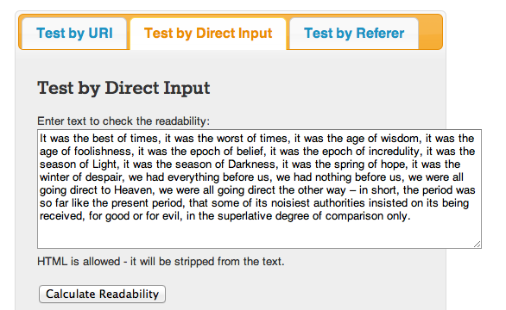
https://www.readabilityformulas.com
Online scores
Free service, unlimited text, instant results.
Notes:
There are many free online calculators. They allow unlimited text, gives instant results, and includes an option to test web pages.
This example in now more commercial and I now use:
https://www.readabilityformulas.com

Slide 12

Online scores
Text statistics
No. of sentences 1
No. of words 120
No. of complex words 10
% of complex words 8.33%
Av. words per sentence 120
Av. syllables per word 1.4
Statistics are provided in addition to calculations
Notes:
Statistics are provided in addition to calculations

Slide 13
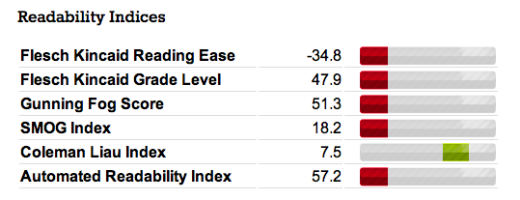
Online scores
Notes:
Statistics are provided in addition to calculations

Slide 14
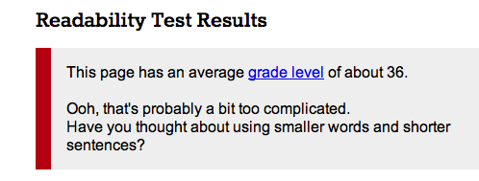
Online scores
A Tale of Two Cities (110 words). Reading ease: –34 Reading grade: 47
Notes:
Statistics are provided in addition to calculations

Slide 15
Results: document statistics
 | Mean n=9 | Range n=9 | Community examples n=2
Text statistics
Page number | 13 | 5-23 | 9
Word count | 4513 | 1875-8530 | 3582
Sentence count | 242 | 125-401 | 280
Mean numbers of words per sentence | 18.5 | 15.6-22.1 | 12.8
Community examples matched for complexity.
Document length is a literacy factor (START substudy)
Notes:
Patient leaflets were on average 13 pages long – range 5-23. Document was a sub-study of the INSIGHT START study.
This community examples were comparable.
Average sentence length is documents was 18 words per sentence.
The range here is for mean values of all studies, not the range within studies.
The community examples had an average of 12 words per sentence.

Slide 16
Results: document statistics
 | Mean n=9 | Range n=9 | Community examples n=2
Text statistics
Page number | 13 | 5-23 | 9
Word count | 4513 | 1875-8530 | 3582
Sentence count | 242 | 125-401 | 280
Mean numbers of words per sentence | 18.5 | 15.6-22.1 | 12.8
Community examples matched for complexity.
Document length is a literacy factor (START substudy)
Notes:
Patient leaflets were on average 13 pages long – range 5-23. Document was a sub-study of the INSIGHT START study.
This community examples were comparable.
Average sentence length is documents was 18 words per sentence.
The range here is for mean values of all studies, not the range within studies.
The community examples had an average of 12 words per sentence.

Slide 17
Results: document statistics
 | Mean n=9 | Range n=9 | Community examples n=2
Text statistics
Page number | 13 | 5-23 | 9
Word count | 4513 | 1875-8530 | 3582
Sentence count | 242 | 125-401 | 280
Mean numbers of words per sentence | 18.5 | 15.6-22.1 | 12.8
Community examples matched for complexity.
Document length is a literacy factor (START substudy)
Notes:
Patient leaflets were on average 13 pages long – range 5-23. Document was a sub-study of the INSIGHT START study.
This community examples were comparable.
Average sentence length is documents was 18 words per sentence.
The range here is for mean values of all studies, not the range within studies.
The community examples had an average of 12 words per sentence.

Slide 18
Results: document statistics
 | Mean n=9 | Range n=9 | Community examples n=2
Text statistics
Page number | 13 | 5-23 | 9
Word count | 4513 | 1875-8530 | 3582
Sentence count | 242 | 125-401 | 280
Mean numbers of words per sentence | 18.5 | 15.6-22.1 | 12.8
Community examples matched for complexity.
Document length is a literacy factor (START substudy)
Notes:
Patient leaflets were on average 13 pages long – range 5-23. Document was a sub-study of the INSIGHT START study.
This community examples were comparable.
Average sentence length is documents was 18 words per sentence.
The range here is for mean values of all studies, not the range within studies.
The community examples had an average of 12 words per sentence.

Slide 19
Results: readability scores
 | Mean scores n=9 | Range of mean scores n=9 | Community examples n=2
Readability scores
Flesch Reading Ease | 55.4 | 47.1-63.1 | 70.3
Flesch-Kincaid Reading Grade | 10.1 | 9.0-12.0 | 6.6
SMOG index | 9.2 | 7.9-10.4 | 6.9
Community examples show targets are achievable.
Notes:
Readability scores were all lower than ideal target of 70.
Mean reading ease was 55 with no study had a score above 70 and only one was above 60.
Reading grade scores were also too high with all documents having higher than recommended reading grade.
The two community example are included to show that reading ease >70 and reading grade <7 are achievable for documents of comparable length and medical complexity.
Reading grade and SMOG scores were considerably lower that grade 8.

Slide 20
Results: readability scores
 | Mean scores n=9 | Range of mean scores n=9 | Community examples n=2
Readability scores
Flesch Reading Ease | 55.4 | 47.1-63.1 | 70.3
Flesch-Kincaid Reading Grade | 10.1 | 9.0-12.0 | 6.6
SMOG index | 9.2 | 7.9-10.4 | 6.9
Community examples show targets are achievable.
Notes:
Readability scores were all lower than ideal target of 70.
Mean reading ease was 55 with no study had a score above 70 and only one was above 60.
Reading grade scores were also too high with all documents having higher than recommended reading grade.
The two community example are included to show that reading ease >70 and reading grade <7 are achievable for documents of comparable length and medical complexity.
Reading grade and SMOG scores were considerably lower that grade 8.

Slide 21
Results: readability scores
 | Mean scores n=9 | Range of mean scores n=9 | Community examples n=2
Readability scores
Flesch Reading Ease | 55.4 | 47.1-63.1 | 70.3
Flesch-Kincaid Reading Grade | 10.1 | 9.0-12.0 | 6.6
SMOG index | 9.2 | 7.9-10.4 | 6.9
Community examples show targets are achievable.
Notes:
Readability scores were all lower than ideal target of 70.
Mean reading ease was 55 with no study had a score above 70 and only one was above 60.
Reading grade scores were also too high with all documents having higher than recommended reading grade.
The two community example are included to show that reading ease >70 and reading grade <7 are achievable for documents of comparable length and medical complexity.
Reading grade and SMOG scores were considerably lower that grade 8.

Slide 22
Limitations and discussion
• Small number of protocols.
• Other factors of readability were not assessed:
i.e. text content and layout (font size, use of space and headings).
• However, text heavy layouts and results probably underestimated true readability scores.
• Patient leaflets are not used in isolation. Talking through a study is essential – but readability enables independent engagement.
Notes:
• Small number of protocols.
• Other factors of readability were not assessed:
i.e. text content and layout (font size, use of space and headings).
• However, text heavy layouts and results probably underestimated true readability scores.
• Patient leaflets are not used in isolation. Talking through a study is essential– but readability enables independent engagement.

Slide 23
Advantages of readability
• Increase the pool of potential participants.
• Engage people in research.
• Reduce the chance that people leave the study later.
• More likely to enable real informed consent.
Notes:
Using easy to understand language:
• Increases the pool of potential participants.
• Engages patients for effectively in research.
• Reduces the risk of people leaving the study later.
• Is more likely to enable real informed consent.

Slide 24
Conclusion
• This small study showed that literacy levels are too high for people to be easily included in research.
• Given the care, detail and costs involved in HIV studies, similar attention is needed for patient information - not as an afterthought.
• This is neither a recent or UK-specific issue.*
• These skills are easy to learn and the tools are easy to use.
* See: Grossman SA et al. Jour Oncology (1994); Sugarman J et al. Hastings Centre Report (1999); Paasche-Orlow et al. NEJM (2003) etc.
Notes:
• This small study showed that literacy levels are commonly too high for most HIV positive people to be actively included in research.
• Given the care, detail and cost involved is other aspects of research, this should be reflected in patient information.
• This is neither a recent or UK-specific issue.*
• These skills are tools are easy to learn.

Slide 25
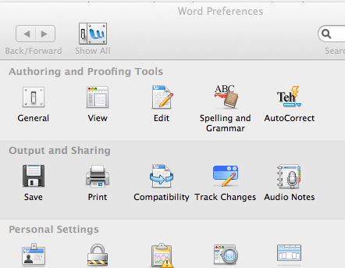
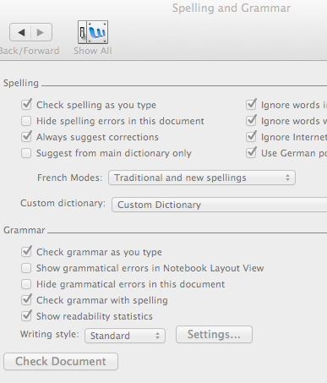
Readability in Microsoft Word
In Spelling and Grammar preferences, check the box to select:
“Show readability statistics”

Slide 26
Readability in Microsoft Word
In Spelling and Grammar preferences, check the box to select:
“Show readability statistics”

Slide 27
Readability in Microsoft Word
In Spelling and Grammar preferences, check boxes to select:
“Check grammar with spelling” and
“Show readability statistics”

Slide 28
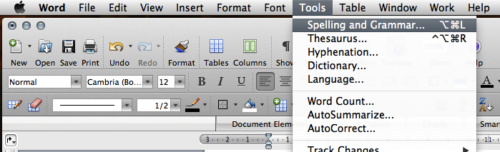
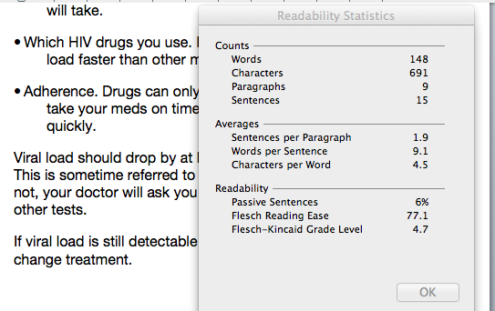
Readability in MS Word

Slide 29
Newspaper readability
Comparison of selection of US and UK journals based on writing style (Flesch reading ease and subjectivity).
Tabloids:
Sun, Mirror.
Broadsheets:
Telegraph, Independent,
NY Times,
WSJ.
Cristianini N et al. Digital Journalism 1(1)102-116 (2012) 10.1080/21670811.2012.714928.

Slide 30
UK adult literacy & numeracy
 | Literacy | Numeracy | Comment
Level 2 or higher | 57% | 22% | GCSE A-C
Level 1 | 28% | 29% | GCSE D-E
Below level 1 | 15% | 49% | “functionally illiterate”
Entry level 3 | 8% | 25% | Reading age 9-11
Entry level 2 | 2% | 17% | Reading age 7-9
Entry level 1 or lower | 5% | 7% | Reading age 5-7
Based on representative sample of > 7000 adults (16-65 years old). Not all participants included in all modules.
Department for Business, Innovation and Skills. Skills for Life Survey (2011). Tables 4.1 and 4.4
https://www.gov.uk/government/publications/skills-for-life-survey-2011-important-findings

Slide 31
UK adult literacy & numeracy
 | Literacy | Numeracy | Comment
Level 2 or higher | 57% | 22% | GCSE A-C
Level 1 | 28% | 29% | GCSE D-E
Below level 1 | 15% | 49% | “functionally illiterate”
Entry level 3 | 8% | 25% | Reading age 9-11
Entry level 2 | 2% | 17% | Reading age 7-9
Entry level 1 or lower | 5% | 7% | Reading age 5-7
Based on representative sample of > 7000 adults (16-65 years old). Not all participants included in all modules.
Department for Business, Innovation and Skills. Skills for Life Survey (2011). Tables 4.1 and 4.4
https://www.gov.uk/government/publications/skills-for-life-survey-2011-important-findings

Slide 32
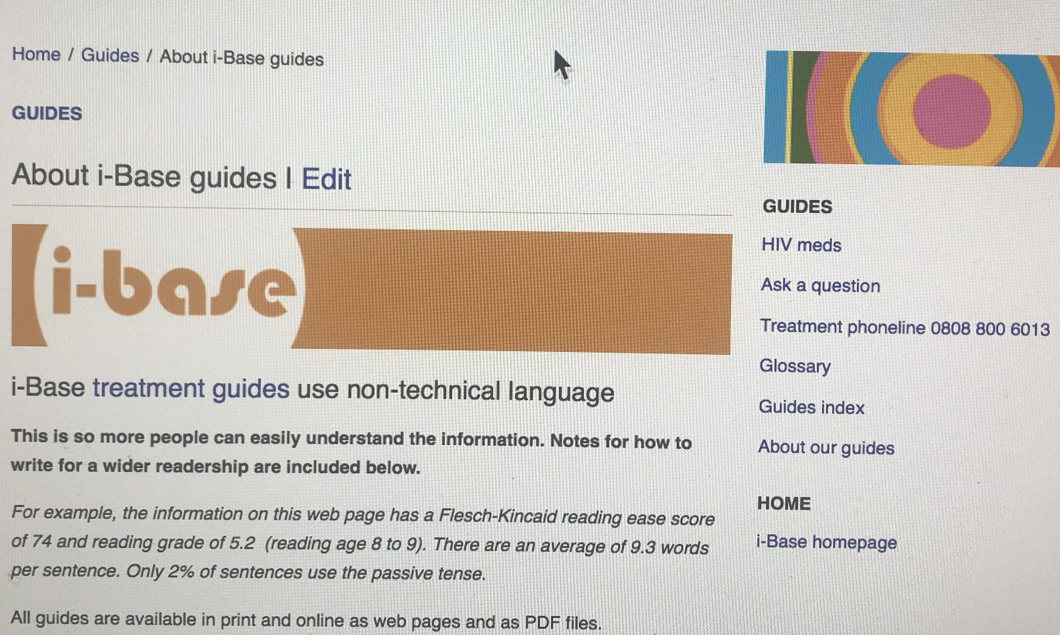
https://i-base.info/guides/about

Slide 33
Thank you
HIV positive people who contacted i-Base.
Researchers who collaborated with patient leaflets.
Marta Boffito, Matt Williams, Liam Martin, Robin Jakobs
Further information
i-base.info/guides/about
www.plainenglish.co.uk
www.hra.nhs.uk

Slide 34
Additional slides

Slide 35
Green eggs and ham
Do you like green eggs and ham?
I do not like them, Sam-I-am.
I do not like green eggs and ham!
Would you like them here or there?
I would not like them here or there.
I would not like them anywhere.
I do so like green eggs and ham!
Thank you! Thank you, Sam-I-am!
FK reading ease: +112; Reading grade: –0.8

Slide 36
A tale of two cities
It was the best of times, it was the worst of times, it was the age of wisdom, it was the age of foolishness, it was the epoch of belief, it was the epoch of incredulity, it was the season of Light, it was the season of Darkness, it was the spring of hope, it was the winter of despair, we had everything before us, we had nothing before us, we were all going direct to Heaven, we were all going direct the other way – in short, the period was so far like the present period, that some of its noisiest authorities insisted on its being received, for good or for evil, in the superlative degree of comparison only.
The opening sentence of A Tale of Two Cities has 110 words. It has a reading ease: –34 and reading grade: 47

Slide 37
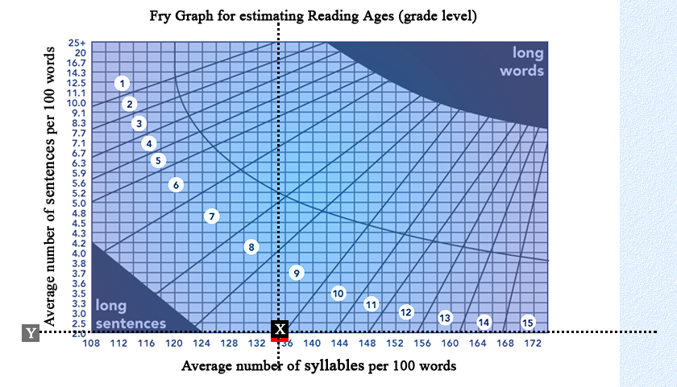
Reading ease
Flesch reading ease score [1]
]

