Slide 1
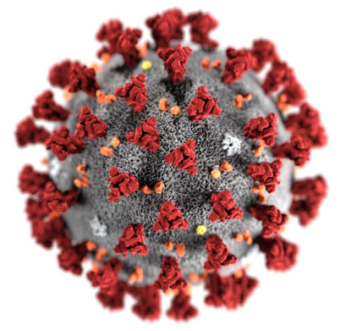



Non-technical update on vaccines against Covid-19
EATG webinar:
16 December 2020
Simon Collins, i-Base.info
Richard Jefferys, TAG
Notes:
Thanks you to EATG chance to talk about TasP.
This is an idea that has already had a dramatic impact on HIV stigma and discrimination.
It has also prevented millions of people from becoming HIV positive.

Slide 2
Non technical review
• Effective vaccines essential goal.
• Three main types of vaccines.
• Range of current candidates.
• Results for three leading vaccines.
• Access: plans for fair global distribution.
• Future timeline.

Slide 3
Vaccine basics
Vaccines trick your body to produce strong immune responses to a virus or bacteria. The body stores these so they can be rapidly produced if needed in the future.
Early vaccines often used a weaker dose of the actual virus.
Modern approaches are much safer - for example, only using inactive sections of a virus or getting the body to produce similar viral proteins.

Slide 6
mRNA approach
• In research for years but none had been approved.
• Both Pfizer/BioNTech and Moderna/NIH use mRNA.
• mRNA contains instructions for muscle cells to produce spike proteins on the surface of SARS-CoV-2.
• Delivered directly to cells.
• Produces an immune response against these proteins.
• The mRNA is then broken down (transient - like SnapChat).
• Produced in a lab and can easily be scaled up.

Slide 7
viral vectors
• Viral vectors use an inactivated harmless virus to deliver spike proteins (as a Trojan horse) so that when immune cells respond to the transporting virus they also respond to SARS- CoV-2.
• Oxford/AZ, CanSino and Janssen use different adenovirus (Chimp Ad, Ad5, Ad26 etc - common cold).
• Can produce both cellular responses (T cells) and antibody responses (B cells).
• Caution: prior exposure to carrier virus can reduce immune response - so a second booster dose might use different vaccine?
• Non-replicating - only produce antigen.
• Replicating - also produces new carrier virus.

Slide 8
protein based
• Protein- based vaccines also get the body to respond to recombinant versions of a viral protein - for example the ‘spike’ for SARS-CoV-2.
• Novavax uses protein-based approach (also Sanofi/GSK).
• They also rely on a second component - an adjuvant - to prime the immune system to respond to the protein.
• Slower to develop but they can generate strong immune responses and have good safety record.

Slide 9
COVID candidates
• Many groups started early in January 2020 - some switched ongoing work on Ebola, SARS or MERS to SARS-CoV-2.
• Pipeline includes hundreds of potential candidates and >40 now in human studies.
• High short-term efficacy - against COVID-19 - no transmission endpoints.
• Universal global access now essential.
• Economic outcomes unclear.

Slide 10
>330 candidate compounds
Slide: COVAX Oct 2020
> 40 in human studies
12 in phase 2/3
(Oct 2020)

Slide 11
By region and funding
Slide: COVAX Oct 2020
Most US, EU, high income - led by commercial then academic

Slide 12
Summary of human studies
Approach ph 1, 2 ph 2, 3
Viral vectors 11 4 Gamaleya, Oxford/AZ, CanSino, Janssen
RNA 4 2 Moderna, Pfizer **
DNA 4 0
Protein-based 12 1 Novavax
Inactivated 4 3 CNBG (2), Sinovac
** Pfizer now approved. Plus others globally - ie Sputnik in Russia

Slide 13
By county, phase & platform
Slide: AVAC/Barney Graham: Nov 2020

Slide 14
Results: Pfizer/BioNTech
• mid-Nov: top-line interim phase 3 results using BNT 162b2 vs placebo in ~43,500 adults (>16 years, 44% > 55 years) in 152 sites globally (130 in the US). Data from 36,000 pts.
• Dec10: Full results in NEJM & FDA documents.
• 95% efficacy: 162 vs 8 cases
• Severe COVID: 9 vs 1 case.
• Conditional approval: UK (2 Dec), US (12 Dec).
• No US funding. Requires ultra cold chain (UCC, minus 80°to transport etc). 96% to high income countries.

Slide 15
Results: Moderna/NIH
• mid-Nov: top-line interim phase 3 results using mRNA-1273 vs placebo in ~30,000 adults in 100 US sites.
• 94% efficacy: 90 vs 5 cases (FDA report: now 185 vs 11 cases): but 86% in >65 yo.
• Severe COVID: 30 vs 0 cases.
• FDA hearing: 17 Dec 2020 - documents online.
• Did have US funding. Requires cold chain (minus 20°to transport etc). 100% pledged to high-income countries.

Slide 16
Results: Oxford/Astra-Zeneca
• 18 Nov: top-line interim phase 3 results using ChAdOx1 vs placebo in ~11,500 adults in UK and Brazil (+ some data from South Africa).
• 70% overall efficacy: but 90% in 2741 UK participants who used half-dose/full dose (error) vs 62% in those using two full doses. Includes transmission as an endpoint.
• >50% doses also separated by 12 weeks.
• Some US funding. No cold chain (+ 2-8°to transport etc). Lowest price ~ $4 a shot : 64% pledged to low income countries (mainly India).

Slide 17
Data gaps
• Duration of protection? Need for boosters?
• Long-term safety? Head-to-head studies?
• Sub-groups by age? HIV risk from Ad5 (STEP)
• Impact of cormorbidities? HIV? Inflammatory conditions, allergies etc.
• Pregnancy, breastfeeding, children…
• Impact with previous SARS-CoV-2/COVID-19?
• Manufacturing capacity/timeline, stability,
shelf-life, price…

Slide 20
Covid-19 vaccine trial protocols released
BMJ 2020;371:m4058 (21 October 2020)
Moderna TX. Protocol mRNA-1273-P301, Amendment 3. 2020.
https://www.modernatx.com/sites/default/files/mRNA-1273-P301-Protocol.pdf
Pfizer. PF-07302048 (BNT162 RNA-Based COVID-19 Vaccines) Protocol C4591001. 2020. https://pfe-pfizercom-d8-prod.s3.amazonaws.com/2020-09/C4591001_Clinical_Protocol.pdf
Oxford/AstraZeneca. Clinical Study Protocol - Amend 2 AZD1222- D8110C00001. 2020.
https://s3.amazonaws.com/ctr-med-7111/D8110C00001/52bec400-80f6-4c1b-8791-0483923d0867/c8070a4e-6a9d-46f9-8c32-cece903592b9/D8110C00001_CSP-v2.pdf
Janssen Vaccines & Prevention BV. VAC31518 (JNJ-78436735) clinical protocol VAC31518COV3001 amendment 1. 2020.
https://www.jnj.com/coronavirus/covid-19-phase-3-study-clinical-protocol

Slide 21
Vaccine access
• Need universal global access.
• “Vaccine nationalism” - high income countries buying first stock plus next options.
• Many countries already have more stock and options (from different vaccines) to treat their population several times.
• Global access to low/middle income countries (LMIC) much lower (3-20% COVAX options are too low for herd immunity).

Slide 22
High income
Low income
Upper-middle
COVAX

Slide 25
USA
EU
India
COVAX
UK
Canada
Indonesia
Japan
Brazil
Mexico
etc
No of doses - scale in 200 million
200 400 600 800 1000 1200 1400 1600 1800 etc

Slide 26
100% pop

Slide 28
Key access links
• Coalition for Epidemic Preparedness Innovations (CEPI) - 2017
• WHO - Access to COVID-19 Tools (ACT) Accelerator - initiative to coordinate international response.
• COVAX - Vaccine arm of ACT
• GAVI - (co-sponsor COVAX)
• People’s Vaccine Alliance (coalition of organisations: Oxfam, UNAIDS)

Slide 29
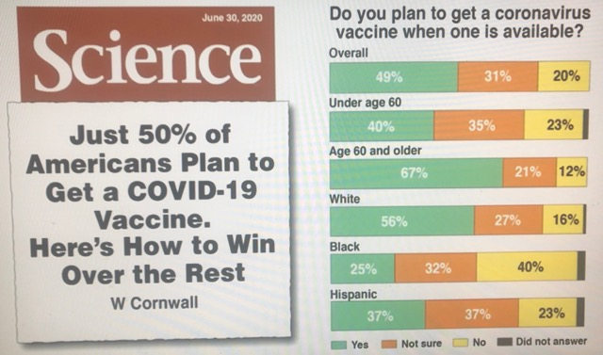
“vaccine hesitancy”
Slide: Fuaci A Dec 2020

Slide 31
UK access for HIV+
• UK access includes nine priority groups.
• Higher risk - by age, care home residency and front line health workers.
• Severe health conditions is group 4 and other complications (inc. HIV) group 6.
• Supported by BHIVA guidance for people living with HIV (www.bhiva.org)

Slide 32
Community Q’s.1 (UK-CAB)
UK-CAB members had many questions when asked about this for upcoming workshop:
Why should I get a vaccine?
How do they know the vaccine is safe? How do I know the vaccine is safe?
What is in the vaccine that they are going to offer me?
Can I get COVID-19 from the vaccine?
What would be the probable symptoms/side effects from the vaccine?
Am I going to get sick with the COVID-19 vaccine like the flu jab?
Can I develop an allergic reaction to the vaccine?
Should I wait to see how my peers react?
Why should I get it if the person administering the vaccines doesn't have it yet?
Who is going to administer my vaccine? My GP or my HIV clinic? Can I choose?
Will the vaccine stop me catching COVID-19 or from getting critically ill? or both?
Could the vaccine interact with my HIV meds? Will my VL blip?
Could the vaccine interact with my estrogen/testorene treatment?

Slide 33
Community Q’s.2 (UK-CAB)
Is the vaccine safe if I live with HIV and other comorbidities?
Can I get the vaccine if I have or have had Hepatitis C?
Is it safe fif I use 'chems' like Crystal Meth, GLB or mephedrone?
Is the vaccine going to impact me differently because I'm black/brown?
Are black and brown people more at risk of getting bad symptoms/side effects from the vaccine?
Have vaccine trials included black and brown men and women living with HIV? Or do the findings just relate to the experiences of white gay men?
Who approved these vaccines? Were the interests of my community are represented?
How do I know I'm being treated equally than my white peers in the process? How do I know this isn't another chapter of medical experimentation in Black people?
If the government didn't even try to address my vulnerabilities to the virus, why I'm expected to trust them with a preventative option?
I've experienced racism in the healthcare system and receiving my HIV care, how can you ensure me this won't be another one of those experiences?
Why did we get a COVID-19 vaccine so quickly, but there is still no vaccine for HIV?
If the vaccine is lifesaving, why is not available to everyone in the world?

Slide 34
Conclusion
• Unparalleled crisis and scientific response.
• High-income countries might soon return to low risk of COVID-19 (after terrible cost to life).
• Global access plan at least another year to reach 2 billion in low income countries.
• Huge volume of research and data - on vaccines, treatment, access etc.
• Long-term data still needed.
• Roll of community for education and support.

Slide 35
Thanks
Non-original slides compiled from various webinars (for community use) – thanks to WHO, COVAX, EMEA, PATH, Anthony Fauci, AVAC/Barney Graham, ICAP, African CDC and others.
simon.collins@i-base.org.uk
www.i-base.info

Slide 36
Additional slides

