Slide 1




COVID-19 & Treatment Update
Simon Collins
www.i-Base.info
Positive East
21 October 2020
-
A two-stage randomised phase II placebo controlled clinical trial

Slide 2
• Second wave is now established (as predicted months ago)
• Same virus as in April – will have same outcomes
• Better experience in hospital but no breakthrough in treatment.
- remdesivir if hospitalised and used early
- dexamethasone – if severe (on oxygen or intubated)
• Please follow all precautions: hygiene, distancing etc
• Vaccine will not be available this year, maybe not for six months, even if lucky. First vaccine unlikely to be the best.
COVID-19: London
-
A two-stage randomised phase II placebo controlled clinical trial
Notes:
• Second wave is now established (as predicted months ago)
• Same virus as in April – will have same outcomes
• Better experience in hospital but no breakthrough in treatment.
- remdesivir if hospitalised and used early
- dexamethasone – if severe (on oxygen or intubated)
• Please follow all precautions: hygiene, distancing etc
• Vaccine will not be available this year, maybe not for six months, even if lucky. First vaccine unlikely to be the best.

Slide 3
COVID-19: daily cases
https://coronavirus.data.gov.uk/cases
-
A two-stage randomised phase II placebo controlled clinical trial
Notes:
These are daily cases

Slide 4
• Being HIV positive doesn’t seem to have a big impact on risk of having COVID-19, or of having more severe outcomes.
• But other COVID factors do – and these are common for many of us: high blood pressure, diabetes, lung complications (asthma, COPD), kidney disease, being overweight.
• Ethnicity/race: BAME communities more affected.
• More vulnerable if CD4 is very low (under 50), chemotherapy, transplant recipients etc. With these continuing to shield is recommended.
COVID-19: HIV
-
A two-stage randomised phase II placebo controlled clinical trial
Notes:
• Being HIV positive doesn’t seem to have a big impact on risk of having COVID-19, or of having more severe outcomes.
• But other COVID factors do – and these are common for many of us: high blood pressure, diabetes, lung complications (asthma, COPD), kidney disease, being overweight.
• Ethnicity/race: BAME communities more affected.
• More vulnerable if CD4 is very low (under 50), chemotherapy, transplant recipients etc. With these continuing to shield is recommended.

Slide 5
• Modern drugs – increasingly easy and effective – but weight gain recognised with dolutegravir, likely bictegravir and TAF. Higher risk in women and if African.
• Injections – just approved in EU – access might take another year in the UK.
• Long-acting drugs in development - maybe every 6 months - but 4-5 years away.
• PrEP options (and PEP) – perhaps monthly pill, annual implant etc
HIV news
-
A two-stage randomised phase II placebo controlled clinical trial
Notes:
• Modern drugs – increasingly easy and effective – but weight gain recongnised with dolutegravir, likely bictegravir and TAF. Higher risk in women and if African.
• Injections – just approved in EU – access might take another year in the UK.
• Long-acting drugs in development - maybe every 6 months - but 4-5 years away.
• PrEP options (and PEP) – perhaps monthly pill, annual implant etc

Slide 6
• cabotegravir long acting injections: CAB LA
• islatravir – oral (daily, weekly, monthly) - annual implant
• bNAbs - VRC01 AMP study and long-acting LS formulations
• Microbicides, single and multi-compound vaginal rings, patches, suppositories, nano-films, douche solutions, vaginal and rectal gels, soft implants etc – and a vaccine.
• Research challenges and ethics
• Dual long-acting bNAbs - RIO study – (UK cure-related)
PrEP pipeline: update
-
A two-stage randomised phase II placebo controlled clinical trial
Notes:
One theme that has developed over the last ten years or so is the overlap between treatment and prevention research.
U=U which is based on the right for universal access to ART - and is driven by the care of HIV positive people. It also is the most important factor to challenge stigma - which is still extensive in most countries.
PrEP includes using HIV drugs for prevention - not just TDF/FTC and TAF/FTC but many of the most exciting compounds in the treatment pipeline.
The next slides review of some of these potential drugs for PrEP.
I will talk a little about each of these compounds with potential use as PrEP.
Including an exciting cure-related study
A summary of other research.
And research difficulties and ethics given high efficacy of oral PrEP and the dropping HIV incidence in many countries

Slide 7
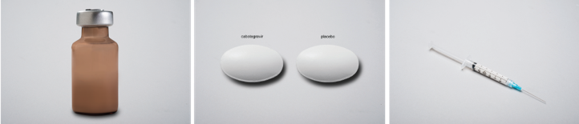
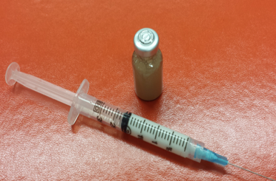
• Cabotegravir LA. Integrase inhibitor: one month of daily oral pills (?) – then IM (into muscle) injections – every 8 weeks.
• Very long half-life – drug levels still detectable at least one year after a single injection – but up to 2.5 years in men and 3.5 years in women.
• Studies require daily oral PrEP to cover the PK tail
- otherwise HIV infections will develop drug resistance
- but in practice?
• Recently resubmitted to the US FDA for treatment based on monthly dosing. Might be able to be given every two months.
Injectable PrEP (CAB-LA)
-
A two-stage randomised phase II placebo controlled clinical trial
Notes:
CAB LA when used with RPV LA has currently been submitted to both FDA and EMA for review as treatment/
Phase 3 results for treatment showed high efficacy with good tolerability - and that injections were preferred (but people who chose to go into a study for injections.
Advantage for PrEP is that daily adherence is overcome.
Needs one month oral tablets lead-in – but this is also being studied without. The injections are DOSE IM - and long acting compounds bring new concerns.
Although on average, a single injection will still result in detectable drug levels after more than a year, for some people this is considerably longer.
In men this can be as long as 2.5 years and in women as long as 3.5 years.
This doesn’t mean the the PrEP effect last this long. It is the time that any new HIV infections are likely to develop drug resistance to cabotegravir (and cross resistance to other integrase inhibitors). This has been seen in at least one person so far.
So in research studies, oral PrEP is mandated for a year after the last cabotegravir injection.
Unclear how this will be resolved in practice - given that people who chose PrEP injections are likely to be people who don’t want to take oral pills - so unlikely they would agree to a year of pills after stopping PrEP injections.

Slide 8
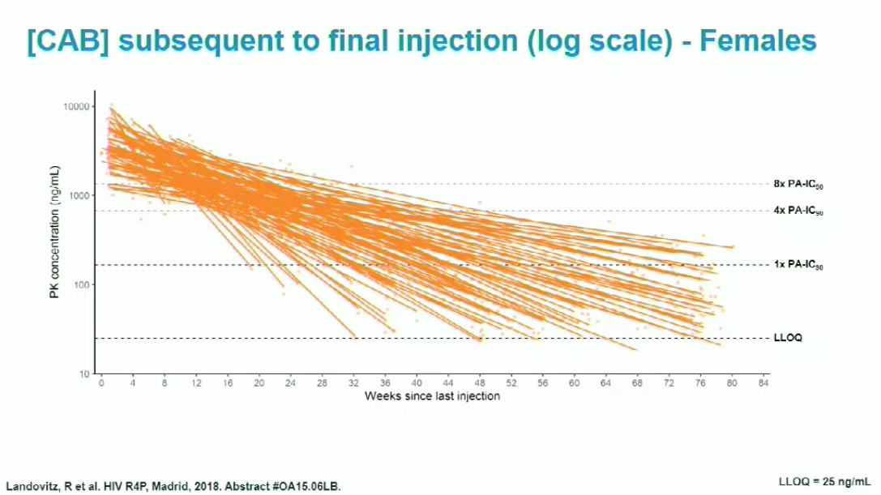
• very long PK tail – HIV infection during the tail = drug resistance.
The ‘tail’: cabotegravir long-acting (CAB-LA)
4 x PA IC50
12 weeks
52 weeks
-
A two-stage randomised phase II placebo controlled clinical trial
Notes:
The very long half-life – referred to as the pharmacokinetic tall is difficult.
This example – and apologies for the poor slide quality – shows the PK tail of cabotegravir-LA in women – out to 76 weeks – and continued follow-up showed some women maintained detectable drug levels 3.5 years after their last injection.
If someone became HIV positive during the tail period, there is a good chance of developing integrase resistance.

Slide 9

• Statistical superiority – important – but likely due to lower adherence to pills. – especially over time.
• TDF/FTC is 99.99% effective with good adherence – 60% better is not the best way to explain the results.
• Results show importance of choice for PrEP.
Injectable PrEP: interpreting results

Slide 10
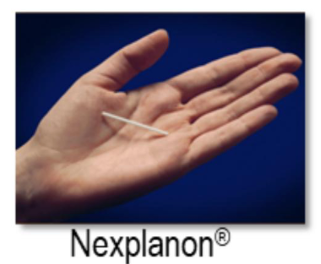
NRTTI - similar to nukes – acquired by Merck in 2012.
Derivative of flavouring in soy sauce (Yasama corporation).
Highly potent against HIV – tiny daily treatment dose 0.75 mg
Two formulations proposed for PrEP for unmet need: i) annual implant (64 mg). ii) once-monthly pill - 12 pills a year – an option for all sexually active people? All women? Etc
Treatment include daily and weekly versions.
islatravir (EFdA)
Hormonal contraceptive implant (Nexplanon)
-
A two-stage randomised phase II placebo controlled clinical trial
Notes:
islatravir (EFdA) - NRTTI - similar to nukes - Was around for at least a decade before acquired by Merck in 2012. Soy sauce derivative,
Highly potent - daily treatment dose 0.75 mg
Two formulations proposed for PrEP:
i) 64 mg annual implant -
ii) once-monthly pill - 12 pills a year - this is a treatment that might interest 7 billion people globally - all sexually active adults? Certainly better option for women.
All dependent on showing similar efficacy to current oral PrEP.
Current PrEP studies
- MK-8591-016 - Phase 2 - n=250 - safety, tolerability, PK of monthly 60 mg and 120 mg pill in HIV negative people at low risk of HIV - ends Dec 2020.

Slide 11

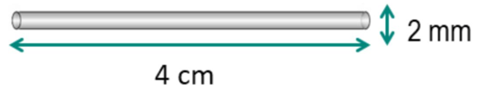
All dependent on showing similar efficacy to current oral PrEP.
Current PrEP study:
MK-8591-016 - Phase 2 – n=250 - safety, tolerability, PK of monthly 60 mg and 120 mg pill in HIV negative people at low risk of HIV -
12 vs 365 pills a year. Due to end Dec 2020.
islatravir (EFdA)
-
A two-stage randomised phase II placebo controlled clinical trial
Notes:
islatravir (EFdA) - NRTTI - similar to nukes - Was around for at least a decade before acquired by Merck in 2012. Soy sauce derivative,
Highly potent - daily treatment dose 0.75 mg
Two formulations proposed for PrEP:
i) 64 mg annual implant -
ii) once-monthly pill - 12 pills a year - this is a treatment that might interest 7 billion people globally - all sexually active adults? Certainly better option for women.
All dependent on showing similar efficacy to current oral PrEP.
Current PrEP studies
- MK-8591-016 - Phase 2 - n=250 - safety, tolerability, PK of monthly 60 mg and 120 mg pill in HIV negative people at low risk of HIV - ends Dec 2020.

Slide 12
Islatravir: CROI 2020
• 12 rhesus macaques were challenged rectally with high dose SHIV.
• 24 hours later, half received a total of 4 weekly doses of islatravir (3.9 mg/kg) and half were untreated controls.
• Follow-up for 7 weeks then step down to 3, then 2 weekly doses.
• After the single dose, 4/6 animals were still protected, but 2/6 became viraemic (at days 14 and 49).
Markovitz M et al. CROI 2020.
-
A two-stage randomised phase II placebo controlled clinical trial
Notes:
The sequential dosing in the same animials retained 100% protection down to two doses

Slide 13
Islatravir: CROI 2020
-
A two-stage randomised phase II placebo controlled clinical trial
Notes:
The sequential dosing in the same animials retained 100% protection down to two doses

Slide 14
Islatravir: CROI 2020
-
A two-stage randomised phase II placebo controlled clinical trial
Notes:
This shows that human dose following a single pill would be above the equilient doses needed to protect macaques.

Slide 15
• broadly Neutralising monoclonal Antibodies
• Generated from HIV-positive people who develop strong antibodies to HIV (after several years).
• Been known since early HIV research but only recently isolated and cloned for use as treatment.
• Need to use in combination – some trispecific.
• Many other treatments – cancer, immune disorders.
• Priced as very expensive drugs: £5K - >£200,000/year.
bNAbs
-
A two-stage randomised phase II placebo controlled clinical trial
Notes:
• Generated from people who develop strong antibodies to HIV.
• Been known since early HIV research but only recently isolated and cloned for use as treatment.
• Need to use in combination – some trispecific.
• Many other treatments – cancer, immune disorders.
• Priced as very expensive drugs: £5K - >£200,000/year.

Slide 16
• Two mechanisms:
- direct antiretroviral (entry inhibitors)
(can have ~1.5 log mono, 2 log dual on VL
- immune modulating vaccine-type effect (after drug levels have left)
• Long acting LS formulations (ie from M428L and N434S) extends half life x 4 – allows 6-monthly dosing.
HIV bNAbs
-
A two-stage randomised phase II placebo controlled clinical trial
Notes:
bNAbs can work in two ways

Slide 17

Two phase 2b/3 studies: started 2015 - results end 2020
AMP studies: VRC01
infusion every 8 weeks vs placebo.
large international randomised, placebo-controlled phase 2b NIAID studies:
i) n=2700 men and transgender (TG) persons who have sex with men in North America South America and Switzerland. Some oral PREP allowed.
ii) n=1900 women in seven sub-Saharan African countries. No oral PrEP
-
A two-stage randomised phase II placebo controlled clinical trial
Notes:
VRC01 in AMP studies - infusion every 8 weeks vs placebo - both with results expected 4Q2020.
Two large international randomised, placebo-controlled phase 2b NIAID studies:
i) n=2700 men and transgender (TG) persons who have sex with men in North America South America and Switzerland. Some oral PREP allowed.
ii) n=1900 women in seven sub-Saharan African countries. No oral PrEP.

Slide 18

Controversies:
• Not expected to have 100% effect.
• Placebo design
• Single Ab – monotherapy
• Risk of resistance
• Clade coverage for African countries?
• Didn’t use long-acting LS version
• Results expected – by end 2020
AMP studies: VRC01
-
A two-stage randomised phase II placebo controlled clinical trial
Notes:
These very large studies are also controversial :
• Not expected to have 100% effectivenes
• Placebo design
• Single Ab – monotherapy
• Risk of resistance
• Clade coverage for African countries?
• Didn’t use long-acting LS version
• Results expected – by end 2020

Slide 19
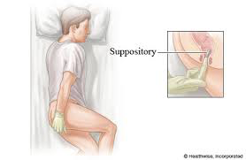
i) Microbicides – gels or vaginal rings (tenofovir, dapivirine: with potential to coformulate rings with hormonal contraceptives or STI treatments etc). Technology to individualise ring size, shape, colour etc.
Dapivirine just approved by EU – but for use outside the EU. ii) HIV vaccines:
• HVTN 702 - just ended (Feb 2020) early due to no efficacy
• HVTN 705 - Phase 3 studies ongoing - IMBOKODO - in 2600 women in SSA and MOSAICO in 3800 MSM and transgender. iii) Alternative PrEP formulations – ie for TDF – implants, slow release formulations, vaginal and rectal gels, films (dissolve on tongue), douche products etc
Other approaches to HIV prevention
-
A two-stage randomised phase II placebo controlled clinical trial
Notes:
i) Microbicides – gels or vaginal rings (with potential to coformulate rings with hormonal contraceptives or STI treatments etc). Technology to individualise ring size, shape, colour etc.
ii) HIV vaccines -
• HVTN 702 - just ended (Feb 2020) early due to no efficacy
• Janssen Phase 3 studies ongoing - HVTN 705 - IMBOKODO - Phase 2b in 2600 women in SSA
iii) Alternative PrEP formulations – ie for TDF/FTC – implants, slow release formulations, vaginal and rectal gels, films (dissolve on tongue), douche products etc

Slide 20
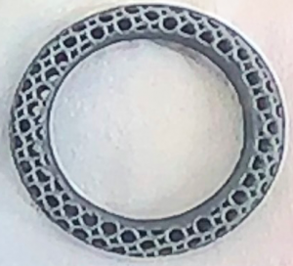
Vaginal rings
3D printing can individualise rings – size, shape, colour, and use multiple compounds – PrEP, antibiotics, contraceptive etc
Benhabbour SRet al. R4P2018, 21-25 October 2018. Oral abstract OA08.06. Audio webcast.
http://webcasts.hivr4p.org/console/player/40471
Carbon 3D Inc
https://www.carbon3d.com
-
A two-stage randomised phase II placebo controlled clinical trial
Notes:
3D printing can individualise rings – size, shape, colour, and use multiple compounds – PrEP, antibiotics, contraceptive etc

Slide 21
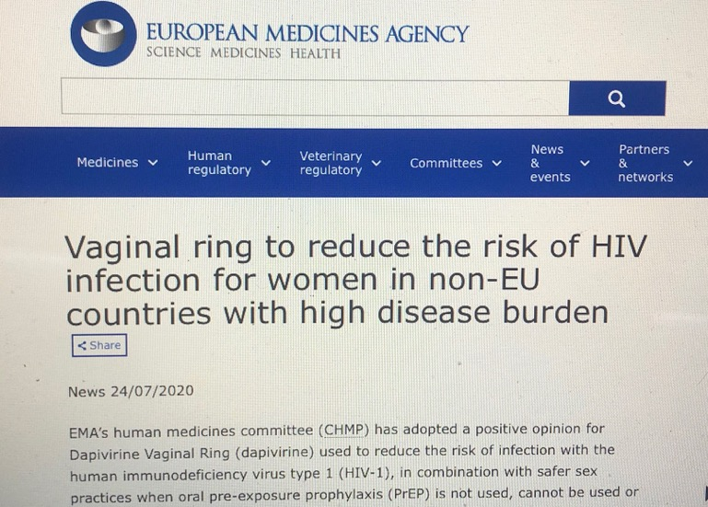
Vaginal rings: EU decision on dapivirine
-
A two-stage randomised phase II placebo controlled clinical trial
Notes:
EU made recommended safety and efficacy – but for outside EU region.

Slide 22

In Memory: Timothy Ray Brown, the Berlin patient, the first person to be cured of HIV
Activist for PrEP, U=U and an HIV cure. https://i-base.info/htb/39020
Timothy Ray Brown, filmed at the International AIDS Conference in 2015 for ‘Is a cure for HIV possible’.
(28 July 2015).
https://www.youtube.com/watch?v=IJgKYybd2aI
-
A two-stage randomised phase II placebo controlled clinical trial
Notes:
Finaly, a slide in memory of Timothy Ray Brown who died on 29 September 2020.

Slide 23
Questions
Thanks:
Polly Clayden, Roy Trevelion: i-Base
Sarah Fidler, John Frater: RIO study

Slide 24
• Oral PrEP already 100% effective – but not an option for many people.
• Some results by end 2020: islatravir monthly pill (phase 2)
AMP studies VRC01 (phase 3)
• Other formulations and compounds are being studied.
• PrEP efficacy is increasingly difficult to study – research needs to be in people with greatest need (ie at highest risk). Maybe not in high income countries.
• Access once approved is essential – relative to cost of a pint and a packet of condoms – ie current generic PrEP.
Summary and conclusions
-
A two-stage randomised phase II placebo controlled clinical trial
Notes:
• Oral PrEP already 100% effective – but not an option for many people.
• Some results this year: islatravir monthly pill (phase 2)
VRC01 (phase 3)
• Other formulations and compounds are being studies.
• PrEP efficacy is increasingly difficult to study – research needs to be in people with greatest need (ie at highest risk). Maybe not in high income countries.
• Access once approved is essential – relative to cost of a pint and a packet of condoms – ie current generic PrEP.

Slide 25
Back-up slides

Slide 26
• Late breaker results reported at AIDS 2020.
• Prespecified: 50% of participants <30 years old, 10% transgender women (TGW) and >50% of US participants would be black/African-American.
• Cabotegravir was statistically superior compared to TDF/FTC: 13 vs 39 people became HIV positive (HR: 0.34; 95%CI: 0.18 to 0.62, p=0.0005).
• Both arms were highly effective: low adherence likely to explain new infections in the TDF/TFC arm.
• HTPN 084 - n=3200 women in seven high incidence African countries: Botswana, Kenya, Malawi, South Africa, Swaziland, Uganda, Zimbabwe.
• Practical issues for adherence, stopping PrEP and price.
HTPN 083 results – July 2020
Landovitz R et al. Late breaker oral abstract OAXLB0101.
-
A two-stage randomised phase II placebo controlled clinical trial
Notes:
Two NIAID studies - similar designs in different population. Both expected to end 2022.
- HPTN 083 - Randomised, placebo controlled phase 2b/3 study - CAB LA vs daily oral TDF/FTC (+ placebos); n=5000 MSM and TGW - US, South America, Thailand, Vietnam, South Africa.
- HTPN 084 - As above - but in n=3200 women in seven high incidence African countries: Botswana, Kenya, Malawi, South Africa, Swaziland, Uganda, Zimbabwe.
completed - Phase 2a study in 127 men for safety, tolerability and acceptability.
Practical issues for adherence, stopping PrEP and price.

Slide 27
Two public funded (NIAID) studies - similar designs in different populations.
Randomised, placebo controlled phase 2b/3 studies - CAB LA vs daily oral TDF/FTC (+ placebos); Both were due to end 2022.
• HPTN 083 - n=5000 gay men & trans women - US, South America, Thailand, Vietnam, South Africa. Results reported at AIDS 2020 – positive results seen earlier than expected.
• HTPN 084 - n=3200 women in seven high incidence African countries: Botswana, Kenya, Malawi, South Africa, Swaziland, Uganda, Zimbabwe.
Practical issues for adherence, stopping PrEP and price.
Cabotegravir PrEP studies
-
A two-stage randomised phase II placebo controlled clinical trial
Notes:
Two NIAID studies - similar designs in different population. Both expected to end 2022.
- HPTN 083 - Randomised, placebo controlled phase 2b/3 study - CAB LA vs daily oral TDF/FTC (+ placebos); n=5000 MSM and TGW - US, South America, Thailand, Vietnam, South Africa.
- HTPN 084 - As above - but in n=3200 women in seven high incidence African countries: Botswana, Kenya, Malawi, South Africa, Swaziland, Uganda, Zimbabwe.
completed - Phase 2a study in 127 men for safety, tolerability and acceptability.
Practical issues for adherence, stopping PrEP and price.

Slide 28
• F/TAF – non-inferior to TDF/FTC – US 2019.
Effectively 100% protection with good adherence.
Smaller tablet. Less risk of renal and bone complications.
Better PK for late/missed dosing but no data for on-demand (2:1:1) or in women
Significantly more expensive compared to generic TDF/FTC
Oral PrEP: F/TAF
Notes:
• F/TAF – non-inferior to TDF/FTC – more flexible for missed doses.
Effectively 100% protection with good adherence.
Smaller tablet. Less risk of renal and bone complications.
Better PK for late/missed dosing but no data for on-demand (2:1:1) or in women
So significantly more expensive compared to generic TDF/FTC that not available on NHS.

Slide 29
• TDF/FTC – daily or on-demand (2:1:1) for some people.
Approved: US 2012, EU 2015, Scotland 2017 and England 2020.
Effectively 100% protection with good adherence.
Inexpensive (~£17 for 30 tablets). ~£2.50 per on-demand cover.
Few side effects. Maybe caution with bone health if young.
High level of adherence needed for daily PrEP. Only option for women and trans men and women: need 6 or more daily pills a week.
Easy to miss ‘pre’ dose with on-demand dosing
Current oral PrEP: TDF/FTC
-
A two-stage randomised phase II placebo controlled clinical trial
Notes:
• TDF/FTC – daily or on-demand depending on population/risk
Effectively 100% protection with good adherence.
Inexpensive (~£17 for 30 tablets). ~£2.50 per on-demand cover.
Few side effects. Maybe caution with bone health if young.
High level of adherence needed for daily PrEP – only option for women and trans men and women. Needs 6 or more daily pills a week. Easy to miss ‘pre’ dose with on-demand dosing

Slide 30
• 1981 – 1987: from no treatment to AZT. Time to 3TC?
• 1987 – 1997: from mono to triple HAART (ART) - 3-drug combination therapy. Life-saving - but, multiple pills often >20/day, difficult side effects.
• 1997 – 2007: better, easier treatment – single pill FDC Atripla.
• 2007 – 2017: 10 single-pill, once-daily, fixed dose combinations (FDCs)
Swiss Statement, PrEP, PARTNER studies and U=U.
START study in 2015 supported universal ART.
Next decade? Long-acting alternatives to daily oral ART – potential for treatment every six months by 2027? - and a cure?
Advances in HIV treatment
-
A two-stage randomised phase II placebo controlled clinical trial
Notes:
Each decade produced advances in HIV treatment that would have been unthinkable for most people at the start of each period.
This is a good way to project forwards ten years – and early studies now could easily become approved treatment by 2027.
In the last decade we have gone from one FDC - Atripla – to ten.
Oral daily PrEP was approved in the US in 2012 and the EU by 2015,
U=U was raised in the Swiss Statement in 2007 to having results from PARTNER studies in 2014 and 2015 – and ART became universally recommended from 2015.

Slide 31
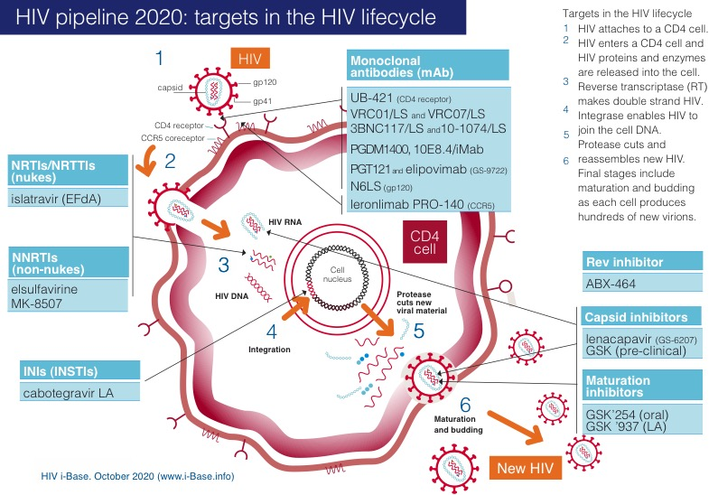
Key: INSTI: integrase strand transfer inhibitor; LA: long-acting; mAb: monoclonal antibody; NRTI: nucleoside/tide reverse transcriptase inhibitor; NNRTI: non-nucleoside reverse transcriptase inhibitor.
-
A two-stage randomised phase II placebo controlled clinical trial
Notes:
This is graphic from the pipeline report - that shows the leading compounds and drug classes for HIV treatment.
Already this year we lost combinectin and two Merck NRTIs were discontinued and MK-8507 in a new weekly oral compound close to phase 2 studies

