Slide 1
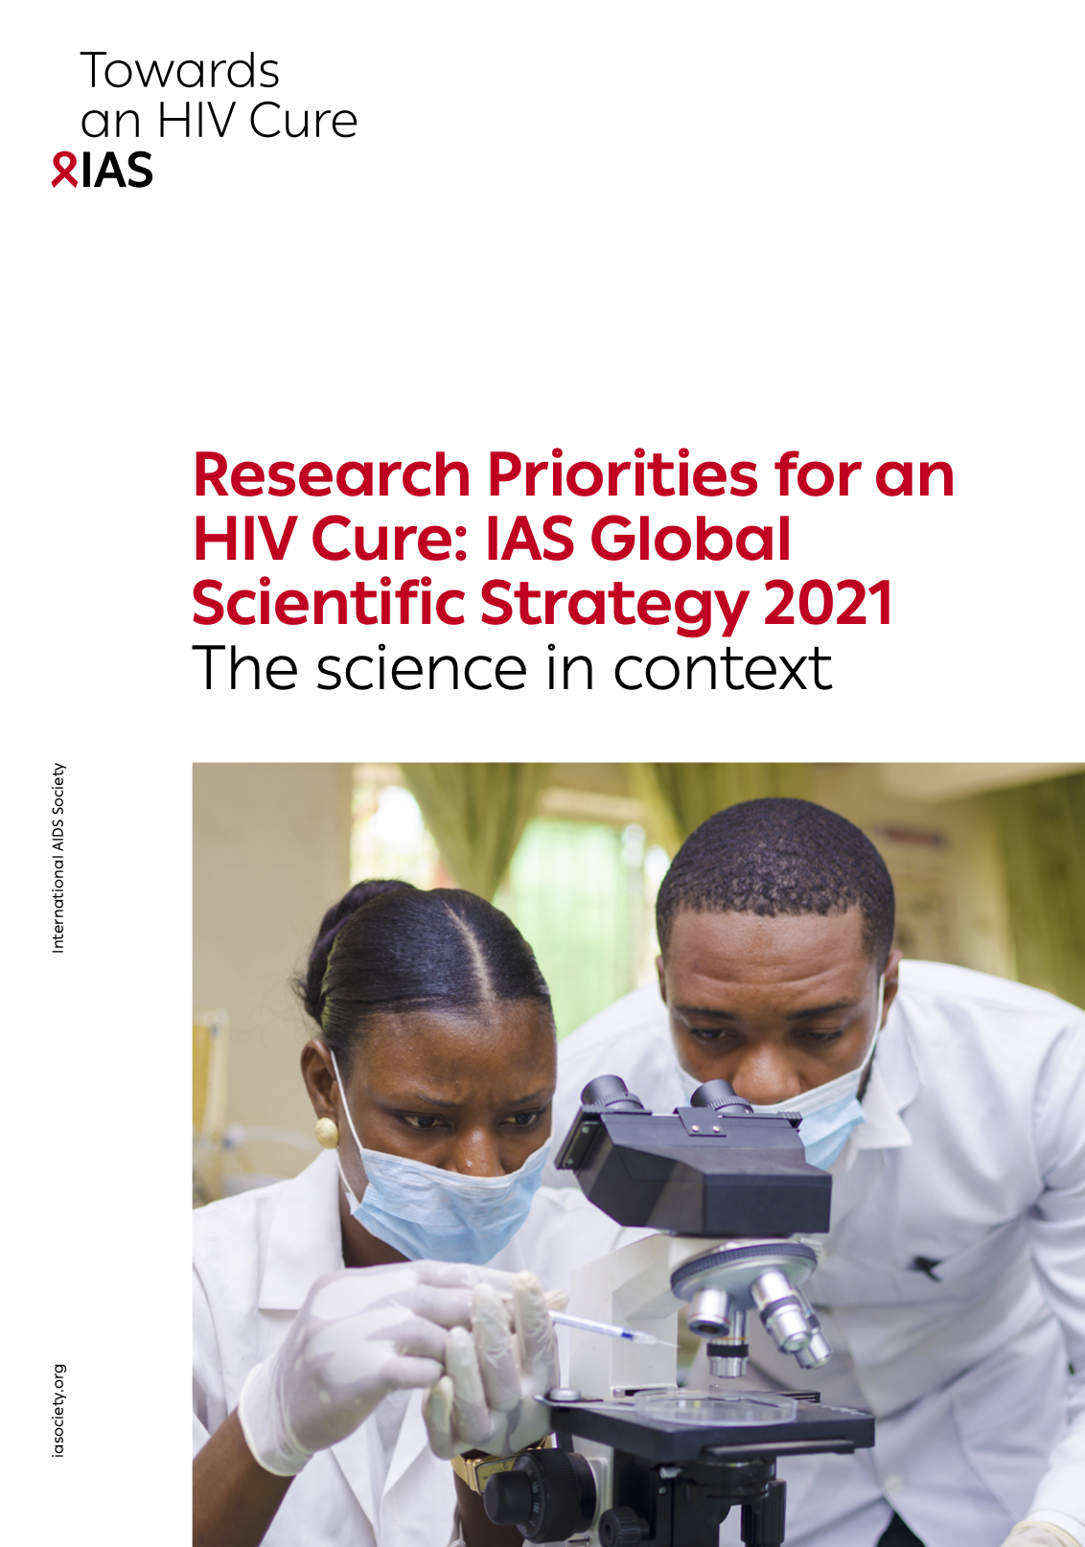

NWO/Aidsfonds Sandpit on HIV Cure: Stakeholder session
Simon Collins, i-Base.info
I am an HIV+ community rep on several cure-related projects.
• Report on cure-related research over 20 years.
• 3rd IAS Roadmap For A Cure Report (Nature, 2021). https://i-base.info/ias-towards-an-hiv-cure-2021
• RIO study: using two long-acting bNAbs to keep viral load undetectable for >6 months off ART.

Slide 2
Three headline points
1. EFFICACY: Cure-related interventions need data that shows a likely benefit. They also need to clearly explain that the study will not cure any participant.
2. SAFETY: Good information and monitoring when off-ART. Risks of reinfection and transmission off-ART. Adherence support when restarting. Plan and respond to events like COVID that would increase risk off-ART.
3. BROADER PARTICIPATION: Broader diversity of participants to reflect the global demographics. Include social research to learn about participant beliefs and experiences.

