Slide 1

PrEP for trans and non-binary communities
Background for panel talk
9th cliniQ conference,
20 April 2023
Simon Collins, i-Base.info

Slide 2
PrEP: an activist timeline
1994 - TDF works as PrEP in animals - 28 years ago [1]
2010 - iPrEX results inc ~ 339 (12%) trans women. [2, 3]
2012 - US FDA approves TDF/FTC as PrEP.
2014 - UK PROUD & French IPERGAY results, pub 2015. [4, 5]
2016 - EU approves PrEP in Europe – NHS loses court case.
2020 - NHS approves PrEP for people.
2023 - Still no data on trans use of PrEP use in the UK.
1. Tsai et al. Science (1995). 2. Grant RM et al, NEJM (2010). 3. Deutsch MB et al. Lancet HIV (2015). 4. McCormack S et al, the Lancet (2015). Molina J-M et al. NEJM (2015).

Slide 3

Data on PrEP use by trans people
UK SHA collect HIV trans data since 2018: <5 cases in 2020 and 2021.
Approx 170 trans and non-binary people are living with HIV.
Wide age range, across the UK, all on ART.
No trans data in the summary report, even as a key population.
PrEP info is only collected and reported as binary data.
PrEP is under-accessed by many (ie ~70% of eligible gay men vs 23% of women). Leads to late HIV diagnosis due to less frequent testing etc.
UKHSA want to work with communities to improve reporting.
Commander Data, Wikipedia.
UKHSA. HIV in the UK 2022 annual data tables. Key populations HIV data tables. Tables 28/29.
https://www.gov.uk/government/statistics/hiv-annual-data-tables

Slide 4
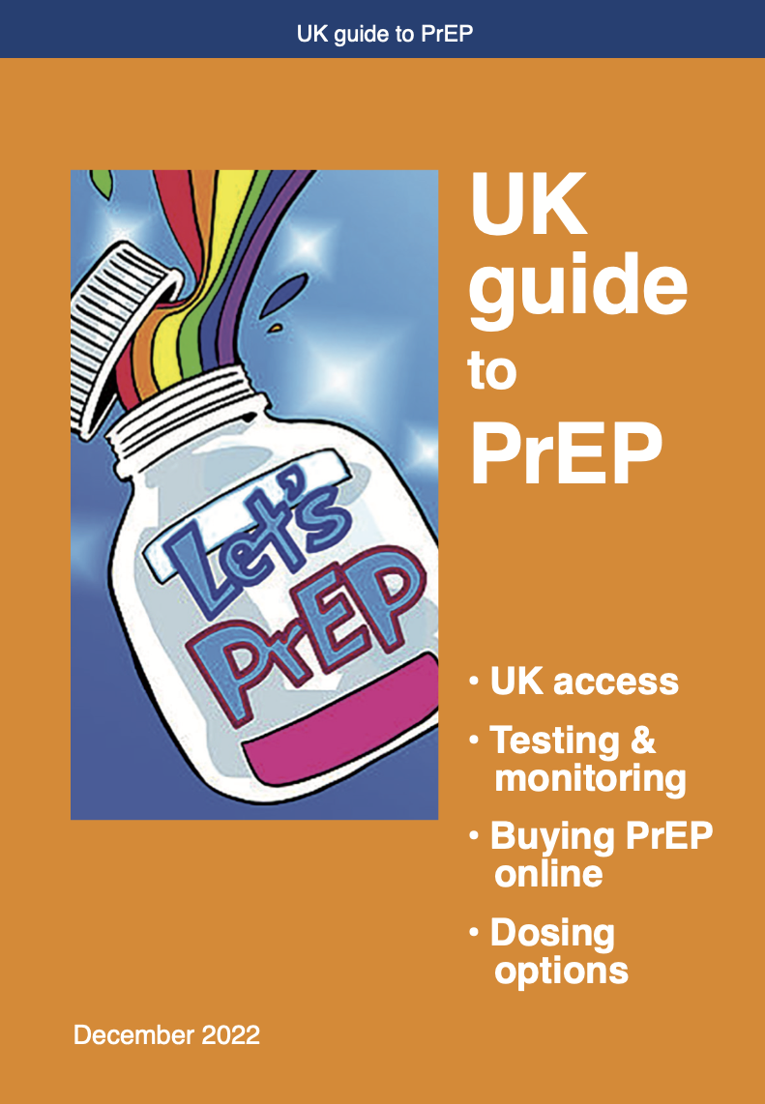
PrEP for trans and non-binary people
PrEP is just as safe and effective.
Daily dosing generally, but depends on type of sex.
Vaginal or frontal sex: daily PrEP at least six days a week.
For anal sex, 2:1:1 dosing should work for everyone.
PrEP does not interact with hormone treatment.
Daily dosing overcomes reduced tenofovir levels with feminising hormone therapy.
www.hiv-druginteractions.org/printable_charts

Slide 5
When 2:1:1 dosing can be an option*
 |  | Vaginal/frontal sex |  | Anal sex
 |  | insertive | receptive | insertive | receptive
trans | women | yes | no | yes | yes
 | men | no | no | yes | yes
cis | women | NA | no | NA | yes
 | men | yes | NA | yes | yes
* Not currently included in guidelines

Slide 6
Stopping and starting PrEP
PrEP is very flexible if your needs change.
If you become much more or much less active.
If your relationship status changes.
Daily dosing for vaginal/frontal takes 6-7 days to reach protective levels. It is okay to start with a double.
When stopping, continue daily dosing for 6-7 days after vaginal/frontal sex and 2 days after anal sex.
Dosing for anal sex is reached by a double-dose, but then needs at least two daily doses – ie 2:1:1.

Slide 7
Designing services and access
How easy is PrEP to access?
Is PrEP provided in a non-judgemental
And respectful setting?
How to improve services.
What is level of confidence in the community over PrEP?

Slide 8
UK guide to PrEP
24-page A5 booklet.
Includes info on dosing, drug interactions, hormone treatment.
7th edition (since 2016).

Slide 9
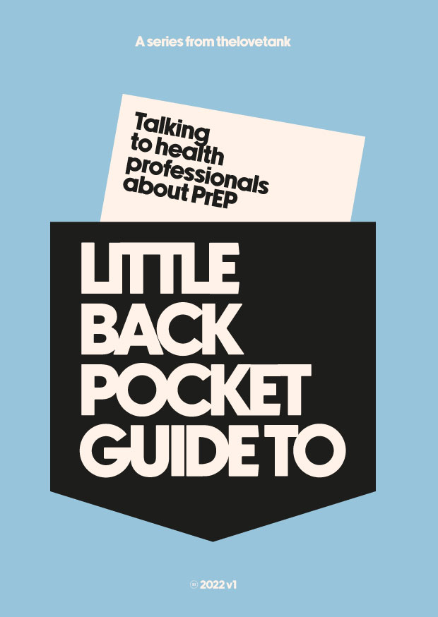


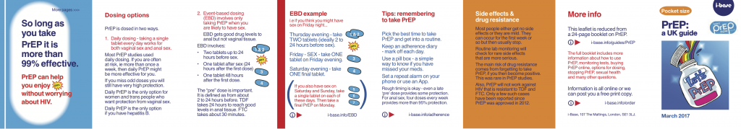
Other resources
Leaflets, booklets, websites:
womenandprep.org.uk
i-Base.info
prepster.info
Iwantprepnow.co.uk
aidsmap.com

