Slide 1
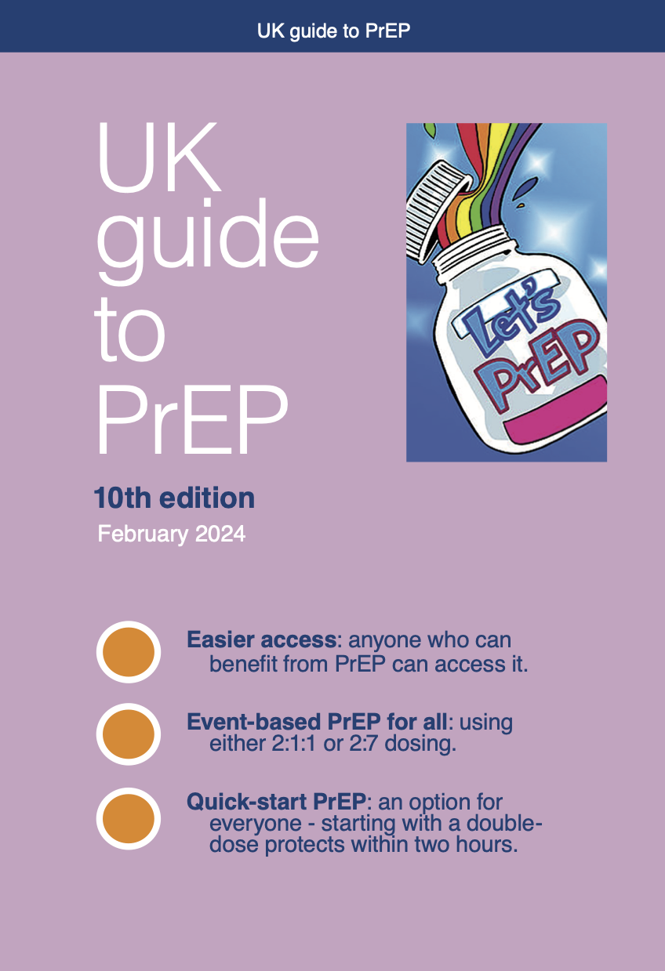
A community perspective on UK Guide to PrEP:
2024 update
C&W HIV GUM teaching, 9 July 2024
Simon Collins
HIV i-Base i-Base.info
Notes:
Thank you for the chance to talk.
Luckily this is a few weeks after the talks from Sheena McCormack and Dan Clutterbuck who went through the technical data and evidence.
I will give a non-technical summary of the changes and why they are so important
This is a non-technical community response – you have already had the best already!

Slide 2
Introduction
Background
PrEP guidelines in 2024.
New changes in the community PrEP guide.
New evidence and references.
Ongoing questions and choices.
Transgender healthcare and rights
Notes:
Thank you for the chance to talk.
Luckily this is a few weeks after the talks from Sheena McCormack and Dan Clutterbuck who went through the technical data and evidence.
I will give a non-technical summary of the changes and why they are so important
I have included a final bullet to flag issues relating to transgender health as this has been such a difficult time recently and because I know C&W is one of the leading clinics that develops services for trans and non-binary people.

Slide 3
Introduction
Background: guidelines and this update.
New changes (1) Double dose start. (2) New adherence data. (3) New options for event-based dosing: similar by sex and gender. (4) Easier access.
New evidence and five key references.
Ongoing questions and choices.
How does this affects PrEP services?
Notes:
The main changes include options for easier ways to use PrEP that have much less emphasis on someone’s sex and gender – or even on the type of sex involved.
The main results mean that everyone can get rapid protection and no-one needs to be on daily PrEP unless this is their choice,
Also, easier access.
I’d also find it really interesting to learn how this affects PrEP services.
I didn’t realise that the guide would involve training workshops for example or that this would delay the new guides being used.

Slide 4
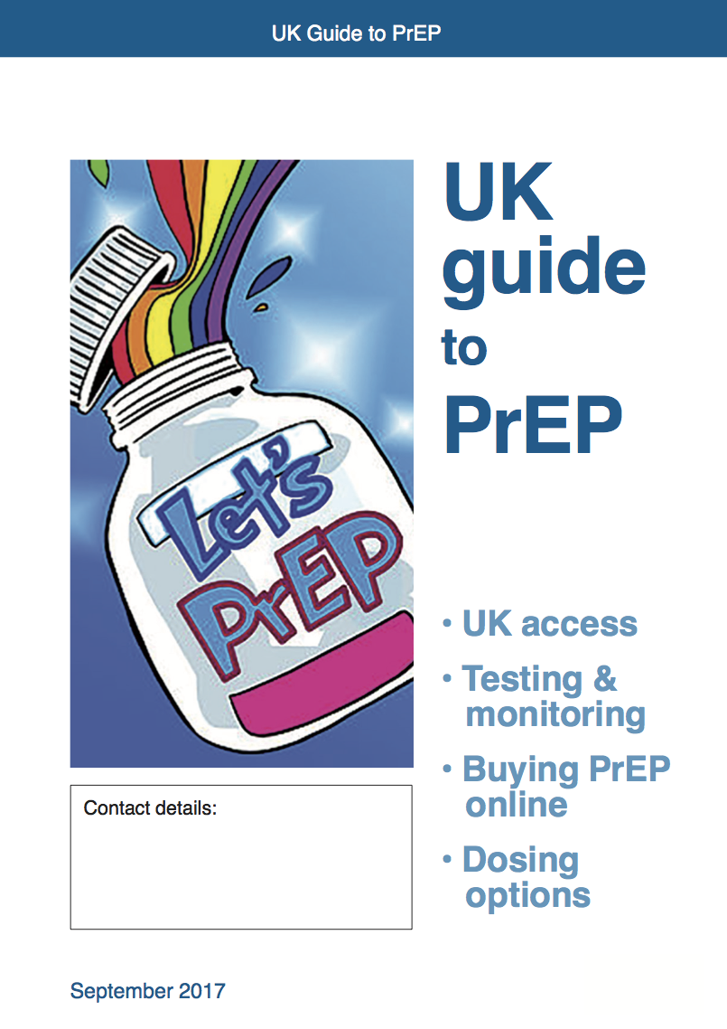
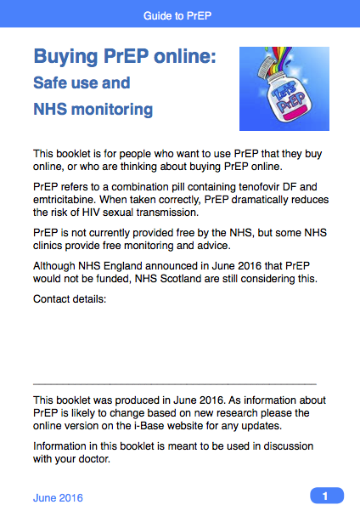
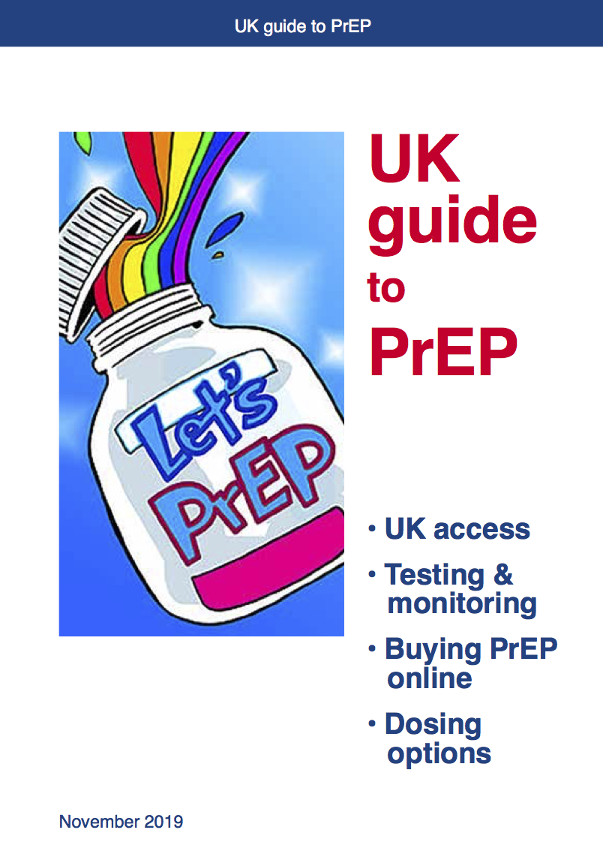
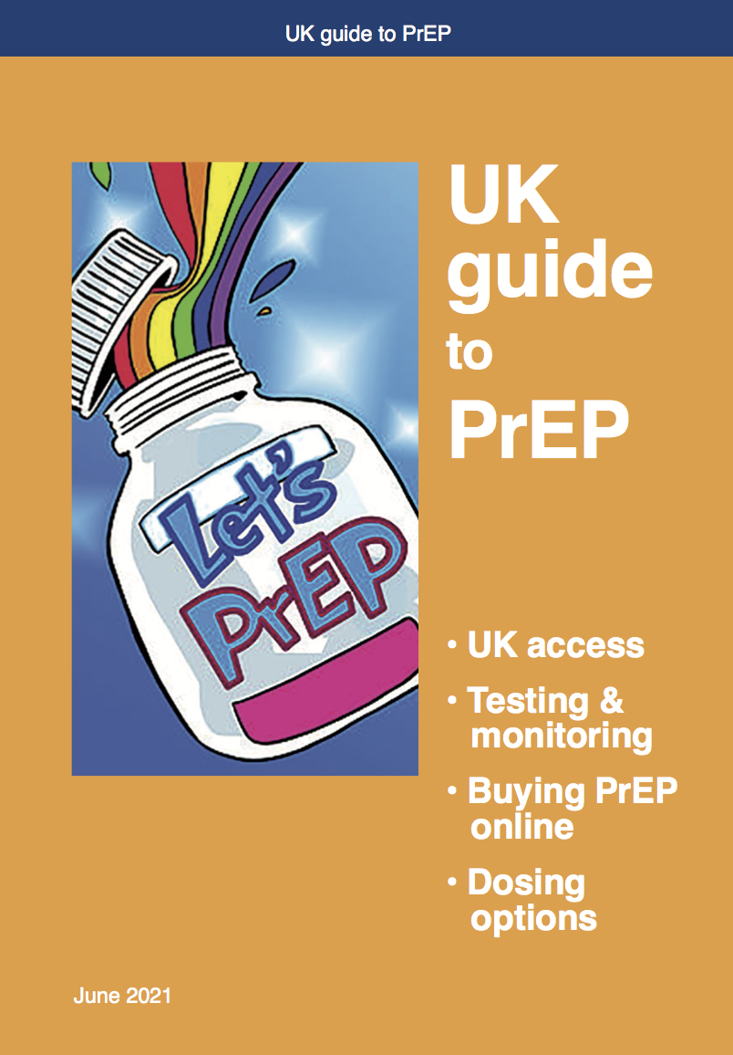
Background to the guide
First produced in 2016.
Community collaboration with leading PrEP researchers and providers to provide evidence-based information.
No funding, co-ordinated by i-Base.
Notes:
As background, i-Base have been coordinating this guide for over eight years.
Here are a few of the different cover designs.
We updated the booklet every year because circumstances and services change.
Over the years it has been so important to be able to update information on easier access to PrEP – so steadily the sections on buying PrEP online have become less important.
We have also added in specific pages on women and PrEP, trans and non-binary people, and about sex work, This content has all been developed by the other community activists – notable from the Sophia Forum, CliniQ, Prepster and IwnatPrEP now.
Medical advisers include from BHIVA, BASHH, 56 Dean Street and Central and North London NHS.
This was a publication to find a gap – not a funded project – not commissioned – guidelines came later.

Slide 5
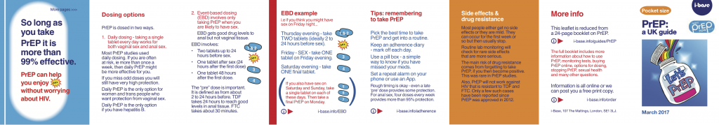

Pocket leaflets & PrEP for Women
Pocket guide to PrEP
Shona, Spanish, Swahili
Xhosa, French, Portuguese
Notes:
Here are a few other linked resources - one is a reduced text pocket leaflet
The others are translations by Sophia Forum in key languages spoken by women living in the UK who could benefit from PrEP.
Both resources are still to be updated in print format – but only if we can raised funding to cover these costs.

Slide 6
PrEP guidelines
Guidelines depend on date, regulatory indication, with different recommendations for different drugs.
South Africa (2016) – WHO, SA
UK BHIVA/BASHH (2018) – EMA
WHO (2016, 2019, 2021) – All
US CDC (2012–2023) and IAS-USA (2021) – FDA
EACS (2019, 2021, 2023) – EMA
Notes:
PrEP guidelines are important – but big differences depending on who they are written for and in which regionsl
Many guidelines are not often updated – technically tis mean they easily date
Depend on the indication differences by different regulatory agencies.
TAF was approved in the US but not EU, FDA doesn’t recognise 2:1:1 dosing other than possible off-label use - with cautions

Slide 7


UK guidelines
(BHIVA/BASHH)
Excellent UK guidelines in 2018 - included
many more options before other guidelines.
6 years ago: No new RCTs but other studies since.
Draft circulated mid-2023 (delayed by CAB-LA?)
Expected in Nov/Dec 23/early 2024.
Guide was out of stock by Dec 23 with 6000 orders by Feb 2024. Worked with UK panel to include main expected changes.
Notes:
UK guidelines were excellent in 2018 – most advanced with many options
But overt the last six years new studies suggest other options
For various reasons the planned 2023 update was delayed, partly to include injectable PrEP.
i-Base worked with the panel to make sure any new community resources wouldn’t be out of date,
Also, demand from clinics meant we needed to reprint.

Slide 8
Background: PrEP equity across UK
PrEP access in UK among those with need in 2022:
74% gay and bisexual men.
39% heterosexual men.
36% heterosexual and bisexual women.
Other differences by age and ethnicity.
New research included much easier options for using PrEP and supported better equity.
UKHSA. HIV in the UK (Oct 2023).
Notes:
As background, access to PrEP in the UK was better among some groups than others,
2022 was improving compared to 2021 data but still lreduced uptake compared to gay and bisexual men

Slide 9
New research (even though not RCTs)
Clearly effective in RCTs as daily or 2:1:1 but… PrEP is a very difficult scientific challenge.
Target drug levels uncertain: which drugs at which levels in which parts of the body?
Surrogate markers for adherence several weeks or months earlier before diagnosis. New cases may or may not have taken PrEP.
New: efficacy linked to drug levels in cells vs tissue.
Notes:
And although new data wasn’t from RCTs accumulated data was becoming convincing – RCT studies on these points might never be run – or at least many people will becomes HIV positive before their results are out.

Slide 10
Timing to start and stop
Example: significant differences in guidelines over time to protection – ie daily dosing before protected.
21 days (US).
7 days daily to start, 2 or 7 days to stop (UK).
7 days to start or stop (EACS).
7 days MSM, 20 days women; 28 days to stop (SA).
Event-based 2:1:1 vary, mostly since 2019.
Notes:
One example of guidlines differences in over time to achieving protection,
All based on theoretical concern of different drug levels in vaginal and rectal tissue – which is challenged by more recent rsearch
Many guidelines only included 2:1:1 dosing after 2019

Slide 11
New: double-dose to start – for all
Several PK studies show a new option for everyone to start oral PrEP with a double dose (2 pills).
Protection in 2 hours vs 7-20 days
Based on closer correlation between protection and drug levels in cells rather than genital/rectal tissue.
More accurately predicts clinical outcome.
Rapid/more durable drug levels with double dose.
Notes:
The data supporting double dosing was published several years ago and was referenced in the 2018 UK guidelines.
There is no safety concern from taking a double dose – and data to show rapid drug levels that are then sustained for days

Slide 12
Dan Clutterbuck, BHIVA 2024
Where - EC₉₀ in PBMCs FGT & rectal tissues after IPERGAY
IPERGAY start 2 hours before Sex
IPERGAY start 24 hours before Sex
Adapted from Cottrell et al. J Infect Dis. 2016 Jul 1;214(1):55-64 and Garrett et al. J Pharmacol Exp Ther. 2018 Nov;367(2):245-251.
Compartment | How Quickly Above Target? | How Long Above Target?
FGT | 2 hours after double dose | 4 days after sex
PBMC |  | 7 days after sex
Rectum |  | 12 days after sex
Notes:
This is perhaps the most important data slide from that talk at BHIVA so I included this in the community review.
Two studies – from 2016 and 2018 show drug levels are reached within two hours of the double dose.
And they are sustained for 7 days in PBMCs

Slide 13
Adherence
New analyses are important for reducing the adherence threshold.
Recommendations were for trans and non-binary people and cis women to need strict daily adherence.
New adherence: 4+ doses a week now also for cis women (JAMA paper)
Some benefit for gay and bisexual men with 2-3 pills, though highest protection with 4+ doses.

Slide 14
Event-based 2:7 option for trans and nonbinary people and cis women
New data from PK studies and modelling studies now enable options other than daily PrEP.
Especially if there is no need for 24/7 protection 365 days a year.
Possible caution over post-dosing – continue daily PrEP for 7 days – ie 2:7 dosing for transgender and non-binary people and cisgender women.

Slide 15
Systemic protection
Oral PrEP is distributed systemically and not locally.
Although tissue concentrations warranted cautious approach to dosing by sex and gender, drug levels in cells (PBMCs) will be similar in all body sites.
Route of exposure becomes irrelevant.
Possibly important implications for route?

Slide 16
Reducing the barrier to access
UK guidelines will reduce the barrier for access: no longer will need tp be at higher risk.
Instead, being at risk is a more practical and equitable approach especially with event-based dosing options.
PrEP can increase QoL by reducing anxiety over risk.
Having PrEP at home can also be starter PEP.

Slide 17
Evidence
Five key studies with accumulating evidence (see additional slides 23 – 32).
Practical information in absence of clinical evidence from RCTs.
Timeline from first evidence (1994), to large studies (iPrEX 2009-2012), to approval (FDA 2012, EU 2016) to guidelines (UK 2018).

Slide 18
Ongoing issues
Data on the duration of event-based PrEP for trans and non-binary people and cis gender women.
Target drugs levels
Data in transgender and non-binary people.
Data on transgender men: excluded or lost in ALL RCTs up to now.

Slide 19
Guidelines matter
“Guidelines are out of date before they are even published”. Mike Youle, 2005
“Vaginas do not demand perfection”.
Jennell Stewert, Challenging the Dogma of Event-driven PrEP, CROI 2024.
Guidelines provide a minimum standard of care that people can reference when advocating for our care and their care.
Notes:
A couple of quotes
One to remember the difficulties of the often thankless task of producing guidelines
The second to suggest the practical importance of accumulating evidence when RCT data is not available and might never be available.
Finally a community connent on why guidelines remain essential for advocates – we can use them to challenge suboptimal care.

Slide 20
References
Zhang L et al. Model-based predictions of protective HIV pre-exposure prophylaxis adherence levels in cisgender women. Nat Med. (November 2023).
https://www.ncbi.nlm.nih.gov/pmc/articles/PMC10667095
Cottrell ML et al. A translational pharmacology approach to predicting outcomes of preexposure prophylaxis against HIV in men and women using tenofovir disoproxil fumarate with or without emtricitabine. J Infect Dis. (February 2016).
https://pubmed.ncbi.nlm.nih.gov/26917574
Garrett KL et al. A pharmacokinetic/pharmacodynamic model to predict effective HIV prophylaxis dosing strategies for people who inject drugs. J Pharmacol Exp Ther. (August 2018).
https://pubmed.ncbi.nlm.nih.gov/30150483
Cespedes MS et al. Gender affirming hormones do not affect the exposure and efficacy of F/TDF or F/TAF for HIV preexposure prophylaxis: a subgroup analysis from the DISCOVER trial Transgender Health (January 2024).
https://www.liebertpub.com/doi/full/10.1089/trgh.2022.0048
Marrazzo J et al. HIV Preexposure Prophylaxis With Emtricitabine and Tenofovir Disoproxil Fumarate Among Cisgender Women. JAMA (1 March 2024).
https://jamanetwork.com/journals/jama/fullarticle/2816036

Slide 21
Tsai C-C et al, Science 1995
Daily weight-based daily PMPA (tenofovir) SC for one month in 35 macaques inoculated IV with SIV (10 x 50% infectious dose): 5 arms, follow up 40-56 weeks.
Dose Timing n % became SIV+
20 mg/kg 48 hrs pre 5 0/5
30 mg/kg 48 hrs pre 10 0/10
30 mg/kg 4 hrs post 5 0/5
30 mg/kg 24 hrs post 5 0/5
Control 48 hrs pre 10 10/10
Tsai C-C et al, Prevention of SIV Infection in Macaques by (R)-9-(2-Phosphonylmethoxypropyl)adenine. Science 1995. (NIH funded). https://pubmed.ncbi.nlm.nih.gov/7502044/
Notes:
The early results were so remarkable – but the lack of urgency for optsions other than condoms took almost two decades for this to become an option,.
This was pre-HAART, pre-protease inhibitors, 7 years prior to TDF approval as ART, with the main study running in 1994 or earlier.
35 macaques we dosed with daily tenofovir that was started either shortly before or after SIV inoculation.
Control animals all became quickly infected – within 1-3 weeks – and none of the 25 animals receiving active tenofovir by any schedule became infected.

Slide 22
Tsai C-C et al, Science 1995
Daily weight-based PMPA (tenofovir) SC for one month in 35 macaques inoculated IV with SIV (10 x 50% infectious dose): 5 arms, follow up 40-56 weeks.
Dose Timing n % became SIV+
20 mg/kg 48 hrs pre 5 0/5
30 mg/kg 48 hrs pre 10 0/10
30 mg/kg 4 hrs post 5 0/5
30 mg/kg 24 hrs post 5 0/5
Control 48 hrs pre 10 10/10
Tsai C-C et al, Prevention of SIV Infection in Macaques by (R)-9-(2-Phosphonylmethoxypropyl)adenine. Science 1995. (NIH funded). https://pubmed.ncbi.nlm.nih.gov/7502044/
Notes:
The early results were so remarkable – but the lack of urgency for optsions other than condoms took almost two decades for this to become an option,.
This was pre-HAART, pre-protease inhibitors, 7 years prior to TDF approval as ART, with the main study running in 1994 or earlier.
35 macaques we dosed with daily tenofovir that was started either shortly before or after SIV inoculation.
Control animals all became quickly infected – within 1-3 weeks – and none of the 25 animals receiving active tenofovir by any schedule became infected.

Slide 23
Thanks
Dan Clutterbuck, Sheena McCormack, Achyuta Nori, Will Nutland, Greg Owen, Mags Portman*, Michelle Ross, Sophie Strachan, Martina Toby, Laura Waters, Ashwin Caffery and Aedan Wolton.
*This guide is dedicated to our inspirational co-author Dr Mags Portman who was a leading advocate for PrEP in the UK. Mags died from mesothelioma in February 2019 aged 44 and we miss her deeply.
Feb 2024 edition will be out of stock by August 2024.
Notes:
Thanks to everyone involved in the guide – especially Sheena and Dan who patiently respnded to dozens of emails trying to get the text and wording right,
Also to community colleagues with expertise in practical aspects of PrEP roll-out
Including Sophie who also actively helped fundraise to help cover some of the print costs.
The Feb 2024 edition will be out of stock by August 2024,

Slide 24
Additional slides
Dan Clutterbuck
What’s New in HIV
Plenary talk, BHIVA Annual Conference, 29 April– 1 May 2024 https://www.bhiva.org/file/665da45a5391c/Daniel-Clutterbuck.pdf

Slide 25
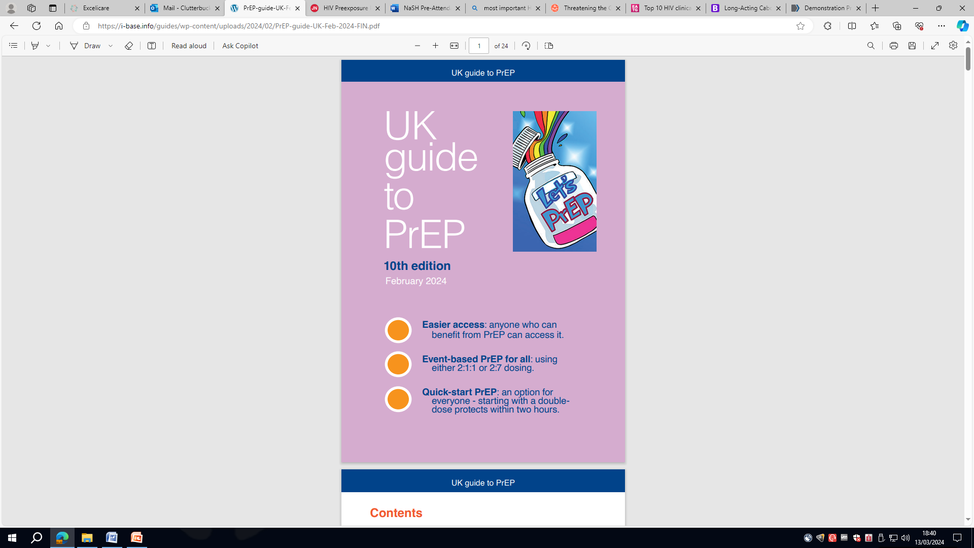
PrEP equity- oral PrEP for receptive vaginal and neovaginal sex
Of five major RCTs of oral daily PrEP for women, two showed effect (TDF2 Partners-PrEP) and and three showed no benefit (VOICE, FEM-PrEP and HPTN 084).
ADAPT study (CROI 2015) - ED PrEP in Bangkok, Cape Town and NYC. No further studies of event-based or quick start PrEP undertaken in cisgender women.
Stewart J. Challenging the Dogma of Event-Driven PrEP. CROI 2024, Oral abs 50.
Dan Clutterbuck, BHIVA 2024

Slide 26
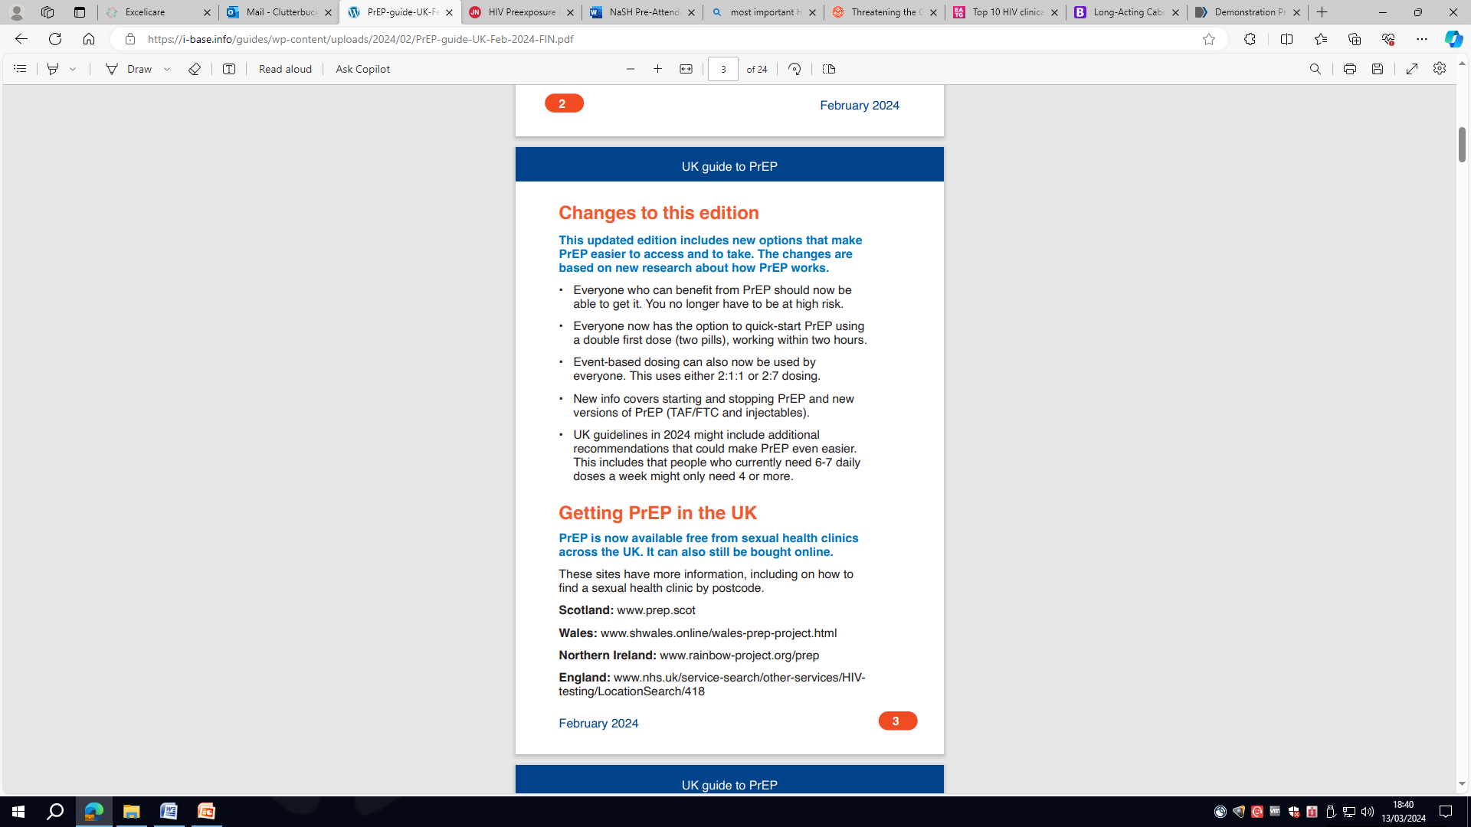
What’s new – oral PrEP ?
Limited new evidence. No new RCTs
Control arms of dapivirine ring and cabotegravir trials (HTPN 084)
Pooled analysis of daily PrEP data (Marrazzo 2024)
Re-evaluation of PK data
Modelling data refined and revised (Zhang 2023).
Dan Clutterbuck, BHIVA 2024

Slide 27
Pooled analysis of PrEP studies
Marrazzo: Pooled analysis of 6296 participants from 11 post-approval studies of PrEP in cisgender women: overall HIV incidence was 0.72 per 100 person-years.
Mapped objective (DBS & plasma) to reported adherence levels and assigned an ordinal rank to each individual, repeated over time.
HIV incidence rates per 100 person-years for different PrEP adherence trajectories were 0 for consistently daily (7 doses/week), 0.13 for consistently high (4-6 doses/week), 0.49 for a mean of 4-6 doses/week and then declining, and 1.27 for consistently low (less than 2 doses/week) adherence.
Exactly comparable to trials in GBMSM & TGW and to the control arm of HTPN084
Marrazzo J et al. HIV Preexposure Prophylaxis With Emtricitabine and Tenofovir Disoproxil Fumarate Among Cisgender Women. JAMA. doi:10.1001/jama.2024.0464. (1 March 2024).
Dan Clutterbuck, BHIVA 2024

Slide 28
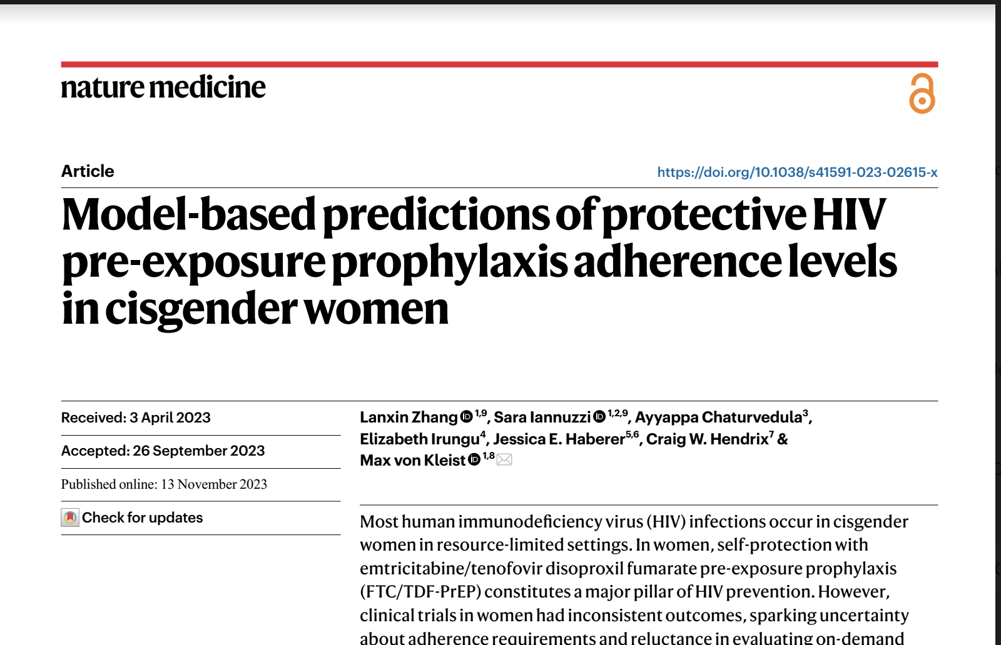
Modelling: Zhang Nature Medicine 2023
‘….In heterosexual women, the range in clinically estimated average efficacy of oral FTC/TDF-PrEP is particularly vast’
Results dichotomised into those with some drug vs no drug (ie to include treatment arms)
Dan Clutterback, BHIVA 2024
Notes:
An alternative modelling study (Zhang 2023) based on all available clinical trials of daily TD-FTC in women and exploring the wide range of reported clinical average efficacy, also strongly suggests that the lower (or no) in efficacy of PrEP reported in heterosexual cis women is a function of low adherence rather than tissue drug concentrations . If PBMC drug levels are the relevant marker of protection, then 3-4 doses per week will offer similar levels of protection for receptive vaginal sex as for other sexual exposures. The extent to which effectiveness in clinical trials was dependent on drug pharmacokinetics as opposed to adherence is incompletely understood, but recent evidence suggests that adherence is the main driver of the observed difference in efficacy in heterosexual women. Zhang, L., Iannuzzi, S., Chaturvedula, A. et al. Model-based predictions of protective HIV pre-exposure prophylaxis adherence levels in cisgender women. Nat Med 29, 2753–2762 (2023). https://doi.org/10.1038/s41591-023-02615-x
This is probably where Zhang comes in? I have had a first go based on a first read but I am sure could be improved. It is complex!
Have included the mention of 3-4 doses per week as providing adequate protection, but not in any recommendations or GPP

Slide 29
Zhang Nature Medicine 2023
Top down (data) vs ‘bottom up’ models
Model adherence, exposure site pharmacokinetics, exposure-site, effect site drug potency and exposure route
Outcome variability between trials can solely be explained by adherence
Any simulated scenario in which drug levels in PBMCs are used as a marker of efficacy closely matches observed clinical outcomes.
Dan Clutterbuck, BHIVA 2024
Notes:
Pharmacokinetic
Furthermore efficacy in TDF-2 differed between sexes with 49% efficacy in women and 80% in men(15). Partners PrEP(14) included a TDF only arm which, overall, had comparable efficacy (67%). For women, the efficacy of TDF PrEP compared to placebo was 71% (p=0.002) and of TDF-FTC was 66% (p=0.005); among men the efficacies were 63% (p=0.01) and 84% (p<0.001) respectively.
modeling revealed that individuals without detectable plasma teno-
fovir (TFV) have taken the product at most once weekly (43% prob-
ability; interquartile range (IQR): 29–54%) or not at all (Supplementary
Figs. 1 and 2). Subsequently, we assumed that individuals with unde-
tectable drug have not taken FTC/TDF at all, hence having 0% PrEP
efficacy. The proportion of random samples with undetectable plasma
TFV in the FTC/TDF intervention arm was 19% in the Partners-PrEP and
TDF2, 44% in HPTN 084, 64% in FEM-PrEP and 71% in VOICE studies
(Fig. 2a–e).

Slide 30
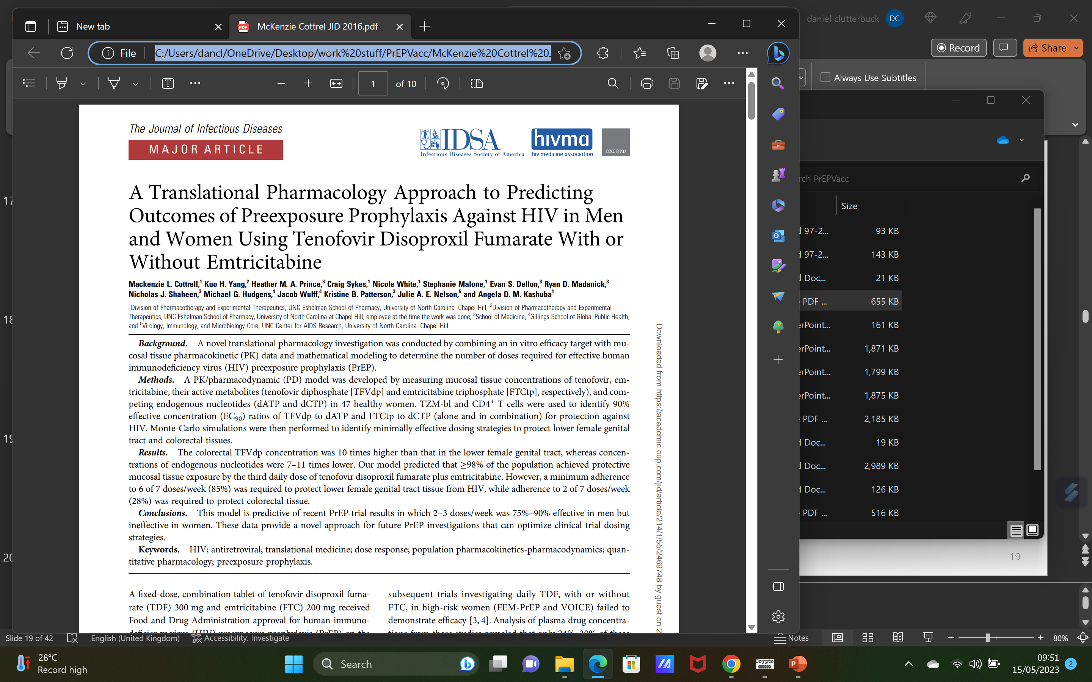
Pharmacodynamic studies
47 women received different single-doses of TDF and FTC with blood, rectal, vaginal and cervical tissue sampling over 48h.
PK/PD model using tissue concentrations of TFV, FTC, and competing endogenous nucleotides
CD4 T-cells used to identify 90% Effective Concentration (EC₉₀) ratios of TVF-DP to dATP and FTC-TP to dCTP
Percentage of the population achieving the EC₉₀ in colorectal tissue and female genital tract tissue
Presented as models of single daily dosing or ED (2;1;1) dosing
Dan Clutterbuck, BHIVA 2024

Slide 31
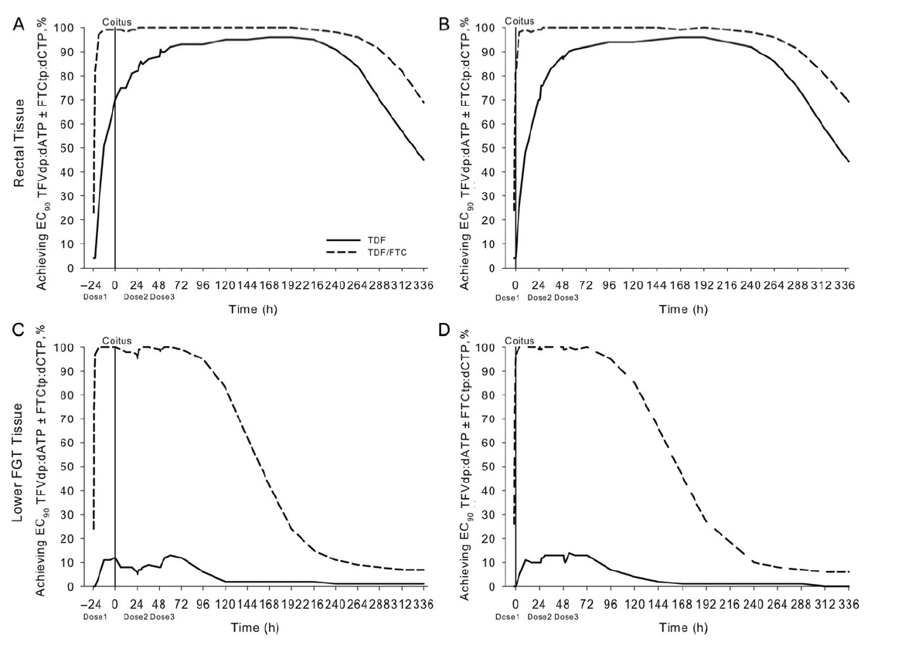
Event driven (2:1:1) PrEP – rectal tissue
24
Hours
before
240 hours later
In rectal tissues, 98% of users have protective levels 24 hours after, 81% have protective levels 2 hours after dosing (double dose)
Tenofovir levels remain protective for 10 days after exposure
Dan Clutterbuck, BHIVA 2024
Notes:
So we recommend dosing not less than 2 hours but not more than 24hours before sex, closer to 24 hours if possible.

Slide 32
Event driven (2:1:1) PrEP – FGT tissue
Dan Clutterbuck, BHIVA 2024
24
Hours
before
2 hours before
120 hours later
In female genital tract tissue, 99% of users have protective levels, even 2 hours after dosing. FTC-tp concentrates in FGT tissues
But TDF never reaches protective levels, and TDF/FTC levels fall after 120 hours

Slide 33

Quick start PrEP - for receptive vaginal/neovaginal sex if you have not taken seven daily pills before sex
BEFORE SEX
Take a Double dose (two pills) at least 2 hours & not more than 24 hours before sex
S
M
T
W
T
F
S
AFTER SEX
Continue to take a pill every day for seven days after your last risk
LAST
DOSE
S
F
T
W
T
M
S
Dan Clutterbuck, BHIVA 2024

Slide 34
Dan Clutterbuck, BHIVA 2024
Where - EC₉₀ in PBMCs FGT & rectal tissues after IPERGAY
IPERGAY start 2 hours before Sex
IPERGAY start 24 hours before Sex
Adapted from Cottrell et al. J Infect Dis. 2016 Jul 1;214(1):55-64 and Garrett et al. J Pharmacol Exp Ther. 2018 Nov;367(2):245-251.
Compartment | How Quickly Above Target? | How Long Above Target?
FGT | 2 hours after double dose | 4 days after sex
PBMC |  | 7 days after sex
Rectum |  | 12 days after sex

Slide 35
Dan Clutterbuck, BHIVA 2024
Where - EC₉₀ in PBMCs FGT & rectal tissues after IPERGAY
IPERGAY start 2 hours before Sex
IPERGAY start 24 hours before Sex
Adapted from Cottrell et al. J Infect Dis. 2016 Jul 1;214(1):55-64 and Garrett et al. J Pharmacol Exp Ther. 2018 Nov;367(2):245-251.
Compartment | How Quickly Above Target? | How Long Above Target?
FGT | 2 hours after double dose | 4 days after sex
PBMC |  | 7 days after sex
Rectum |  | 12 days after sex

