Slide 1
Risks and risk-mitigation - ART stockout/unavailability Important considerations
Prof Sanjay Bhagani
Professor of Clinical Infectious Diseases/HIV Medicine
Royal Free Hospital/UCL, London
s.bhagani@nhs.net

Slide 2
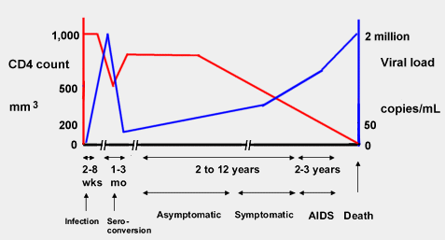
CD4 counts, HIV viral load and risk of adverse events
Risk of infections and cancers

Slide 3
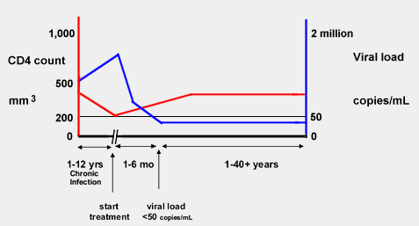
Impact of Antiretroviral Therapy (ART)

Slide 4
Why is viral suppression so important?
Maintenance of CD4 counts
Minimise risk of opportunistic infections and low CD4 count associated cancers
Reduced risk of transmission
U=U
Zero risk with viral loads <200 c/mL
Minimal risk with viral loads <1000 c/mL
Risk of vertical transmission
Reduced risk of non-AIDS comorbidities
No risk of viral resistance to drugs

Slide 5
Why is adherence to ART so important?

Slide 6
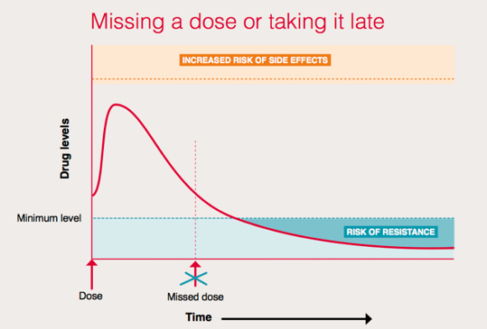
Drug levels, PK, adherence
Notes:
Missing or being late with a dose can let drugs levels drop.
Most meds are okay to take few hours early or late.
Most meds are also okay if you occasionally mis a day.
It probaby takes most people 1-2 weeks off-ART before becoming detectable.

Slide 7
When is resistance most likely to arise?
When ART is taken haphazardly, and virus is allowed to replicate in the presence of low-levels of ART
Resistance likely to impact drugs with low genetic barrier – i.e. drugs where one or two mutations will make them ineffective
NNRTIs (efavirenz, nevirapine, rilpivirine, etravirine)
First generation INSTIs (raltegravir, elvitegravir)
Most nucleos(t)ides
If drugs are stopped completely for periods of weeks – risks of resistance low UNLESS drugs with different half-lives

Slide 8
So what happens when ART is stopped completly?

Slide 9
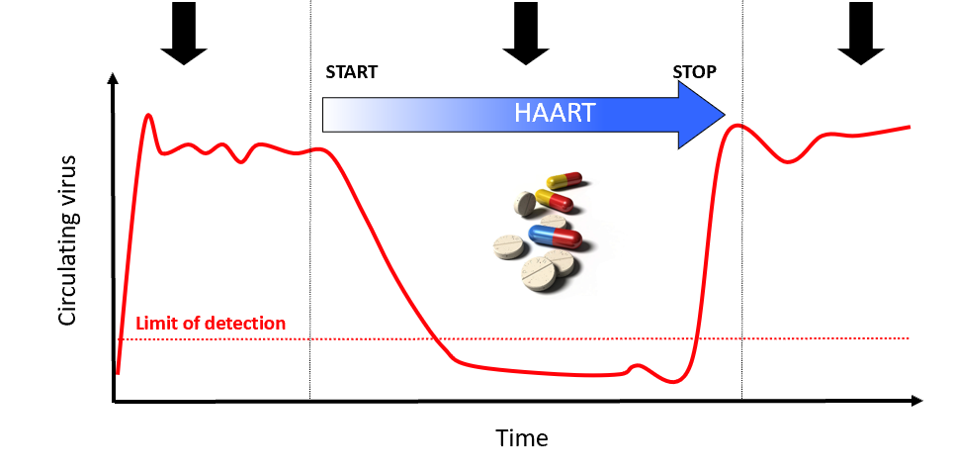
Current Medicines Do Not Eliminate HIV
HIV levels are high in untreated HIV infection
HIV medicines decrease HIV to “undetectable” levels
When HIV medicines are stopped, HIV “rebounds”
“Highly Active Antiretroviral Therapy”
WHY? Because HIV hides in a “reservoir” that is not cleared by HIV medicines
Notes:
HIV comes back quickly (“rebounds”) if we stop antiretroviral treatment
Even after years of being on antiviral therapy that keeps the virus at undetectable levels, we know if these medications are stopped that the virus rebounds quickly. This why we need a strategy to address the flaws in the thought that triple drug therapy alone would lead to a cure (the elimination of HIV from the body).
ART, however, does not eliminate the viruses that persist in the latent reservoirs. HIV remains “hidden” in these latent reservoirs and will rebound if ART if stopped. For these reasons ART is a lifelong therapy to keep the virus from rebounding and causing sickness. But, long term ART can lead to short-term and long-term toxicities and is very expensive. It is uncertain whether there will be sufficient resources on a global level to provide HIV treatment to everyone who needs it. So far, the world has fallen far short of this challenge. Furthermore, people living with HIV deserve a cure to keep themselves and partners safe and healthy.

Slide 10
Important short-term considerations and symptoms if ART stopped
Viral load increase for most people from week 2 onwards
Most will reach baseline viral load over a few weeks
Risk of onward transmission
Some might have rebounds higher than baseline
May be associated with symptoms for some people
Retroviral rebound syndrome – some manifestations can be severe
CD4 decreases a lot slower
However if starting from a low nadir CD4 count, there is a significant risk of opportunistic infections (especially not on prophylaxis) in the short-term

Slide 11
Medium-to-long term effects of ART interruption – insights from the SMART Trial

Slide 12
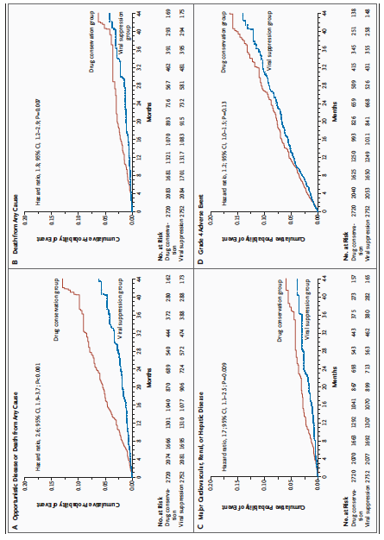

Slide 13
Other issues with ART interruption
Risk of death/opportunistic infections
Risk of cardiovascular (heart attacks/strokes/etc), renal disease and liver disease
Divergence of curves from 4 months onwards

Slide 14
Can we use intermittent therapy in an even smarter way?

Slide 15
Exploiting the pharmacokinetics and ‘forgiveness’ of modern ART
Modern ART regimens have relatively long half-lives (hence once daily dosing) – PK mostly worked through on the basis of Caucasian healthy volunteers
Viral rebounds take over seven days to manifest
Have high genetic barrier (second line INSTIs)
Can taking therapy 4/5 days a week work?

Slide 17
Before we look at the results, some important considerations on who was enrolled
647 people enrolled (randomized to intermittent vs. continuous ART)
On three drug regimen – 2 NRTIs + boosted-PI or NNRTI or INSTI
Stable regimen >4 months
HIV RNA <40 c/ml >12 months
Current CD4 >250
Excluded
Pregnant women
HBV co-infection
Those requiring immune suppression therapy
Those with kidney function impairment

Slide 18
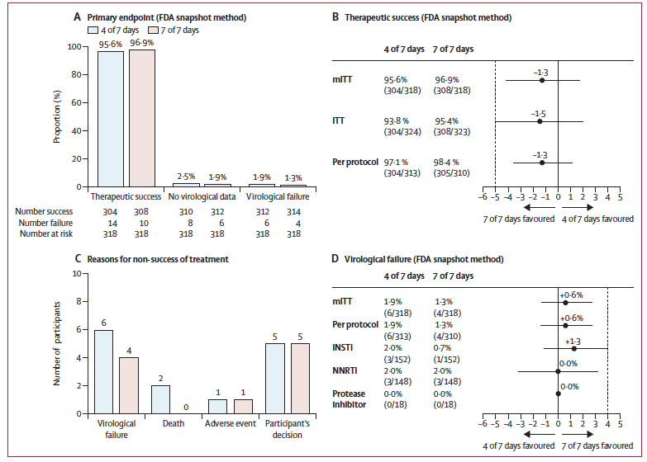
Virological Failure:
Occurred in 10 participants
Six in the intermittent group
Four in the continuous group
Almost ALL the failures were with
mutations in NRTI/NNRTI regions
With only ONE INSTI resistance (on raltegravir)
At 96 weeks no difference in viral reservoir or inflammatory markers

Slide 19
So what can we conclude about intermittent ART (4-days on/3-days off)
Probably ok and virologically safe in the short-term in people on second generation INSTI (dolutegravir/bictegravir – TLD, BTAF, etc) or boosted-PI three-drug regimens
May be problematic in people on NNRTI regimens

Slide 20
So, if absolutely necessary, who can turn to intermittent ART regimen in the short-term
CD4 count >250, HIV RNA undetectable >12 months
On a three-drug regimen with INSTI or bPI
Other cohort and single-arm studies have looked at this too

Slide 21
Who shouldn’t consider intermittent ART
Pregnant women
People with HIV/HBV co-infection (although some recent data to suggest that this may be ok too)
No data in people with CD4 counts <250

Slide 22
What about interruption of OI prophylaxis/OI treatment/pre-emptive treatment?
Primary prophylaxis for PCP
Probably low(er) risk if interrupted
TB chemoprophylaxis
Probably low(er) risk if interrupted
Pre-emptive treatment for cryptococcosis
Moderate risk – careful monitoring required
TB treatment
High risk of disease progression
Histoplasmisis, talaromyces, cryptococcal meningitis treatment and secondary prophylaxis
High risk of disease progression and recrudescence

Slide 23
Some final thoughts:
These are tough times
ART is life-saving and life-sustaining
Short-term complete interruption may be tolerated by many, especially with nadir CD4 >350
Not for pregnant women
Intermittent (4/5 days on, 3/2 days off) ART may be feasible for some
Not for pregnant women, HBV/HIV co-infection
Probably not for CD4 <250
Treatment for TB, histoplasmosis, talromyces, cryptococcal meningitis must continue uninterrupted

Slide 24
Acknowledgments
Simon Collins and Tracy Swan for useful discussions and slides

