Slide 1
ITPC Workshop at AIDS 2026
Behind the Jargon: community trial design: your questions answered…
AIDS 2026, Rio de Janeiro, July 2025
Detrich Peeler ITPC,
Tracy Swan, Independent consultant, Barcelona
Simon Collins, i-Base.info
Notes:
Thank you for the chance to talk.
This is a really dynamic part of research

Slide 2
Q&A workshop
Every study tells a story.
Ie: does a new HIV drug work
But who is included and who is left out,
what information is missing, and what questions to ask?
Notes:
Every study at AIDS 2026 tells a story.
Start with an idea and then test whether it works: scientific, social and ethical overlap.
Identify the roles of people living with HIV, and other community stakeholders in study design.

Slide 3
?
What questions do you have about research that have not been answered?
?
?

Slide 4
Examples
• Do we still need new HIV drugs?
• Are placebo studies still needed?
• How is the size of a study worked out?
• What is are phase 1, 2, 3 and 4 studies?
• What is the best combination?
• What is the difference between prospective and retrospective studies.
• When are cross-sectional studies needed?
• How do we know about drug interactions between ART and illegal drugs?
• Who should be included in studies: ages? Health history? need for treatment/insurance?

Slide 5
Key types of research
Experimental vs observational
Cross-sectional vs longitudinal
Prospective vs retrospective

Slide 6
Why randomize?
SMART study showed risk of being off ART
START study showed benefit of ART even at high CD4 counts

Slide 7
Why control arms?
Active vs placebo controls?

Slide 8
Phase studies for new drugs
Pre-clinical: lab and animal studies
Phase 1: first in human – safety 10-20 people
Phase 2: proof of concept and activity 100-300
Phase 3: large registrational studies 500-5000
Phase 4: post approval safety varies

Slide 9
Ethical example 1: interventional study
Trial design when there is high need or demand for a drug or treatment: ie for PrEP, or weight loss drugs?
Who gets access?
Is a placebo ethical?
What happens at the end of the study?
Is it ethical to stop a drug if benefits reverse?
Access, approval, pricing

Slide 10
Ethical example 2: cure study
• ART is currently safe and effective.
• Cure interventions might have side effects and risks
• Need to interrupt or stop ART
• People enroll with optimism even when no benefit.
“But I might be the one who is lucky”
Some people want to actively help science as a way to give something back – but risks need to also be clear.
Notes:
Luckily, altruism for science and the future often still a main reason to join studies.
But also still an imbalance with expectations.
At one of the pre-CROI or IAS cure meetings - maybe 150 delegtes - this issue of disconnect was discussed in detail.
And someone still stood up and saids :yes, but I might be the one who is luckly:.
Does informed consent say 10% chance of taking >12 weeks to resuppress?

Slide 11
Ethical, social and access
Ethical issues?
Social issues?
Access issues?
Hope? Truth? Reality? Funding?
Who asked the questions? Why?
Timeline between an idea or discovery and reaching clinical practice.
Notes:
Iit would be good to get a few ideas – which are tricky at first

Slide 12
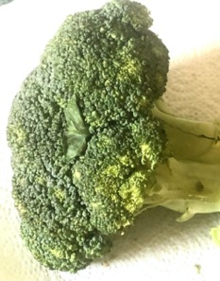
Results and telling the story
Statistical significance and spin
Absolute vs relative changes
Drug X reduced risk of diabetes by 50%.
Original risk might only be 1 in 1000.
Will 2 in 1000 make any real difference?
Question who? Over what time? Where?

Slide 13
Community roles
Ask the first questions – demand the research.
Advise – bring wider community views – is this an important question? will people enroll?
Help design the study. Include community representation.
Write participant information: language and ethics?
Publicise in the community to help enroll.
Join steering, management committee or DSMB.
Help with publications and presenting results.
Report results to participants and wider community.

Slide 14
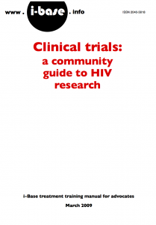
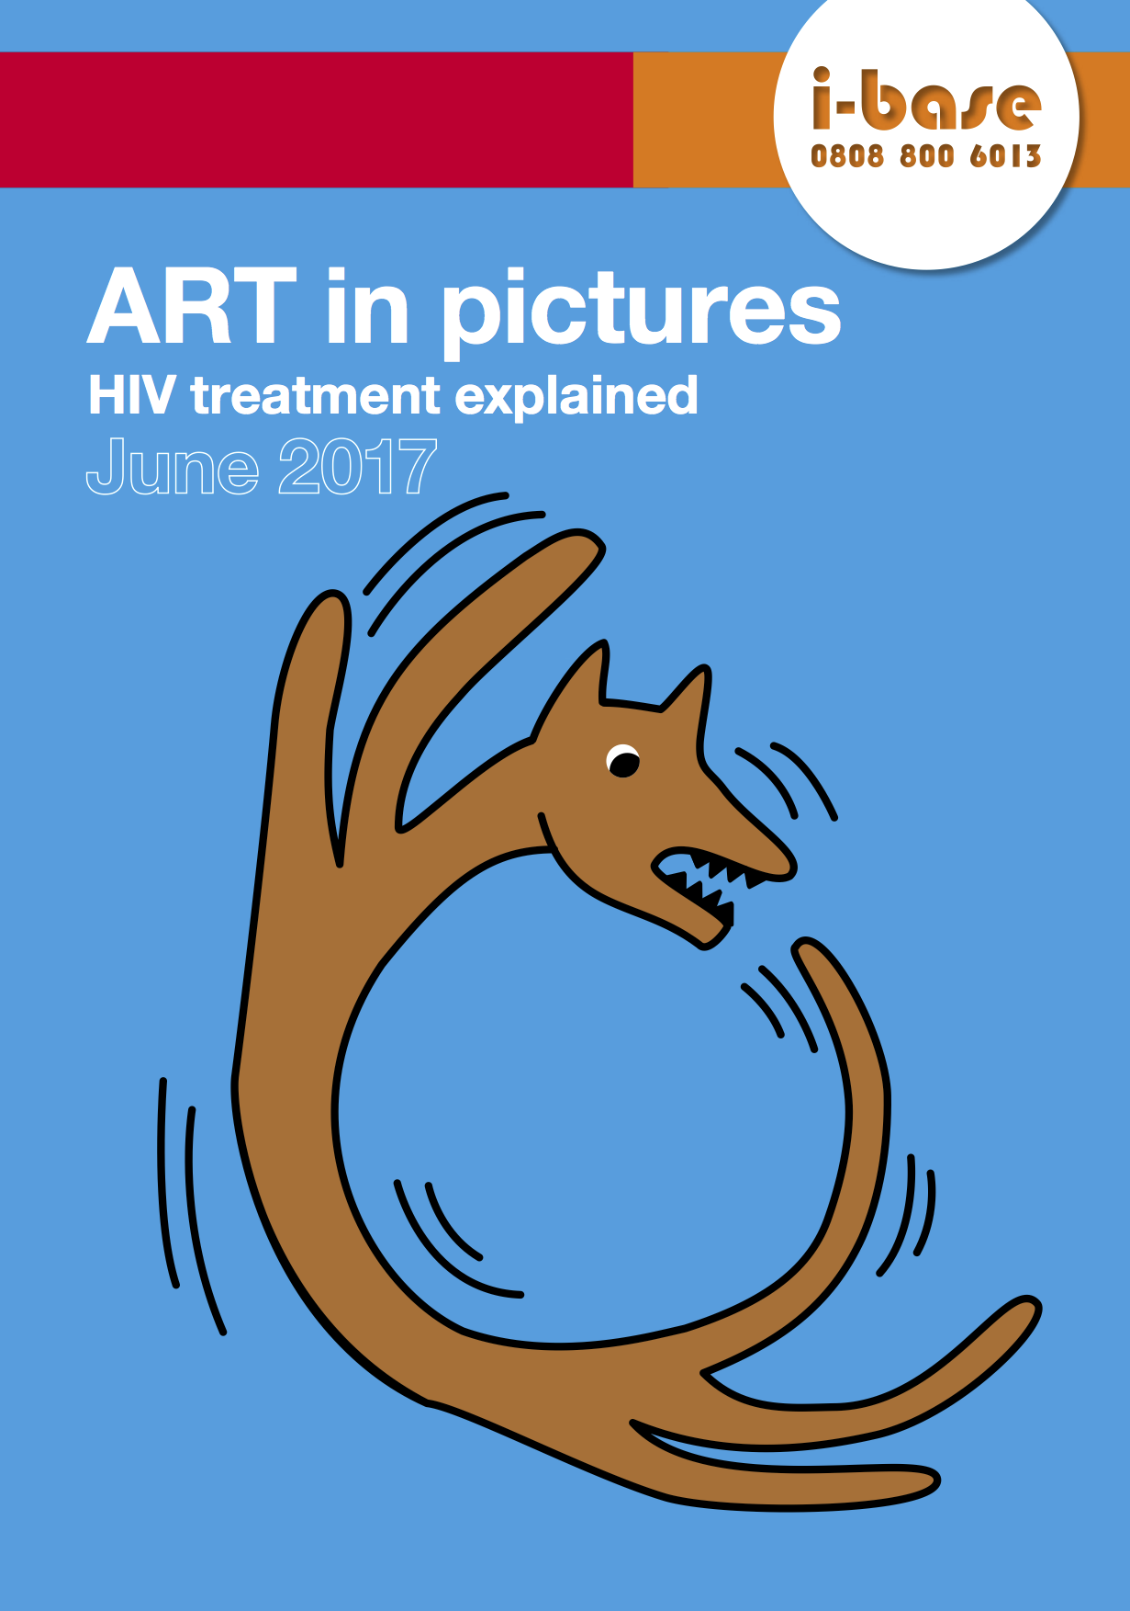
Further info
Clinical trials and research: an HIV community guide (2023)
https://i-base.info/clinical-trials-community-guide-to-hiv-research
ART in pictures
https://i-base.info/guides/art-in-pictures

Slide 15
Back-up slides
simon.collins@i-base.org.uk

Slide 16
?
Wny science?
Evidence vs opinion
Essential
Question everything
Design repeatable studies…
Recognise reliable sources - for how science is reported.
Reference the evidence for what you say.
Notes:
This is central to everything we will talk about
– Question everything
– Understand the different between evidence and opinion
– Recognise reliable sources
– Reference the evidence for what you say.

Slide 17

Wny science?
The scientific approach to understanding the world usually involves three stages.
Observe something.
Question why - a hypothesis.
Run an experiment to test this idea.

Slide 18
Why community? (with our many demands)
Advocacy, education and engagement.
Overcome complex and difficult science.
Cure provides hope for the future.
Ie - cure is an easy concept: but absence of virus? Or clinic visits, or meds, or risk to partners or stigma? [1]
Language?
Ethics?
Safety?
1. Verdult F. Community survey on HIV cure. IAS 2012, Washington.
Notes:
Why community?
Why complicate your research, and your science and your research grants?
With our comments on trial design, and safety, and ethics, and on simple language etc????
As someone involved in advocacy I am always trying to encourage closer links between research and community.
To help those of use living with HIV to understand this aspect of our health, especially looking to options in the future.
On the one hand cure is an easy concept. – For a virus it means elimination – but in practice doesn’t need to be this - might be an absence or treatment, or risk, or stigma.
Most of us don’t have a scientific or medical background and yet cure-related research is some of the most difficult and technical – but people living with HIV definitely hope for a cure.

Slide 19
Behind the Jargon: 10 Keys to Understanding HIV Drug Development for Communities
D. Peeler1, S. Collins2, T. Swan3
1ITPC, IP and Access to Medicines Program, Johannesburg, South Africa, 2I-base, Founder, London, United Kingdom, 3Indepedent Consultant, Barcelona, Spain
Learning objectives and outcomes: Experienced HIV treatment activists will uncover key information from clinical trials, including stages of development, trial designs and objectives, and the terms that describe them; using 10 real-life examples and providing on-line resources. This information will enable participants to engage with research, ask the right questions, and quickly find the information that matters to them. This lively, interactive workshop will support community members to identify, understand and analyze relevant information from clinical trials, conference presentations, abstracts and posters, peer-reviewed journal articles and press releases, complementing and supporting work on HIV treatment literacy and access to medicines. Short description for the programme: Participants will learn to cut through technical jargon to find the story behind clinical trials: who was included and who was left out, what information is missing, and what questions to ask. This workshop offers the key to understanding drug development and interpreting results from clinical trials to a new generation of HIV treatment activists - information that can be used for individual and public health advocacy. Using 10 real-life examples, this interactive workshop will help participants feel more confident to engage in treatment literacy, and work on access to, demand creation for, and uptake of new ARVs.
Format: Mostly activities for the participants: PowerPoint presentation to take less than 50% of the duration of the workshop.
Active learning: During the workshop, the facilitators will present 10-real life examples from clinical trials, will actively soliciting questions from participants and engage participants in discussion by posing questions (when do we learn what we need to know about an ARV? Which experts are involved in trial design and what have they been wrong about? Why are ARVs approved only for certain uses, such as switching treatment or PrEP? What information, or group of people, is missing from a trial - and what are the potential consequences? What is the difference between information from a press release and a journal article?).

Slide 20
Advocacy roles?
Source of accurate information?
Balance hopes with reality of research.
Balance risks with limited likely benefit.
To make sure research is as safe as possible.
To help with informed consent.
To help explain the results.
Notes:
Iit would be good to get a few ideas – which are tricky at first

Slide 21
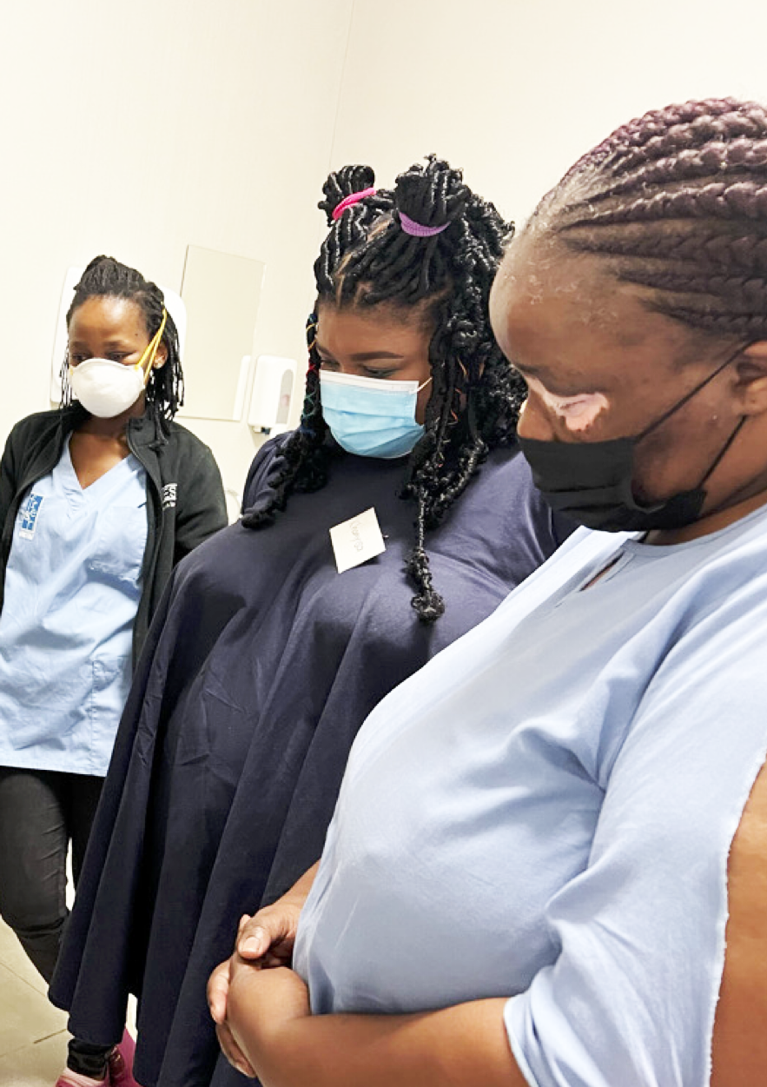
Recent results with bNAbs
Two recent studies (FRESH and RIO) using immune-based treatment (bNAbs) kept viral load undetectable for 6, 12, 18, 24 months without ART.
How many people? which countries? which treatment? what is the cost?
In the randomised RIO study some of these people were in the placebo arm.
CROI 2025, San Francisco.- oral abstracts 107 and 106
Notes:
Iit would be good to get a few ideas – which are tricky at first

Slide 22
FRESH and RIO studies
Both studies enrolled participants who were diagnosed and use ART very early in acute HIV. Needed high CD4 (>500) and undetectable for at least 1 year,
 | FRESH (single arm) | RIO (randomised placebo)
Country | South Africa | UK
N | 20 women, subtype C | 68 men, subtype B
Treatment | 2 x bNAbs + TLR7 | 2 x bNAbs vs placebo
Off-ART wk 48 | 6/30 | 22/34 vs 2/34
Still off ART + comment | 4/30 (for 1.2 to 3.4 yrs) inc 1 with VL >100,000 | 6/68 inc 2 participants in the placebo arm
CROI 2025, San Francisco.- oral abstracts 107 and 105
Notes:
Iit would be good to get a few ideas – which are tricky at first

Slide 23
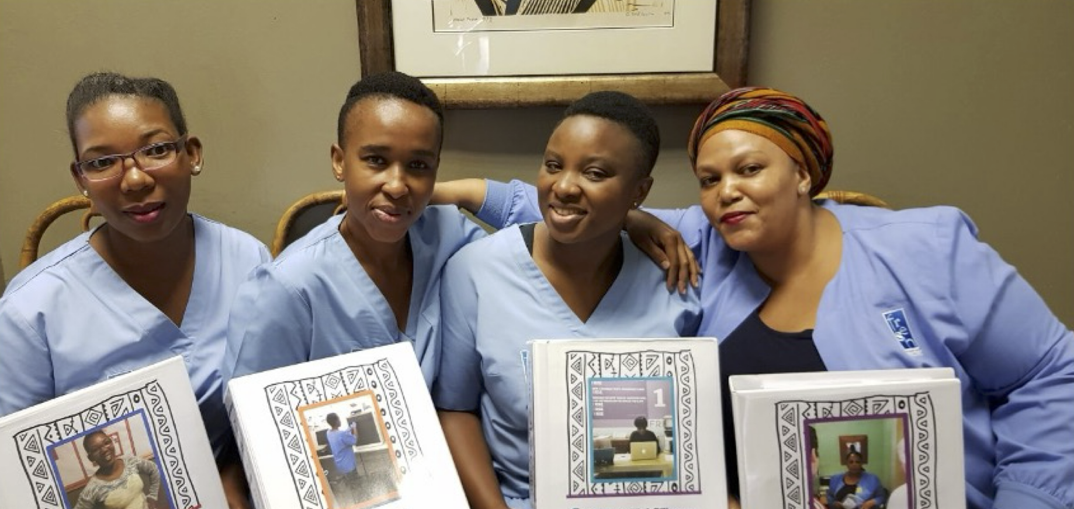
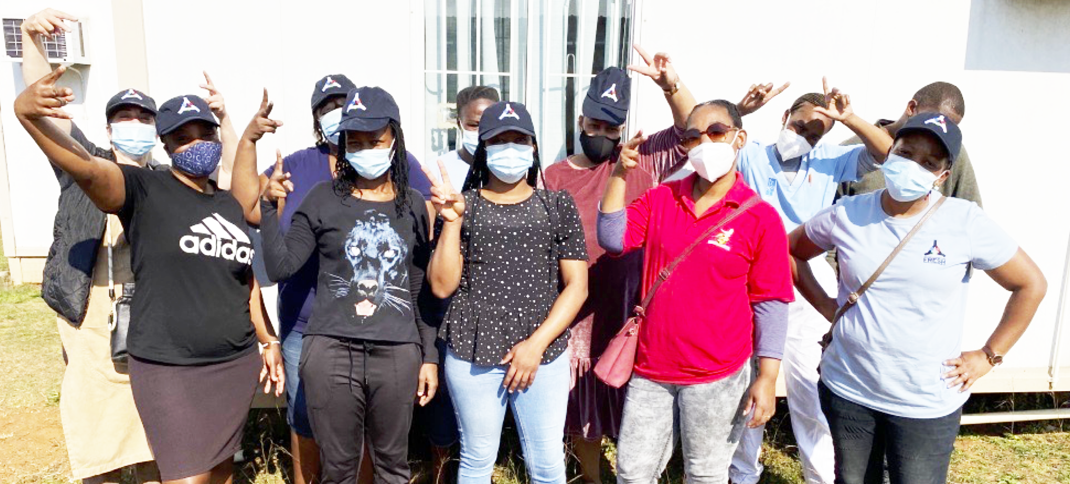
Advocacy roles in FRESH
Explaining study
• Single arm vs randomised etc
• Explaining ATIs and safety for partners.
• Peer support.
Community responses to results:
• Why have you been hiding this cure (timeline for research)?
• Why were there no men involved.?
• Can we get this cure now?
Krista Dong, FRESH Cohort
Notes:
Iit would be good to get a few ideas – which are tricky at first

Slide 24
Disclaimer
I am 65, HIV+ treatment activist with HIV i-Base in London.
I started ART in 1996 with a CD4 count of 2, have been undetectable since then, with good access to treatment and monitoring.
I need to take other meds so ART is easy for me.
Notes:
Appreciate the ethical, social, and access considerations in HIV cure research, especially
for communities.
Identify the role of PLHIV, adolescents, and community stakeholders in HIV cure-related advocacy and trial preparedness.

