Slide 1
National conference of people living with HIV: 13 June 2026
Treatment update and Q&A
Are treatment issues still important for HIV?
Angelina Namiba, 4MMM network
Simon Collins, i-Base.info
?
?
?
Notes:
Thank you for the chance to talk.
This talk is about an important aspect of research.
The reason many studies finish early is because the results are netter ot worse than expected.
These studies show wht

Slide 2

Source: Wikipedia
Notes:
I was asked to talk about unethical studies, so here are a few examples.
Most of the talk though will be more positive – about where assumptions were wrong – when good researchers were trying hard to design good studies.

Slide 3
Introductions (10 mins)
Do we need a treatment update? (5 mins)
Research examples (20 mins)
Q&A session – your questions (40 mins)
Notes:
I was asked to talk about unethical studies, so here are a few examples.
Most of the talk though will be more positive – about where assumptions were wrong – when good researchers were trying hard to design good studies.

Slide 4
?
• Do we still need to know about science and treatment literacy?
• Is everything sorted with one pill a day or shots every two months?
• Is everything now just about access to ART and psychological issues/support?
?
?
Notes:
I was asked to talk about unethical studies, so here are a few examples.
Most of the talk though will be more positive – about where assumptions were wrong – when good researchers were trying hard to design good studies.

Slide 5
?
Key areas for Qs
?
New ART and PrEP
Side effects
Cure-related research
HIV and ageing
Inflammation
Body changes and weight
Menopause
Chemsex, alcohol, smoking
Low level viral load (LLV)
Complications: cancer, heart disease, stroke
Memory loss, Alzheimer’s, Parkinsons, independent living.
HIV and sleep (EACS guidelines).
?
Notes:
Every study starts with an idea, which is then turned into a question.
It also involves which one aspect of the study results would be used to prove the idea.
This is called the primary endpoint.

Slide 6
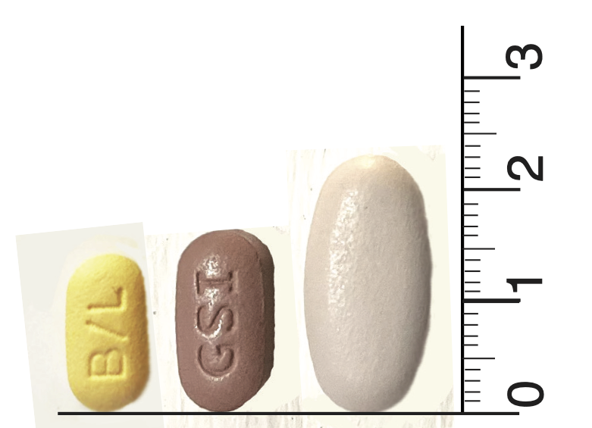
1. New drugs
Do we need better meds?
Better daily options?
Longer-acting ART?
  oral weekly pills
  3/4/6-monthly injections.
PrEP pipeline?
  one pill a month – MK-8527 (alimatrevir)
  annual injections (lenacapavir, LEN)
Pharmacology of long-acting ART and PrEP
  How long do the drugs stay in our bodies
  What about missed doses?
  Drug interactions and drug resistance: 57 contraindicated drugs for lenacapavir and more than 170 cautions about potential interactions.
  https://i-base.info/htb/53854
cms
BIC/LEN, Biktarvy, Triumeq
Notes:
Do we need new drugs and better durgs?
For people with complex combinations?
For everyone starting or switching
Long-acting ART and PrEP timelines include 6 monthly and 12 monthly

Slide 7
Daily oral BIC/LEN for complex Ph3 week 48
DOR/ISL US approval April 2026
Weekly oral ISL/LEN Ph3 week 48
ISL/ULO (islatravir+ulonivirine) Early phase
4 monthly inject bNAb lotivibart (N6LS)
4 mo. cabotegravir
6 monthly inject bNAbs (TAB+ZAB) + LEN Phase 2
6 monthly inject GS-3242 integrase Phase 2 (with LEN)
1,2,4,6 monthly VH-184 integrase Phase 2
6 monthly VH-499 capsid Phase 2
PrEP monthly oral MK-8527 (alimatrevir) Phase 3
PrEP annual injections lenacapavir (LEN) Phase 2

Slide 8
2. Cure-related research
How important is a cure?
For a few people, some people or all people?
Priority for children or oldest?
How relatively important?
Exciting results with bNAbs – but need a sensitivity test first and need better bNAbs.

Slide 9
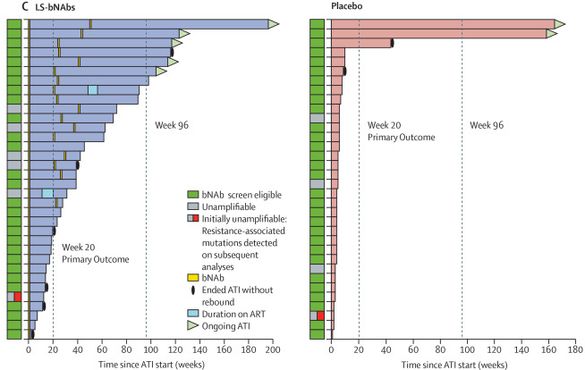
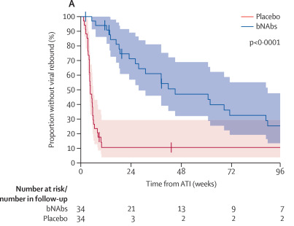
2. Cure-related research
RIO study – UK (n=68): after 2 years 7 vs 2 have undetectable VL
Lee M et al, Lancet HIV, May 2026

Slide 10
?
3. HIV and ageing
?
Do we age faster and/or with more symptoms?
Residual inflammation on ART?
Impact of HIV history before ART? Longer off-ART before starting treatment might increase all risks – therefore earlier diagnosis helps. >40% still diagnosed late.
Risk of heart disease, stroke and some cancers.
Menopause.
Neurological concerns: Memory, Alzheimer’s, Parkinson’s.
Independent living…
?

Slide 11
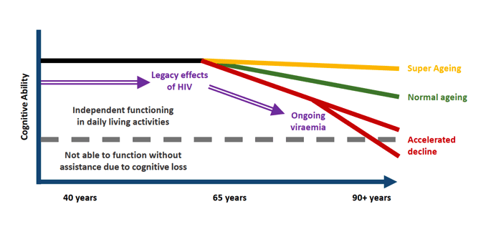
Aceelerated ageing?
Winston A et al. UK-CAB talk

Slide 12
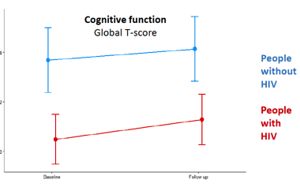
HIV and brain ageing
Neurological ageing in UK Poppy Study had same average slope of decline with or without HIV in closely matched groups, although function was lower in people with HIV.
Winston A et al. Poppy Study.

Slide 13
4. HIV and sleep
An approach to quality of life,
New section in EACS guidelines (2025)
In addition to lifestyle-related and environmental factors your doctor can run three simple tests to see whether a referral is important.

Slide 14
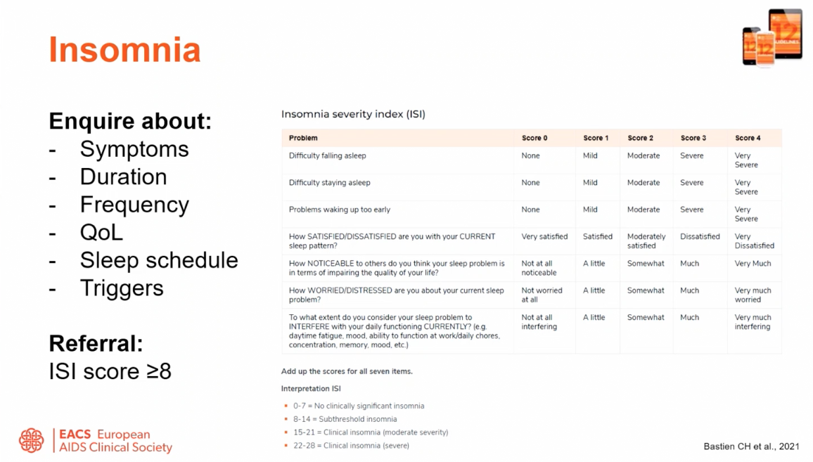
EACS guidelines 2025
Insomnia score

Slide 15
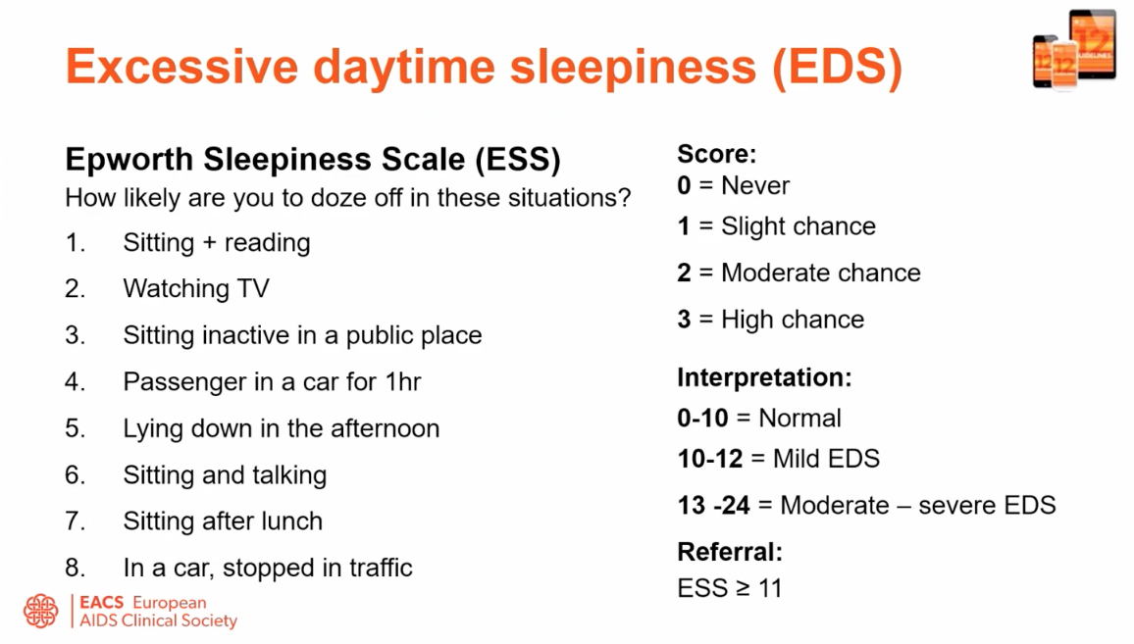
EACS guidelines 2025
Daytime sleepiness

Slide 16
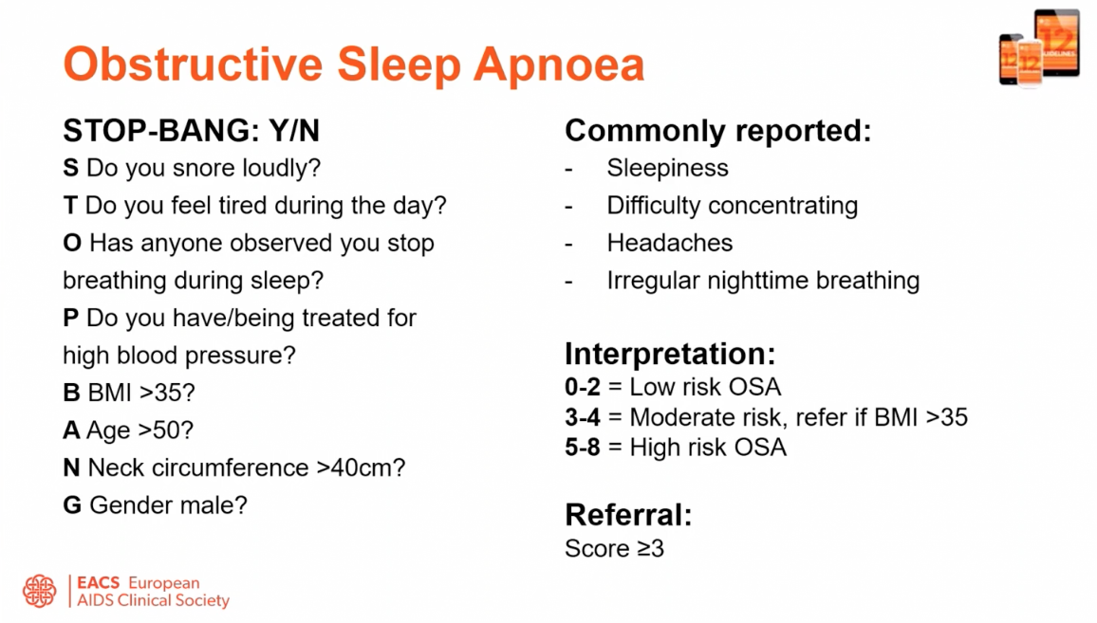
EACS guidelines 2025
Obstructive sleep apnea

Slide 17
5. Life issues and services
HIV and chemsex – lack of data, developing services, could GLP-1 drugs help?
Workshop at BHIVA/BASHH included 25% of A&E admissions were people with HIV, half had stopped ART (VL = 250,000)
Alcohol in moderation
Cigarettes have disproportionate impact on people with HIV
Statins reduce heart attack and stroke – why the caution?

Slide 18
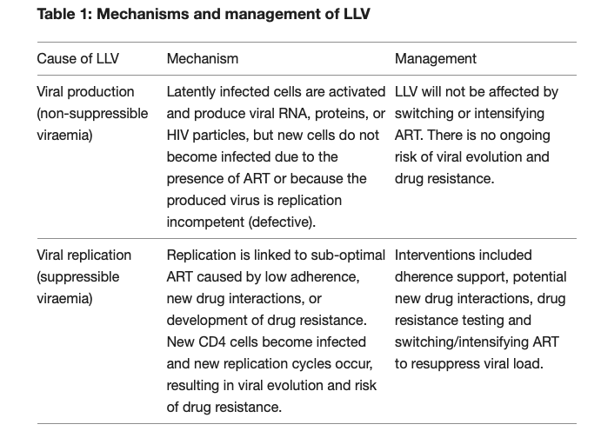
6. Low level viral load
Low-level viral load and unexplained viral rebound?
What if your doctor doesn’t believe that you are adherent?
Consensus guidelines on LLV. Lancet HIV. June 2026.
Notes:
Every study starts with an idea, which is then turned into a question.
It also involves which one aspect of the study results would be used to prove the idea.
This is called the primary endpoint.

Slide 19
Summary
ART gives us a chance to live longer.
Quality of life includes both medical and social issues.
Shorter times with our doctors needs planning.
Make sure you are getting latest information and advice: ask for second opinion.
Notes:
First – some very

Slide 20
Thanks
anamiba15@gmail.com
simon.collins@i-base.org.uk

Slide 21
i-Base Q&A service
www.i-Base.info
by email and online

