Slide 1



UK-CAB – August 2026
Feedback from AIDS 2026 conference
Simon Collins, i-Base.info
Notes:
Thank you for the chance to talk.
This is a really dynamic part of research

Slide 2
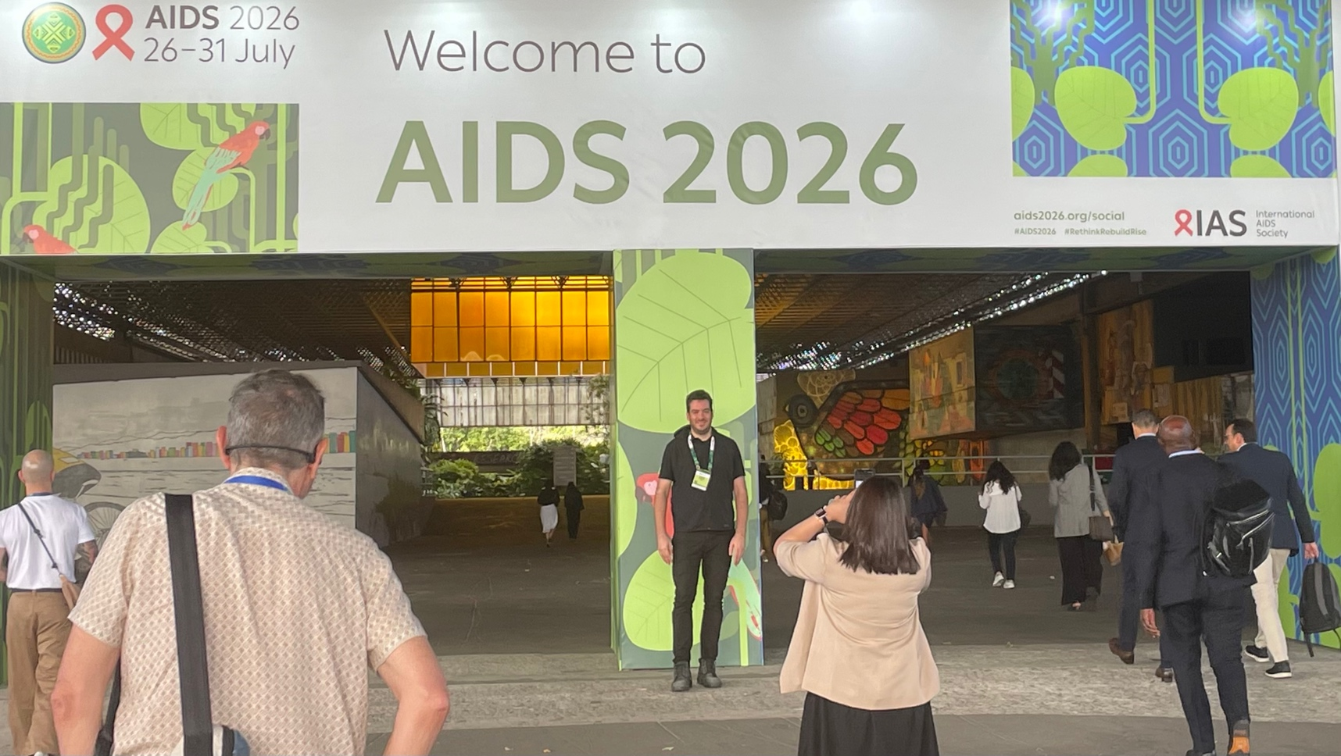

Slide 3

AIDS 2026:
7500 delegates, 700 scholarships.
Abstracts and programme online
https://programme.aids2026.org
Opening ceremony
https://www.youtube.com/live/Xfgnx-s0woY
Rapporteur summaries
https://www.youtube.com/live/_DwcVL8-DmA

Slide 4
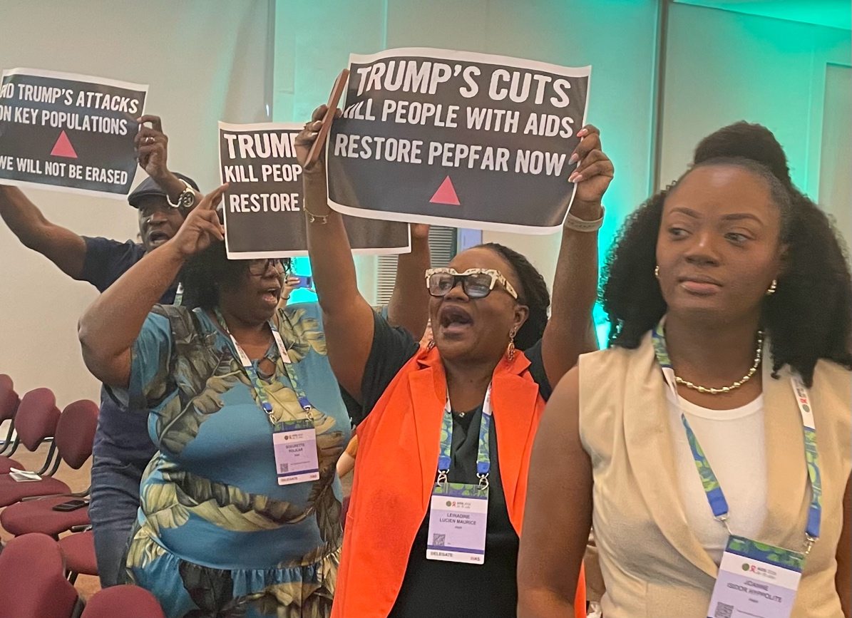
AIDS 2026: #Rethink, Rebuild and Rise

Slide 5
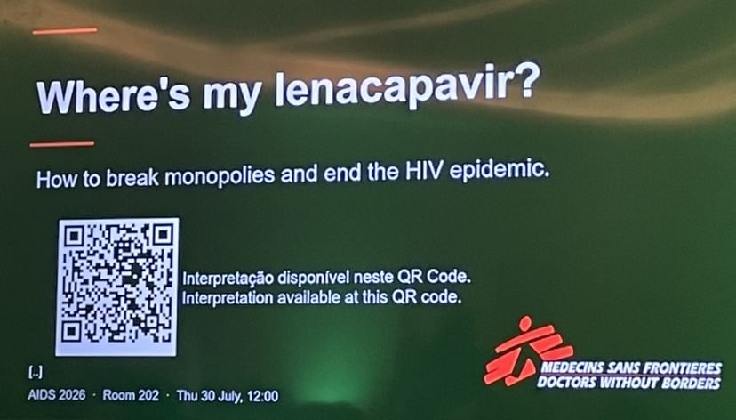
AIDS 2026: #Rethink, Rebuild and Rise

Slide 6
AIDS 2026: #Rethink, Rebuild and Rise
Six overlapping themes
Global funding crisis.
New ART pipeline.
Long-acting PrEP.
Advanced HIV, ageing
Cure-related research.
Community activism.
Notes:
Six themes – all connected and overlapping

Slide 7
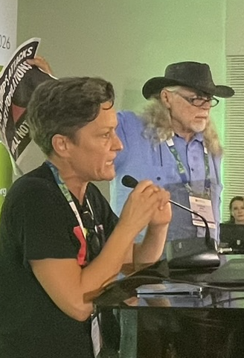
1. Global Access
"We gather in the shadow of decisions made by a few and felt by too many in communities and clinics across the planet ... increasing hostility to communities".
- Beatriz Grinsztein, IAS President, opening ceremony.
• High profile to funding and access.
• PEPFAR satellite meeting.
• PEPFAR data – closing 1700 community clinics and changing funded programmes.
• Some countries have no condoms, lube or PrEP.

Slide 8
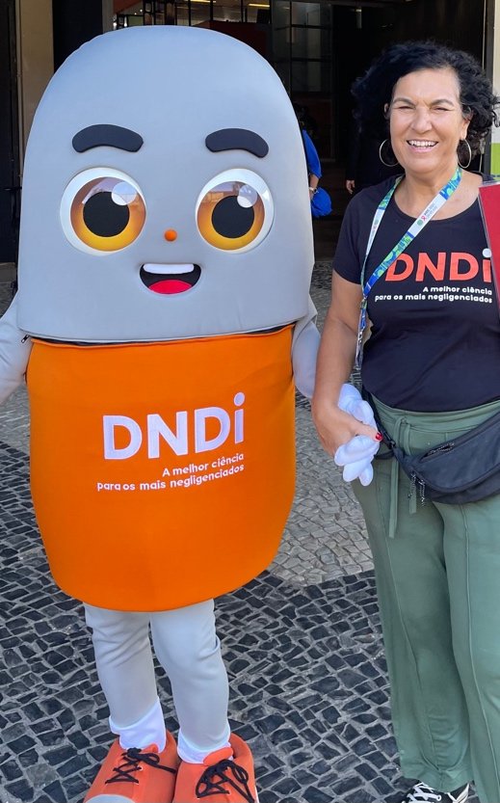
2. New ART pipeline
• Once-weekly ISL/LEN: ISLEND-1 and -2.
• Once-weekly ISL/ULO (ulonivirine)
• 6-monthly LEN + 2bNAbs – phase 2 104 week – now phase 3 – Gilead.
• CAB-LA + lotivibart (N6LS) - ViiV
• Plenary talk by Monica Gandhi: ACCESS
Including to LEN + CAB-LA.
Also: CAB/RPV with VL >50 copies/mL

Slide 9

3. Long-Acting PrEP
• PURPOSE-1 and -2 OLE studies: Continued high efficacy, high demand, low access.
“It is not right that the whole continent is excluded” – MSF symposium.
• LEN access excludes Latin America.
• Challenge for Brazil to manufacture?
• Will alimatravir (MK-8527) be different: licenses signed with 7 generic companies (3 in Africa).
• Agreement with Brazilian MoH – for continent?
• Once-monthly for <US$15

Slide 10
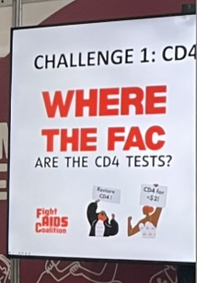
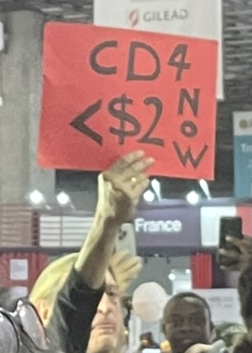
4. Advanced HIV, ageing
• Late diagnosis common (50%)
• Funding crises restricting care:
- No CD4 tests, cotrimoxazole or fluconazole prophylaxis in some LMICs.
- No access to CAB-LA or LEN for treatment or research.
• LANCET commission on HIV and ageing: a global perspective.
The Lancet HIV Vol13, No. 8e569-e610.
https://www.youtube.com/watch?v=WHhBYh1zKMI

Slide 11
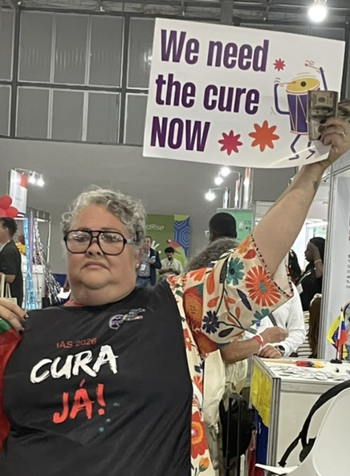
5. HIV-related cure
"América Latina por la cura"
• IAS satellite: Equity of global cure research
• Michel Nussensweig: bNAbs –
new data supports use in chronic infection.
• Sarah Fidler: Q&A panel on cure advances
• 4 talks (2 from the UK) on novel approaches including CAR-T cell studies.
• 2 new stem-cell transplant cures

Slide 12
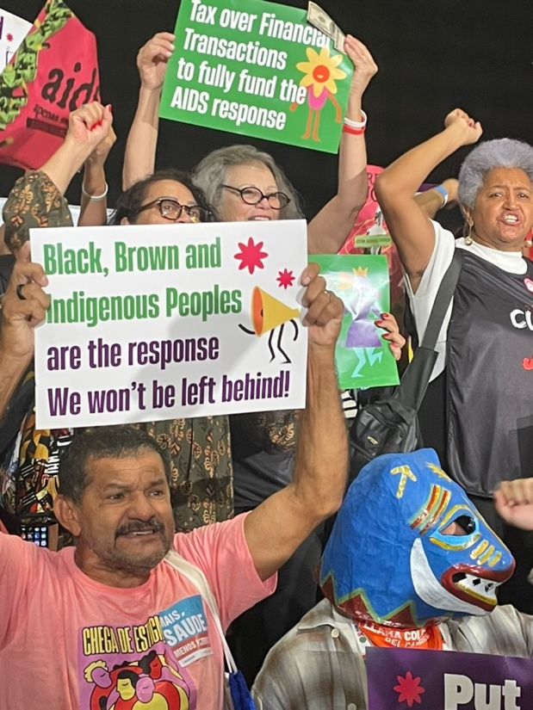
AIDS 2026: #Rethink, Rebuild and Rise
6. Community activism.
Quebra de patente já
(break the patents)
100s of exhibition stands in Global Village.
Community HIV+ leaders as key speakers. (see opening and closing).
All key populations.
Notes:
Six themes – all connected and overlapping

Slide 13

Once-weekly ISL/LEN phase 3 studies
Rockstroh JK et al.
Late-breaking oral abstract OAB1406LB.

Slide 14
Once-weekly ISL/LEN phase 3 studies
Rockstroh JK et al. Once-weekly oral islatravir/lenacapavir (ISL/LEN) versus daily bictegravir/emtricitabine/tenofovir alafenamide (B/F/TAF) in virologically suppressed adults with HIV-1: Week 48 results of the ISLEND-1 phase 3 trial. Late-breaking oral abstract OAB1406LB.
https://programme.aids2026.org/Abstract/Abstract/?abstractid=12349
Colson AE et al. Once-weekly oral islatravir/lenacapavir (ISL/LEN) versus daily standard-of-care therapy in virologically suppressed adults with HIV-1: week 48 results of the ISLEND-2 phase 3 trial. Late breaking oral abstract OAX1106LB.
https://programme.aids2026.org/Abstract/Abstract/?abstractid=12363
Rockstroh JK et al for the ISLEND-1 Study Team. Phase 3 Trial of Weekly Oral Islatravir–Lenacapavir for HIV-1 Treatment, for the ISLEND-1 NEJM. DOI: 10.1056/NEJMoa2607973. (29 July 2026).
https://www.nejm.org/doi/full/10.1056/NEJMoa2607973

Slide 15
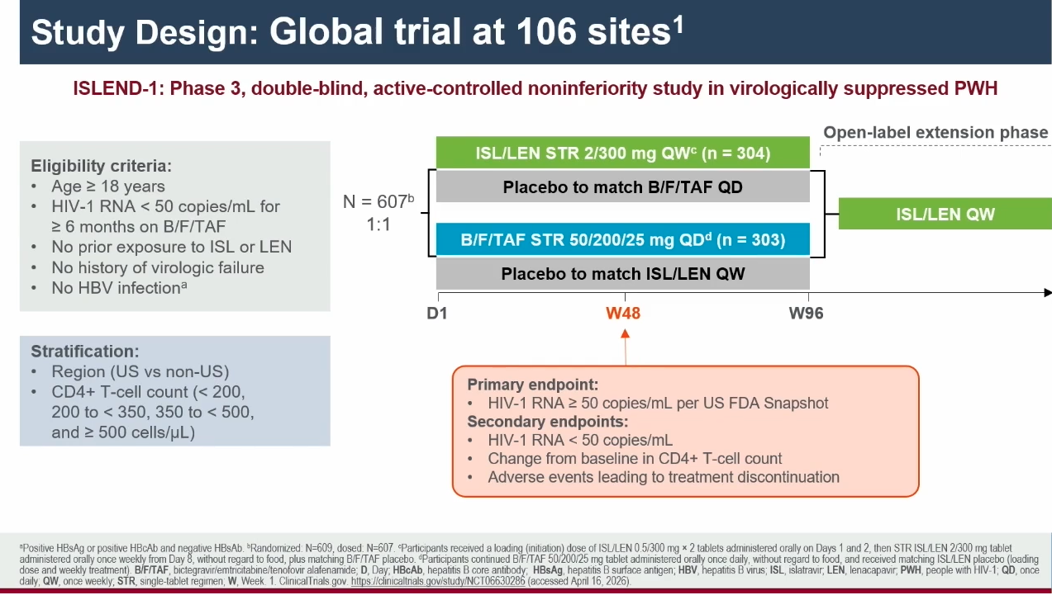
Rockstroh JK et al. OAB1406LB.

Slide 16
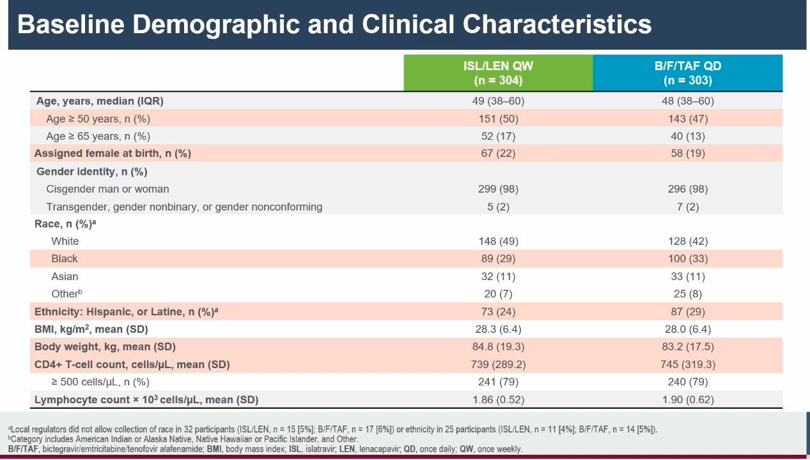
Rockstroh JK et al. OAB1406LB.

Slide 17
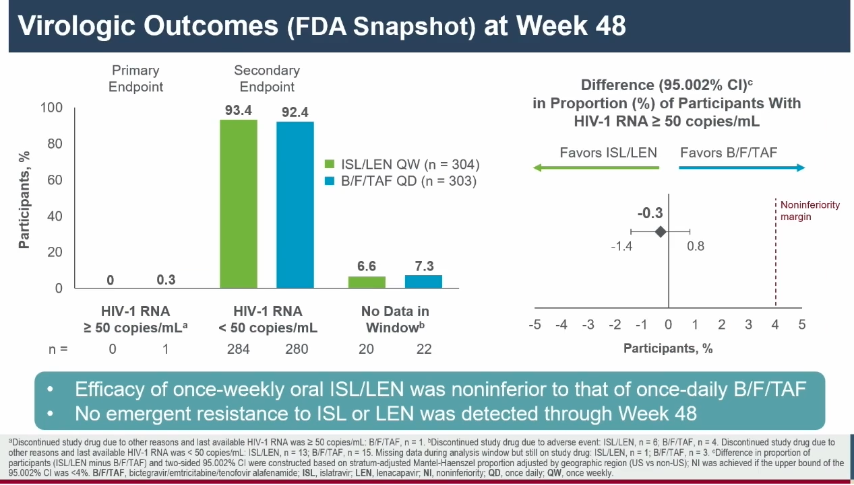
Rockstroh JK et al. OAB1406LB.

Slide 18
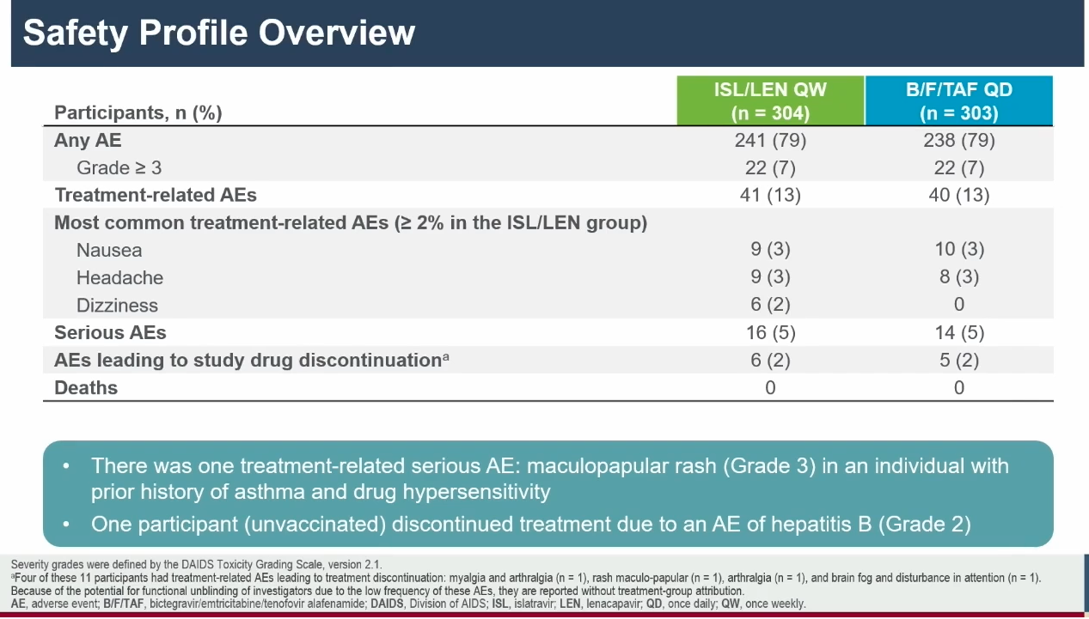
Rockstroh JK et al. OAB1406LB.

Slide 19

Once-monthly oral PrEP for $US 3/year
Cross S et al. MK-8527: mass production for US $15/year as PrEP. Oral abstract OAE0504.
https://programme.aids2026.org/Abstract/Abstract/?abstractid=4194

Slide 20

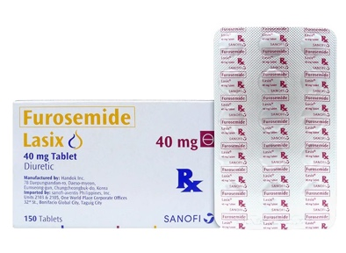
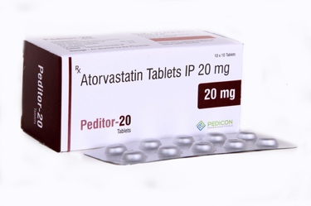
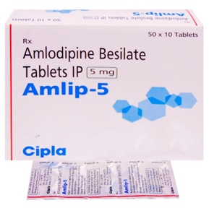
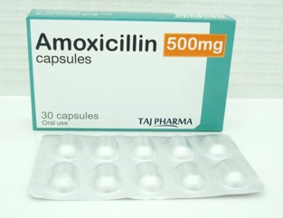
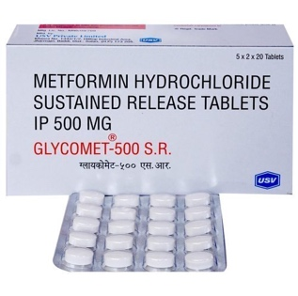
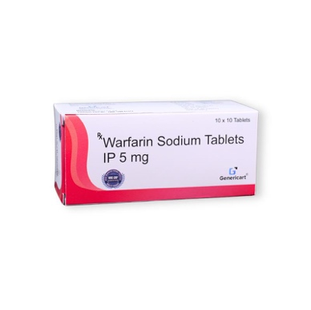
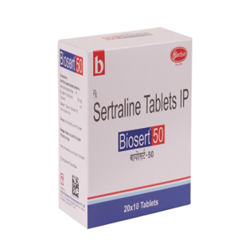
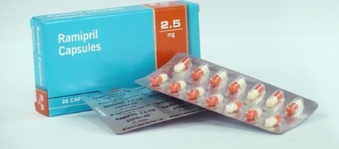
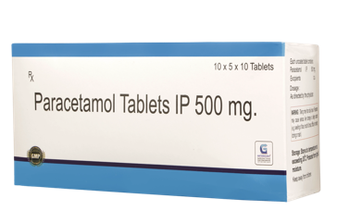
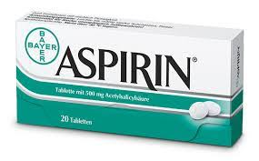
Cross S et al. Oral abstract OAE0504
UK National Health Service: prices for cheap generics: < $1
28 Tablets = $0.29
21 Tablets = $0.97
28 Tablets = $0.61
28 Tablets = $0.64
28 Tablets = $0.27
28 Tablets = $0.63
28 Tablets = $0.79
28 Tablets = $0.45
32 Tablets = $0.57
28 Tablets = $0.57
https://www.gov.uk/government/publications/drugs-and-pharmaceutical-electronic-market-information-emit

Slide 21

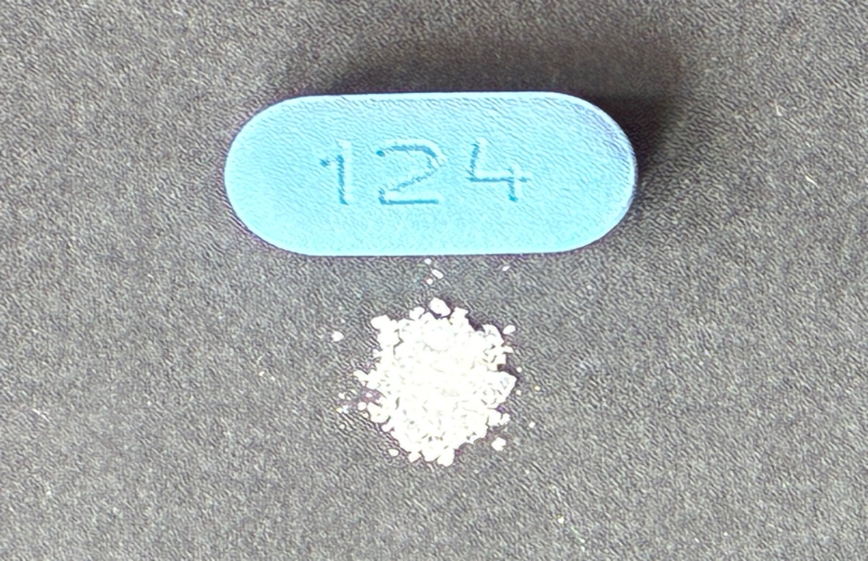
Cross S et al. Oral abstract OAE0504
TDF/FTC – 500 mg/day
Alimatrevir -132 mg/year
Slide: Samuel Cross et al.

Slide 22

Cross S et al. Oral abstract OAE0504
Results: Estimated cost of production
1
2
3
Annual API Cost
Formulation and Logistics
Profit and Taxation
Weighted mean API cost = $9,138/kg
Formulation ($0.01), packaging ($0.10), excipients,
5% API loss ($0.28ppy)
Transportation, tariffs and labour (21%)
Profit 30%
Taxation 27% (Standard Indian tax rates for generic suppliers)
x
Annual API dose
11mg once monthly =132mg ppy
$1.21ppy
$1.80ppy
$2.49ppy

Slide 23
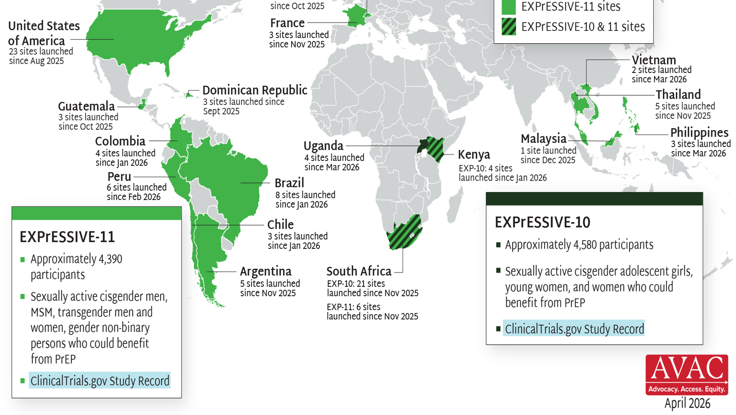
EXPrESSIVE Phase III Program Countries of MK-8527
17 countries hosting sites for Phase 3 studies:
EXPrESSIVE-11 (launched Aug 2025) and EXPrESSIVE-10 (launched Nov 2025)
$180 million funding from Gates Foundation
Slide: Samuel Cross et al.
AVAC AIDS2026 slideset https://avac.org/blog/resource_type/presentation/

Slide 24
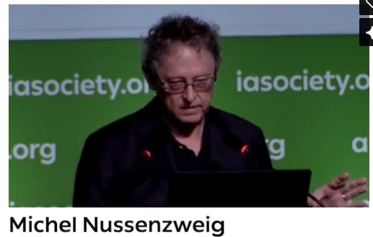
bNAbs - Michel Nussensweig
Nussenzweig M. bNAbs: Where are we and where do we go from here? Plenary talk PL01.
https://programme.aids2026.org/Programme/Session/3

Slide 25
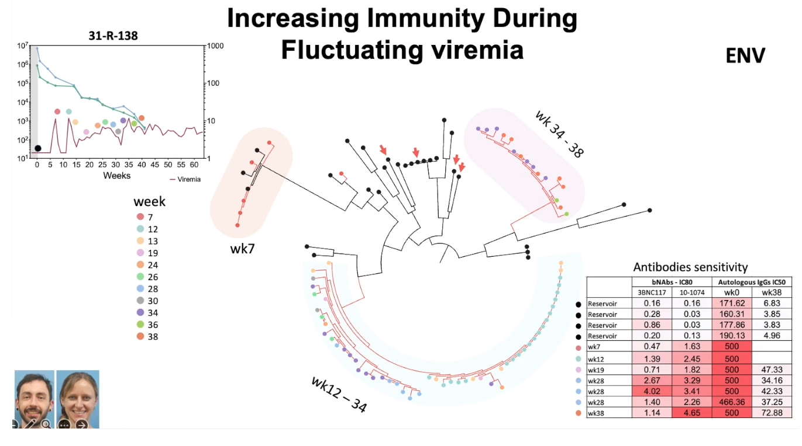
Nussenzweig M. Plenary talk PL01

Slide 26
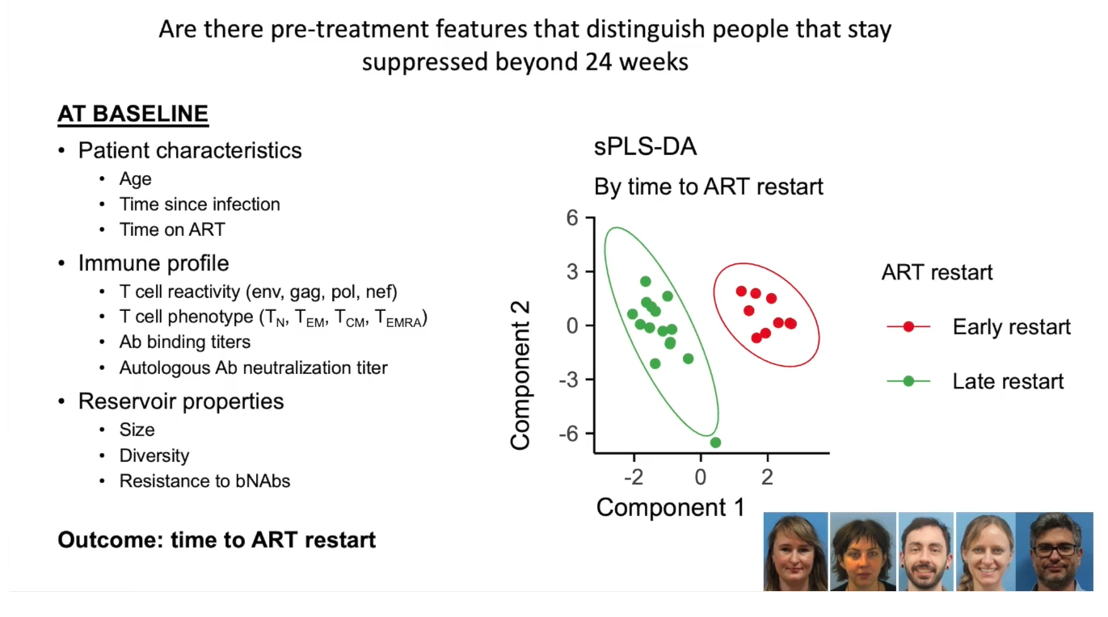
Nussenzweig M. Plenary talk PL01

Slide 27
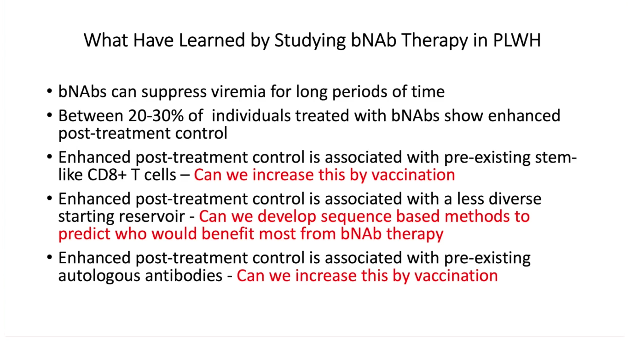
Nussenzweig M. Plenary talk PL01

Slide 28
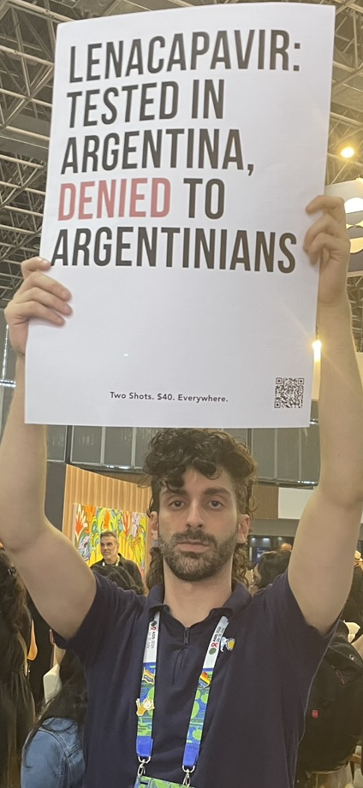
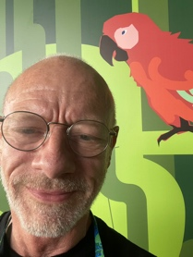

AIDS 2026: #Rethink, Rebuild and Rise
Thank you
simon.collins@i-Base.org.uk
Notes:
Six themes – all connected and overlapping

Slide 29
AIDS 2026: #Rethink, Rebuild and Rise
Spare slides
Notes:
Six themes – all connected and overlapping

Slide 30
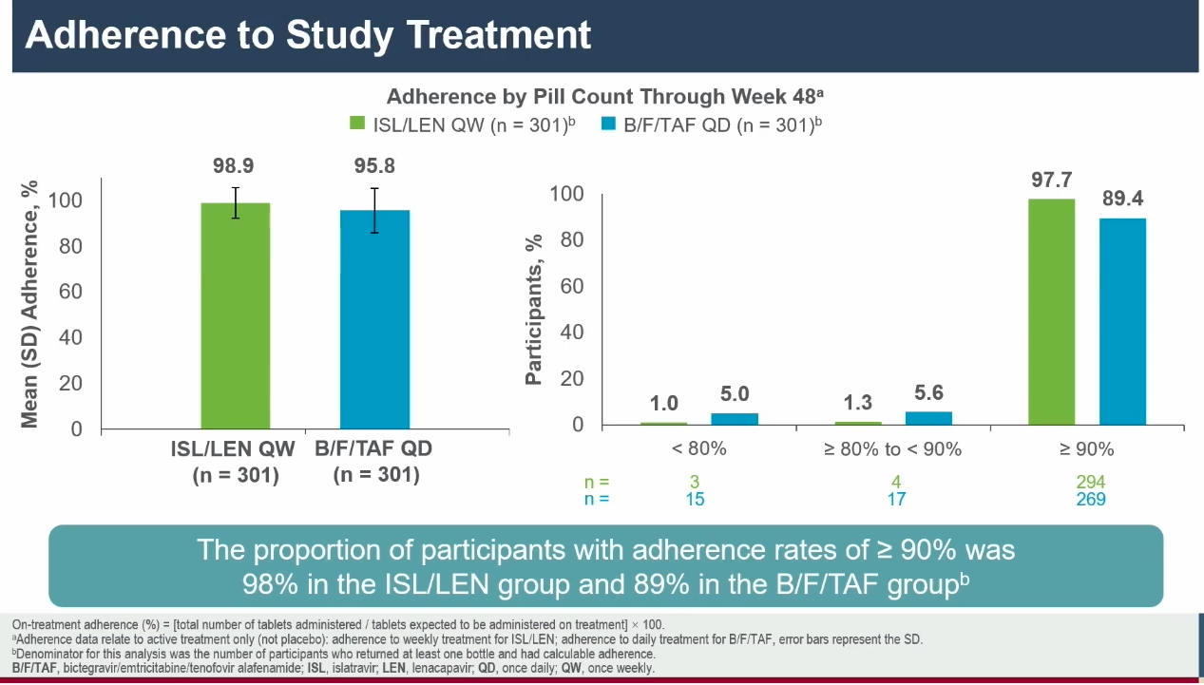
Rockstroh JK et al. OAB1406LB.

Slide 31
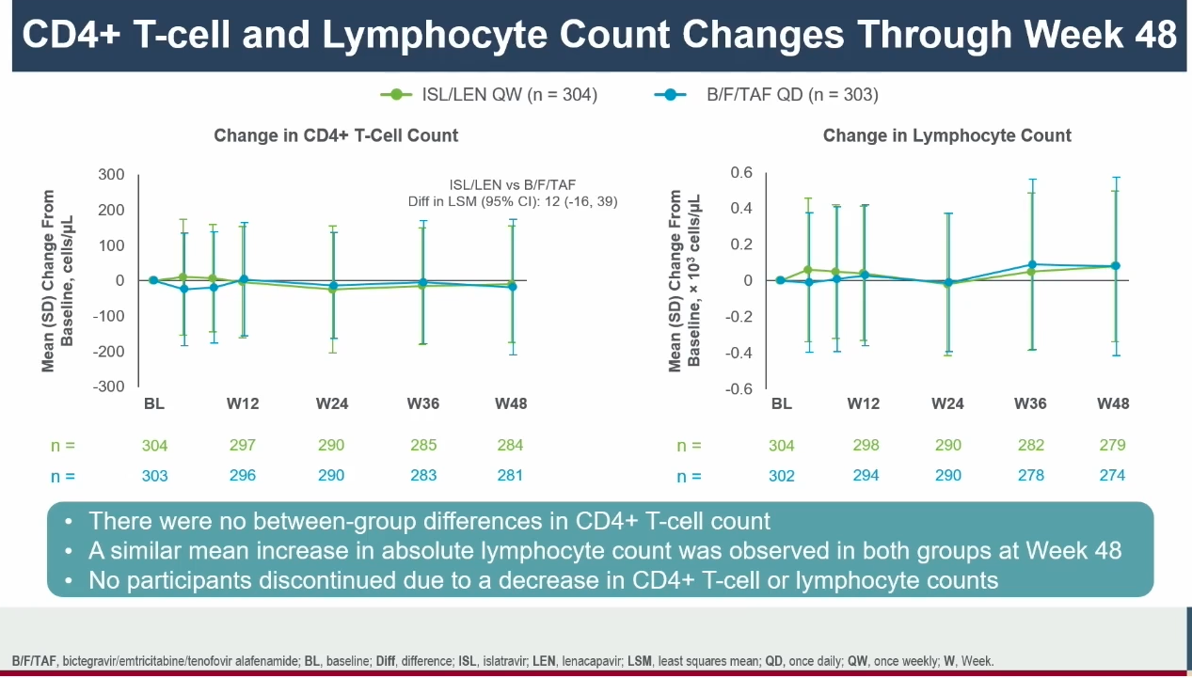
Rockstroh JK et al. OAB1406LB.

